Slide 1
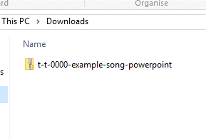
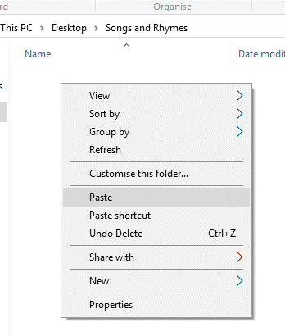
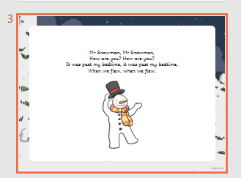
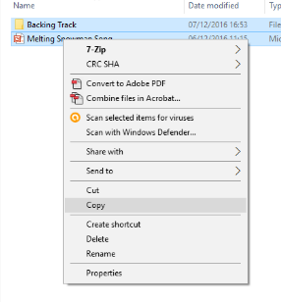
Guidance for Video/Audio in PowerPoints
1. Open the folder and copy all the files.
2. Paste the copied files into a new folder.
3. Open the PowerPoint file, enable editing and enter presentation mode (start the slide show).
Please note the embedded audio may not be compatible with early versions of PowerPoint.
You may wish to delete this slide before beginning the presentation.

Slide 3
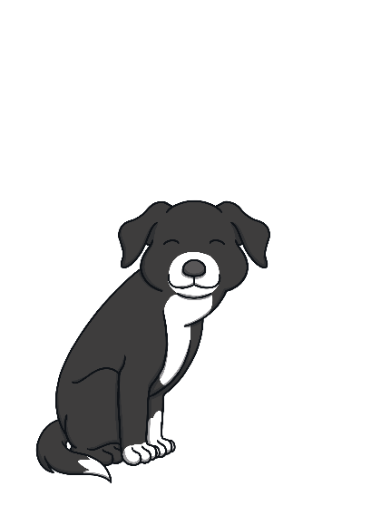
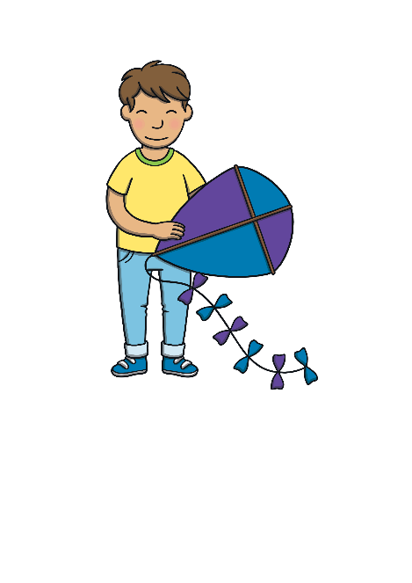
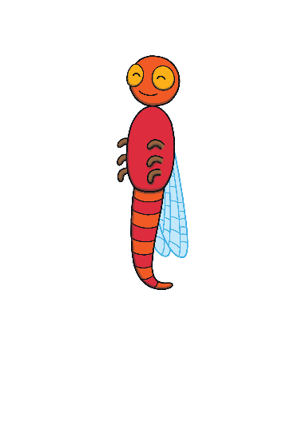
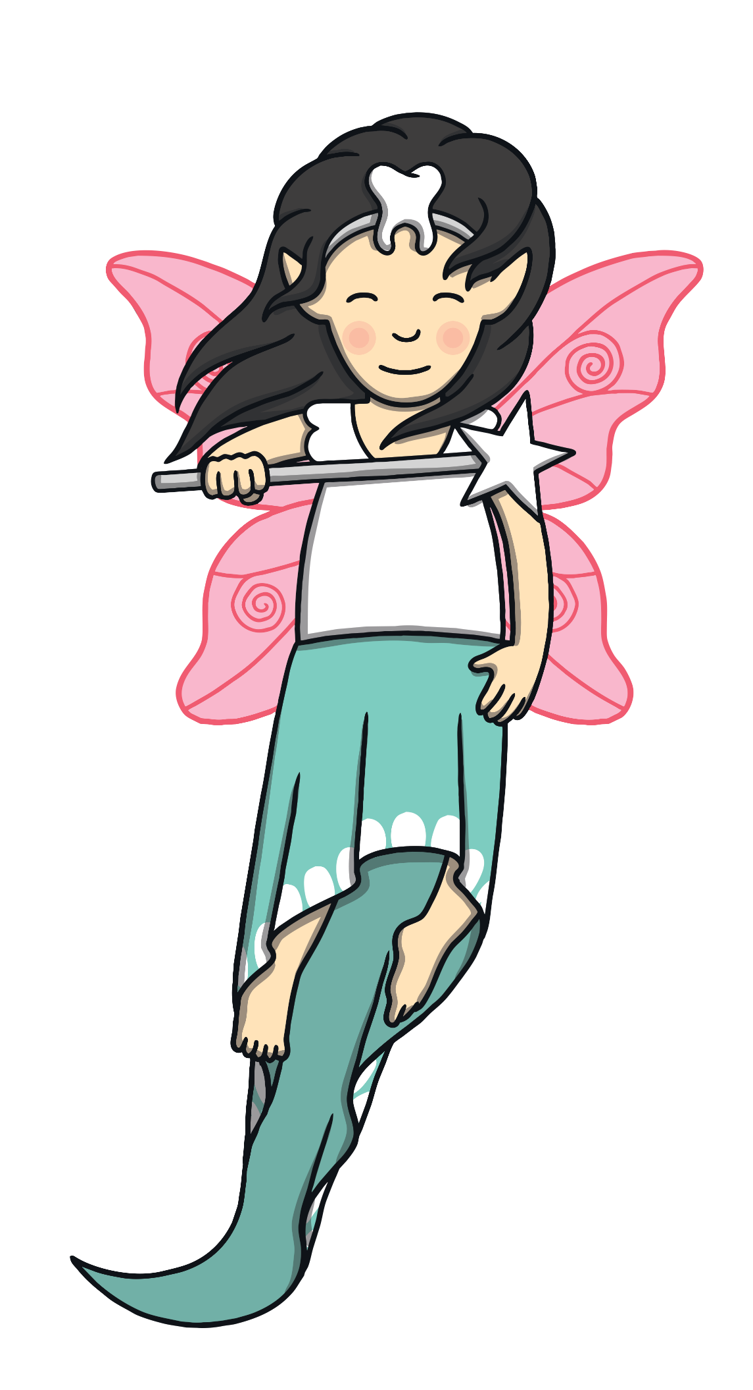
Revisit and Review
Let’s practise Sam’s Sounds and Tricky Words!
g
p
c
u
a
o
s
e
t
b
n
ck
m
r
f
i
k
d
h
ll
ss
l
ff
I
to
no
go
the

Slide 4
Sing the Alphabet
Revisit and Review
Can you sing this alphabet song along with Kit?
(To the tune of the traditional alphabet song)
A, B, C, D, E, F, G,
Sing the alphabet with me.
H, I, J, K, L, M, N,
Have a rest and start again.
O, P, Q, R, S, T, U,
Come along and sing it too.
Sing V, W, X and Y,
Z is last so say goodbye.
Play Song

Slide 5
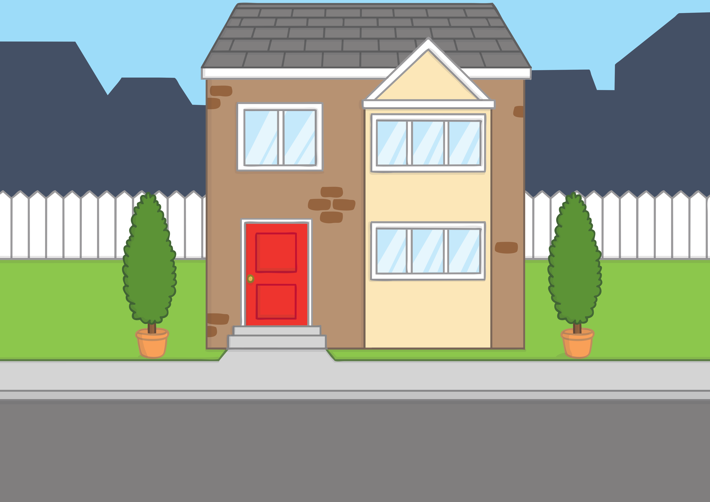
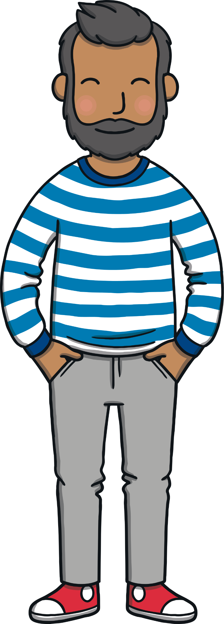
Teach
It was the school holidays. Kit and Sam were just so excited! Today, they were flying off on holiday with Mum and Dad.

Slide 6
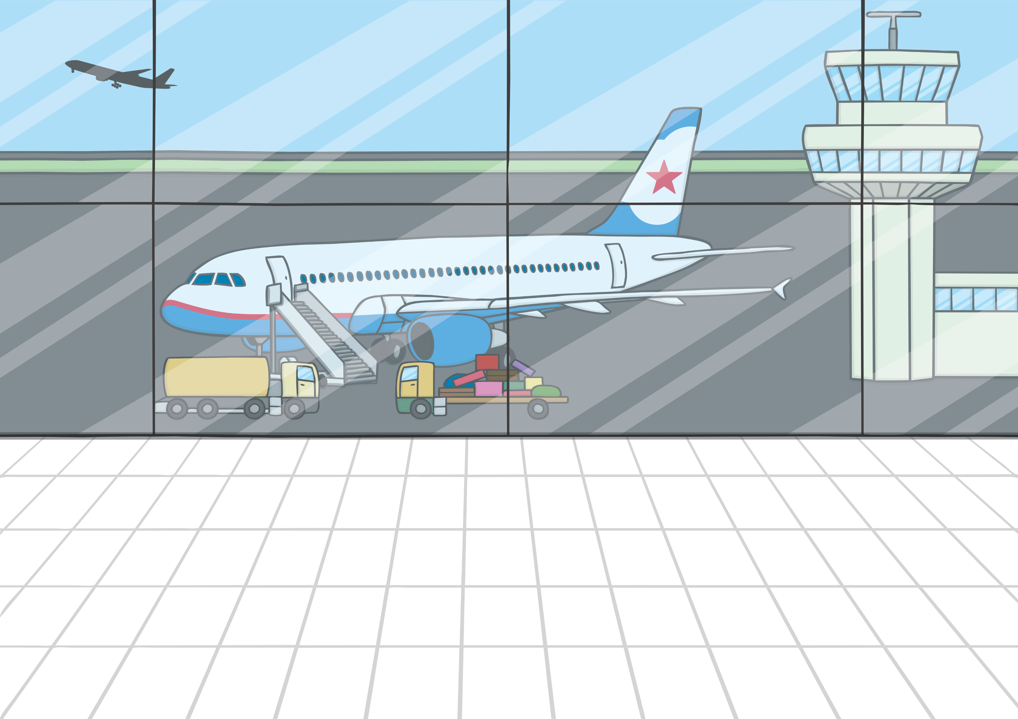
Teach
They got to the airport. Kit and Sam watched as the jumbo jets took off and headed towards the sun.

Slide 7
Teach
“Wow!” said Sam. “Look! The jumbo jets are making their own clouds in the sky!”
“I can’t wait until it is our turn to take off!” said Kit.

Slide 8
j
Teach

Slide 9
Teach
j

Slide 10
Action
Teach
Sweep your hand up like a jumbo jet taking off.
Say ‘j, j, j’.

Slide 11
Write the Letter
Teach
Down the jet, around its trail and dot the sun.
j
Play

Slide 12
Let’s Sing!
Teach
(To the tune of ‘Lavender’s Blue’.)
Jets in the sky,
j – j
Jets in the sky.
Fly to the sun,
j - j
Off to have fun.
Play Song

Slide 13
Vapour Trail Words
Teach
Kit and Sam are looking at the pattern of the vapour trails coming from the jets. Their trails are making words! Can you read them?

Slide 14
Teach
jet
Check

Slide 15
Teach
jam
Check

Slide 16
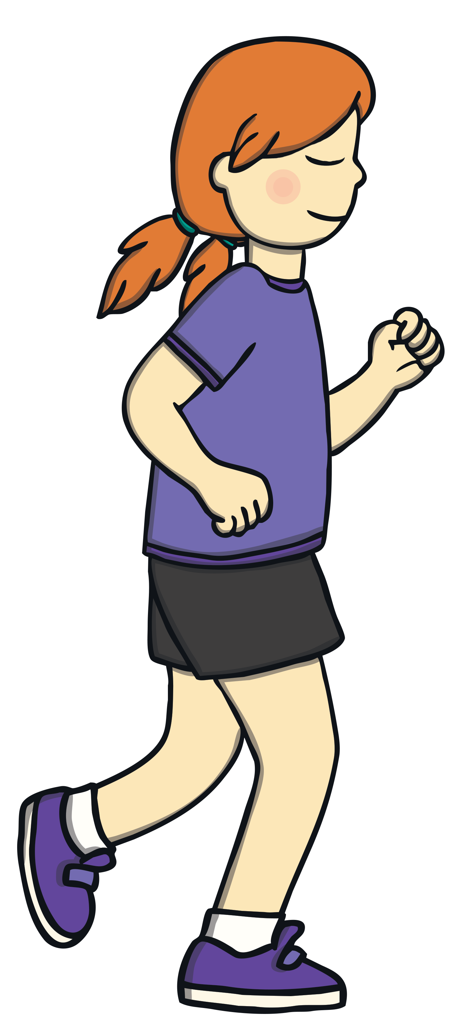
Teach
jog
Check

Slide 17
Teach
Jack
Check

Slide 18
Teach
Jill
Check

Slide 19
Teach
jacket
Check

Slide 20
Apply
“It’s time to go,” said Mum.
“Just what I was thinking,” said Dad.

Slide 21
Sentence Time
Apply
Why was it time for Kit and Sam to go? Read the sentence then click ‘Show’ to reveal the answer!
Click ‘Sound Buttons On/Off’ to select whether you want to show sound buttons under the sentence.
X
Click me for Kit’s teaching tips!

Slide 22
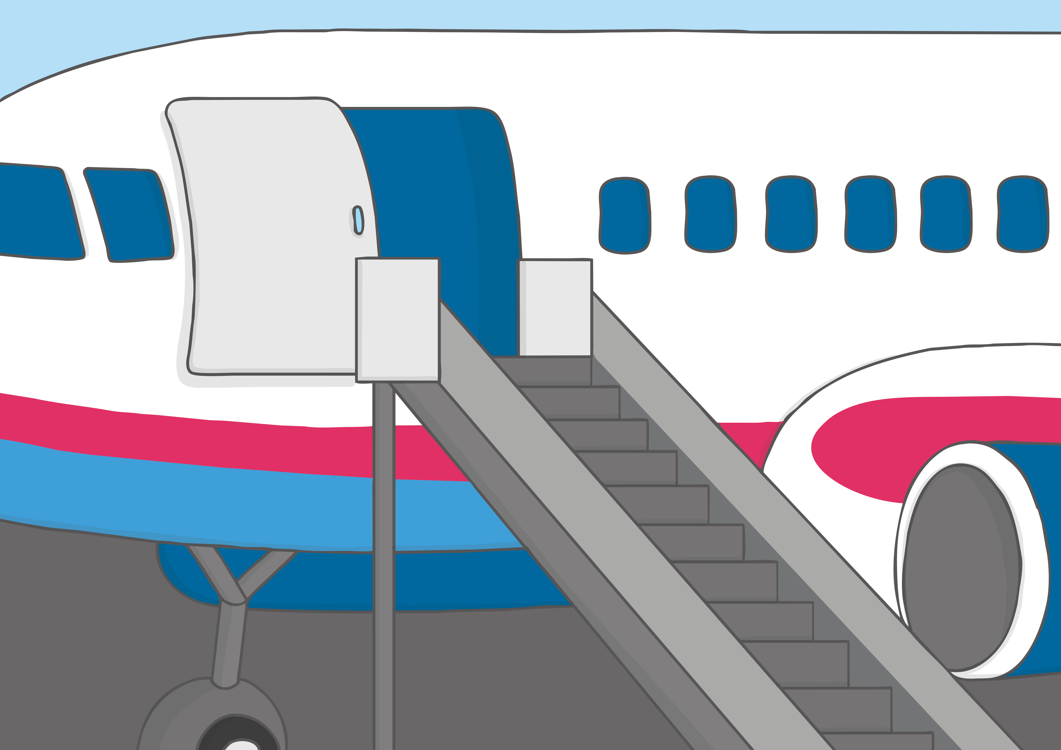
Apply
Kit and Sam go on the jet.
Sound Buttons On/Off
Show

Slide 23
Apply
“I am glad we made it on the jumbo jet in time!” said Kit.
“Me too!” said Sam. “Now we will be making our own clouds in the sky.”

Slide 24
Today, we have learnt…
j

