Slide 1
Year 5 and 6 Maths Information Evening

Slide 2
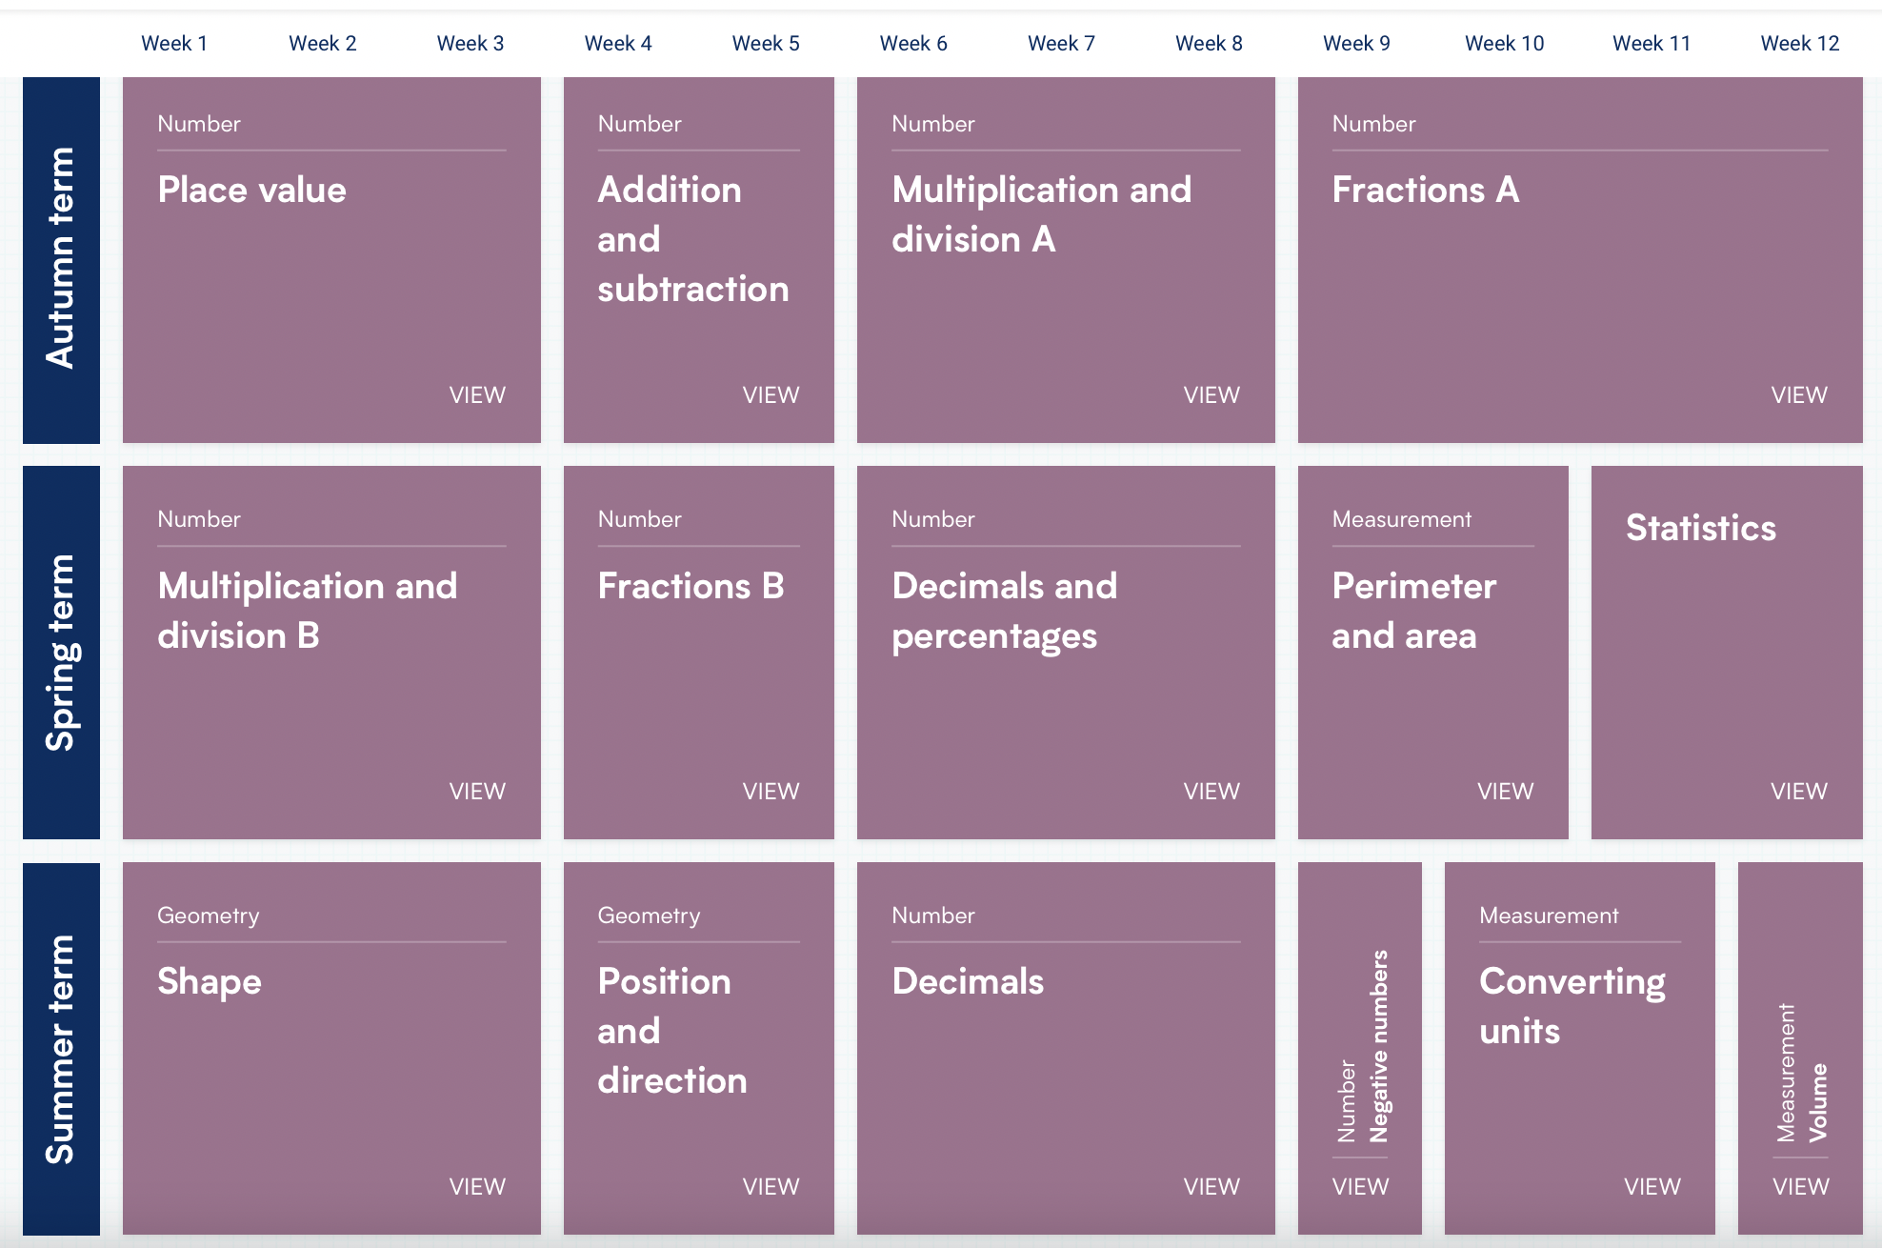
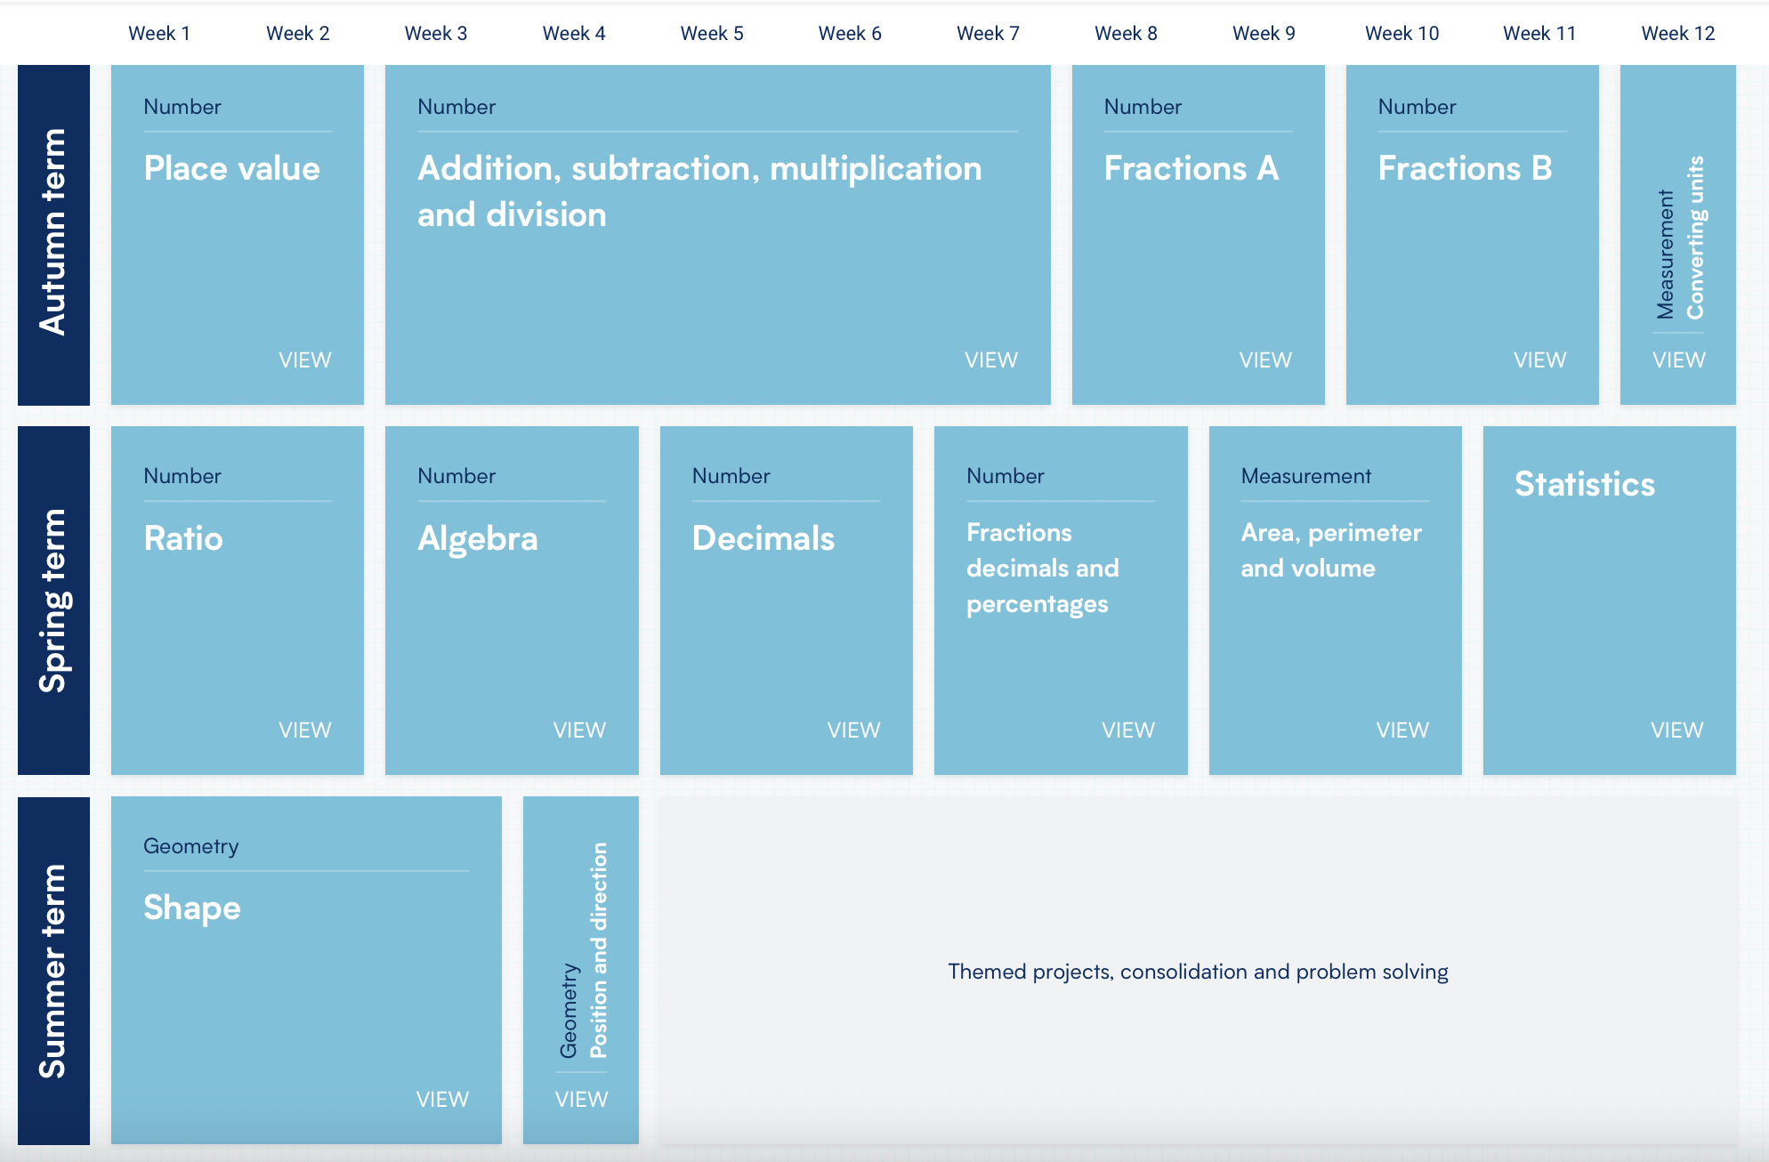
Key Parts of the Curriculum

Slide 3
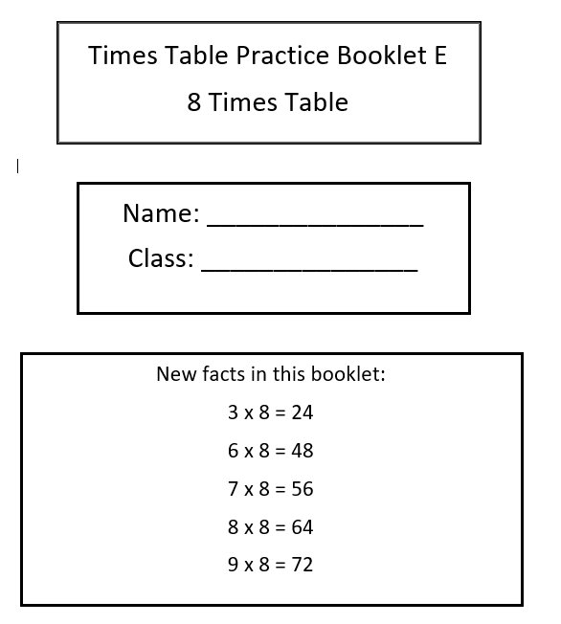
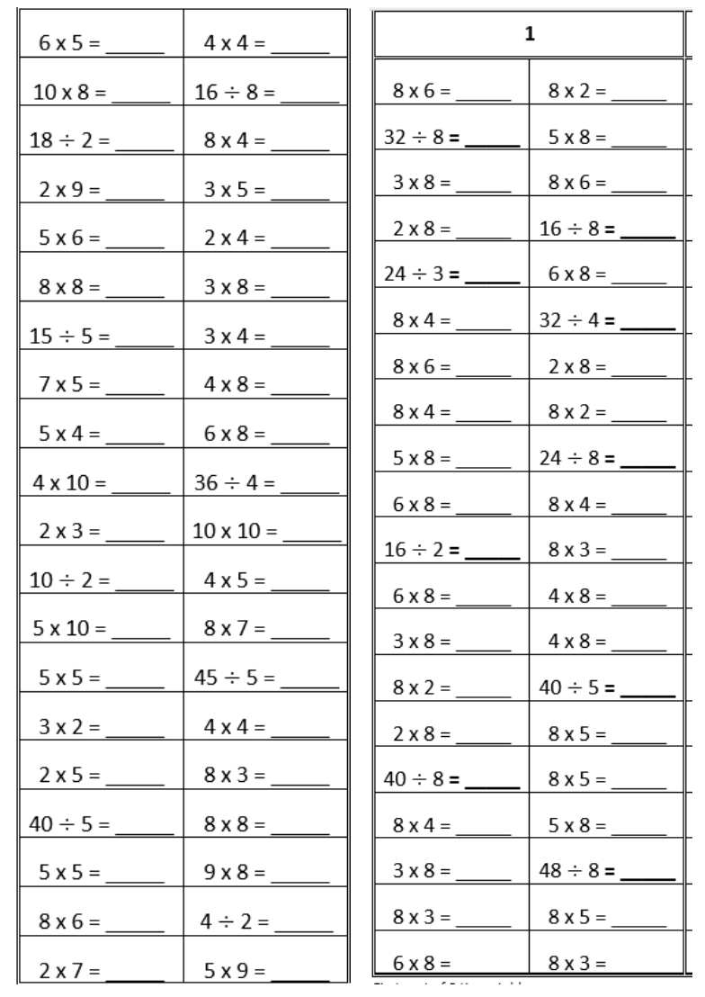
NCETM Booklets
Used from Year 3 to Year 5 to embed and consolidate times tables knowledge
Used as recap and intervention in Year 5 and 6

Slide 4
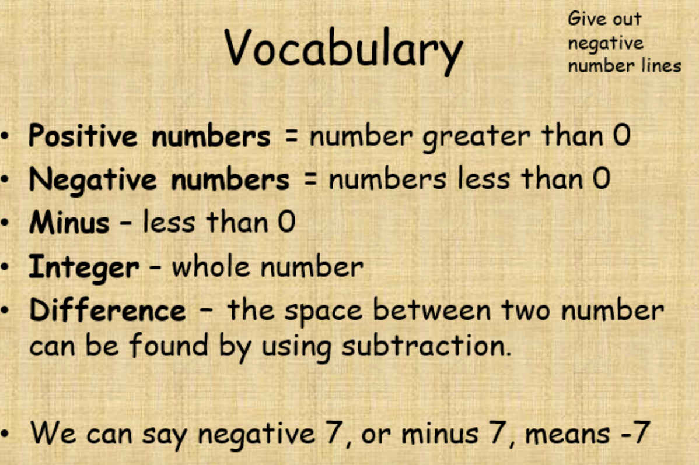
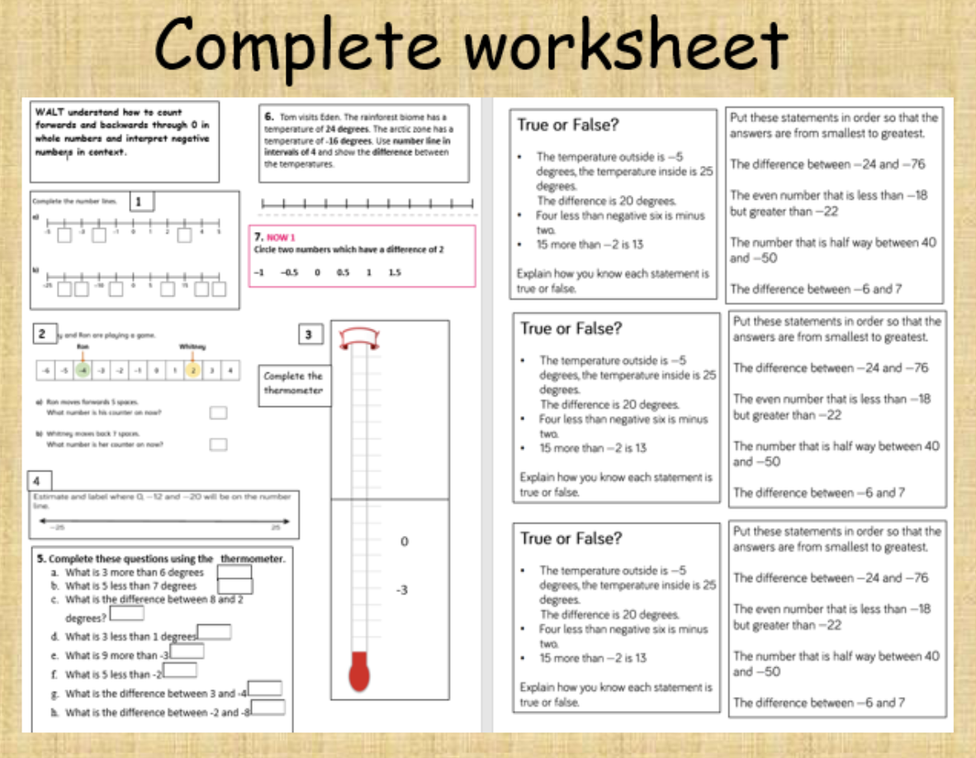
What a Maths lesson looks like:
Rapid recall
Fluency 5/Flashback 5
Key vocabulary - both new words for the coming lesson and recaps from previous lessons
Varied fluency and shared practice, unpicking Maths concepts using varied representations (opportunities for collaborative mathematical discussion)
Independent practice based on the lesson’s content
See Year 5 lesson on negative numbers

Slide 5
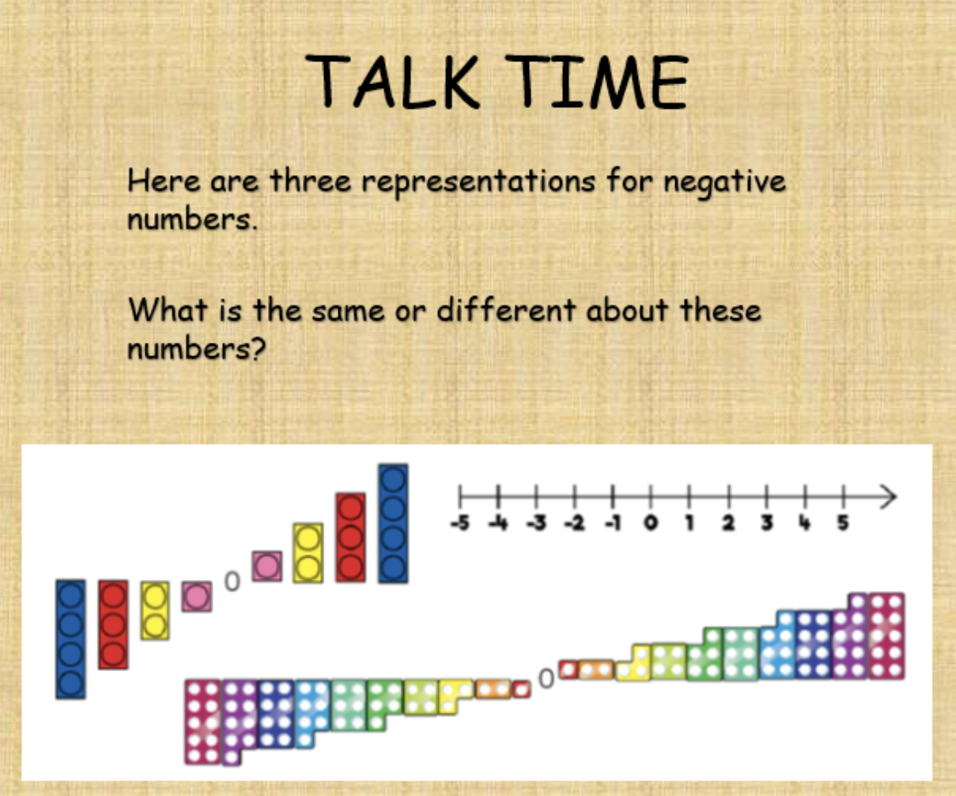
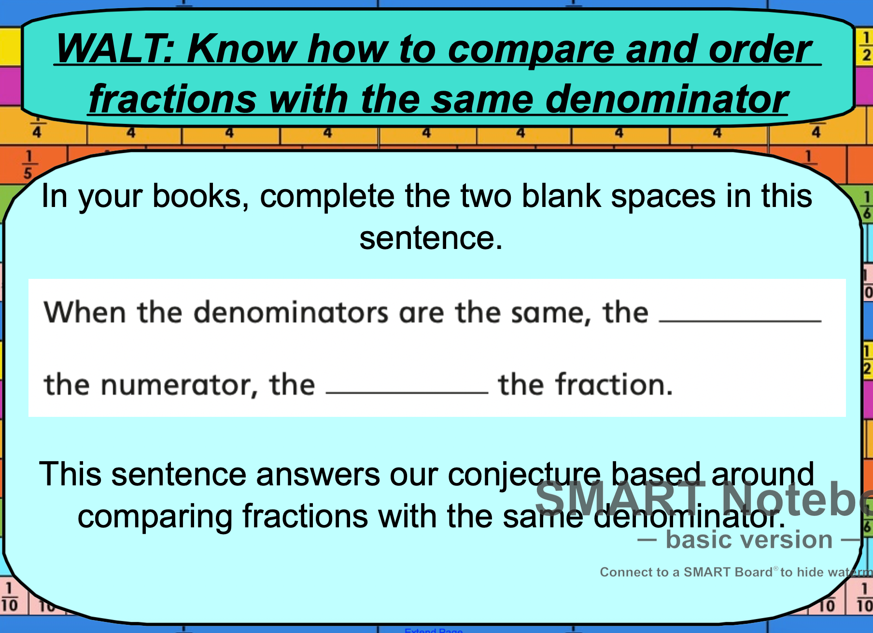
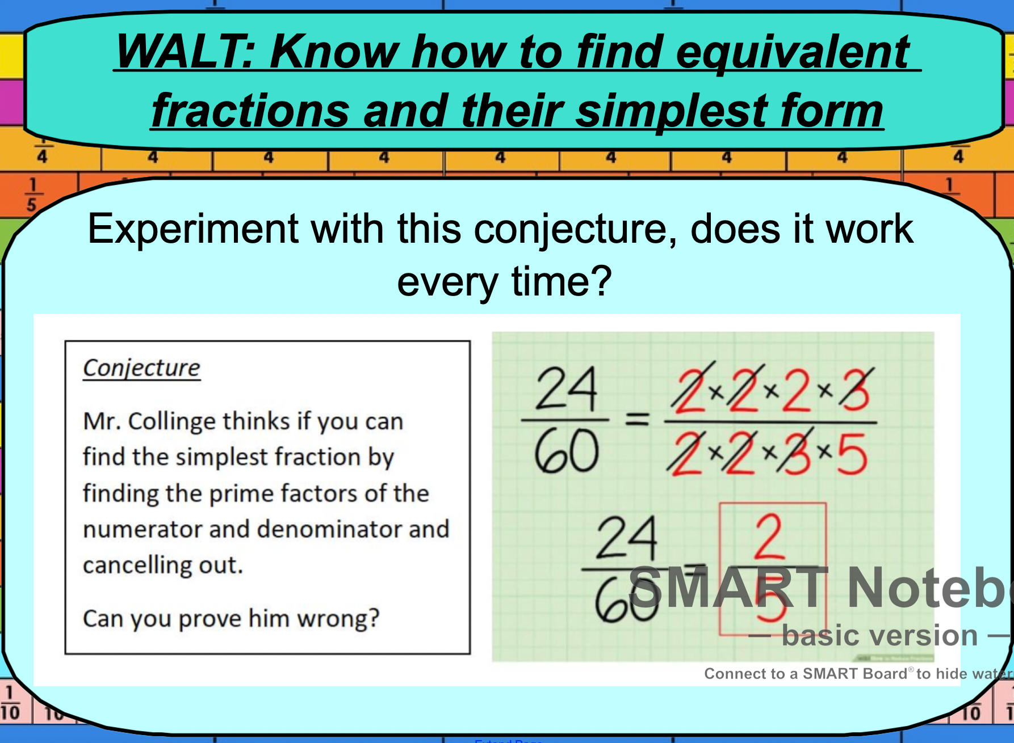
Mathematical Discussion and Sentence Stems
At Mylor Bridge School, we make use of sentence stems to promote mathematical language and embed key knowledge

Slide 6
Formal Operations Year 5 and 6 End Points
Written addition and subtraction with vocabulary (6782 + 2819) (7261 - 6287) (AM)
Subtraction with exchanging across multiple zeroes (9000 - 8717) (MC)
4 x 1 digit and 4 x 2 digit (4751 x 9) (4751 x 29) (AM)
Short division (with and without remainders - expressed as decimals, mixed numbers) (813 divided by 3) (MC)
Long division with two digit divisors (with and without remainders - double decker division) (351 divided by 13) (1636 divided 17) (MC)
We are aiming to put videos online demonstrating these strategies and how they are used in our classrooms

Slide 7
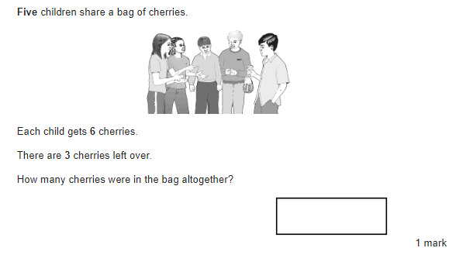
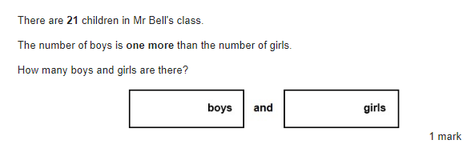
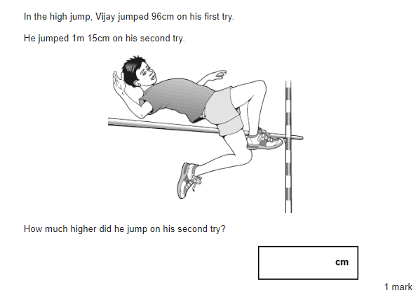
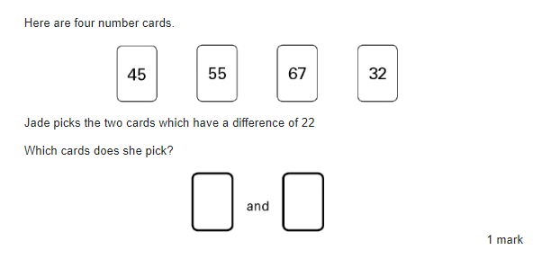
Reasoning and Problem solving application – Addition and Subtraction

Slide 8
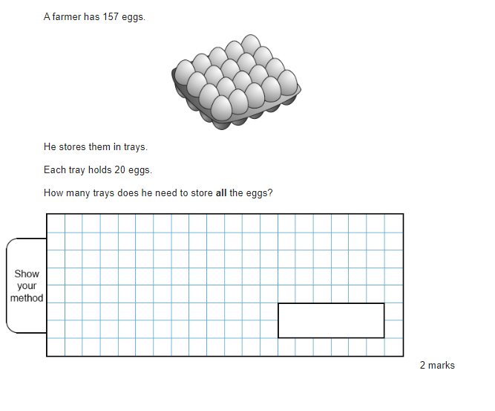
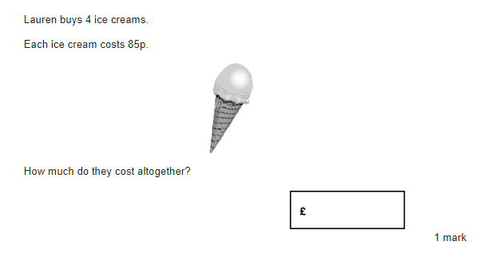
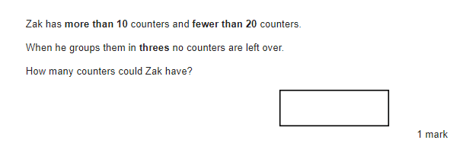
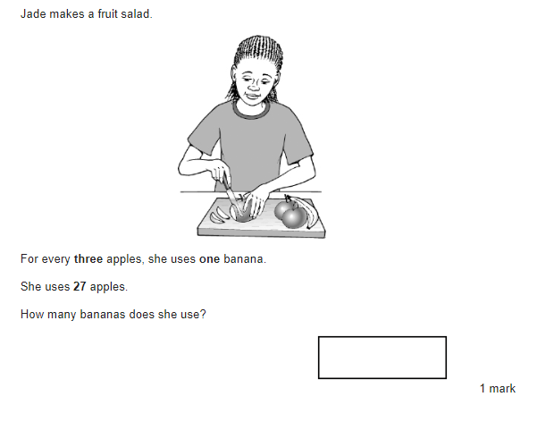
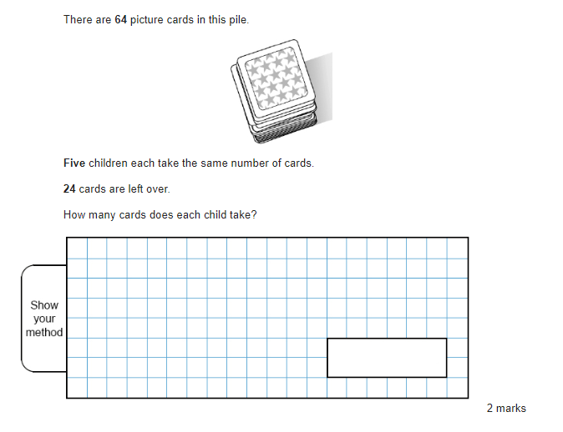
Reasoning and Problem solving application – Multiplication and Division

Slide 9
How can I help at home?
Regular practise of times tables
“Can you tell me a Maths word I don’t know?”
“What did you learn about today in Maths?”
Help with independent practice - unfinished classwork if necessary
Positive attitudes towards Maths - “I used to love these at school” as opposed to “I didn’t like Maths!”
Times Tables Rockstars, songs on YouTube (times tables), EdShed (MathsShed) for further games

