Slide 1
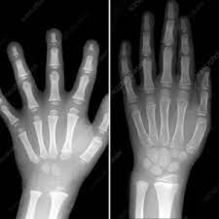
Writing in Reception.
Children need good gross motor skill as well as fine motor skills to be able to write.
Hand development 3 year old
Hand development 7 year old

Slide 2
Gross motor skill development.
Throughout their time in Nursery and Reception the children are developing core strength and hand muscles in order to be ready to write. Until these are developed securely the children will not be able to develop the fine motor skill they need to be able to hold and control their pencil or pen.
Ways in which we help the children to develop these gross motor skills….
• Using bikes and trikes
• Climbing and pulling themselves up with their arms
• Our Real PE sessions focus on core skills including balance and agility
• Creating obstacle courses
• Giving the children space to move
• Using large equipment – brushes, mops, rollers
You can help at home by visiting the park with your child, allowing them to go for walks with you, using their scooter or bike, encouraging them to run, jump, climb and pull themselves up using their core.

Slide 3
Lots of fine motor activities need to take place before a child is ready to pick up a pencil correctly and write.
The following activities can help children to develop their hand muscles and fine motor skill in order to be ready to hold a pen or pencil…..
• Squeezing playdough
• Threading beads
• Using pegs to clip things together
• Building towers
• Using tweezers
• Pick up small objects
These are planned into our provision and children who need these activities are encouraged to try them.
We also plan for whole class activities at this time of year to support this development…
Whole class activities which support this development….
Finger rhymes Fine motor challenges – 1 minute challenges

Slide 4
What does writing look like in Reception?
Although these stages have ages attached to them children develop at different rates. We see children with every grip seen here. We spend lots of time modelling and practicing what a tripod grip looks like.

Slide 5
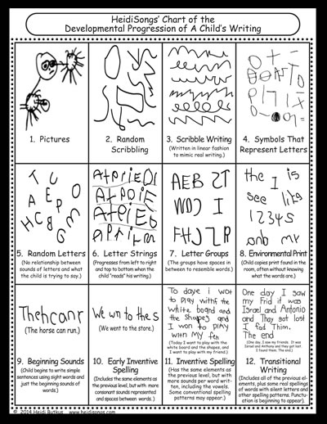
Being ready to write.
We encourage the children to make marks during their play as well as in set tasks with an adult.
All writing tasks have a purpose.
Writing materials are on offer in every classroom and outside.
Children are encouraged to access and use these as part of their play.
Mark making is modelled by all adults. Children have the opportunity to practise the letters they have learnt so far.
Their formation is corrected when needed to ensure they avoid developing bad habits that are difficult to fix later.

Slide 6
How can you support at home?
Encourage your child to make meaningful marks.
• Cards
• Letters
• Invitations
• Lists
• Praise them for having a go.
• Encourage them to prepare to write.
• Have mark making materials on offer – notebooks, cards, paper, pencils, pens, chalks, paint, mud/sand and sticks if outside.
• Don’t correct the formation unless you know they KNOW the letter sound already.
Encourage your child to practise forming these correctly at home, using the handwriting phrase.

