Slide 1
Twinkl phonics/ Reading
by
What do I need to know?

Slide 2
What is Twinkl Phonics?
It is a programme to help children to become confident readers and writers.
The programme is very successful and used in many primary schools. It is designed to enable every child to become confident and fluent readers at the first attempt.
Children are able to learn to read at a pace that suits them.

Slide 3
What will the lessons look like?
The scheme uses a phonics based approach.
All children learn to read sounds and blend the sounds together to read words.
During their year in Reception the children will learn 44 sounds.
Each sound is accompanied by a simple action and picture.
These known sounds are reviewed daily and new sounds introduced.

Slide 4
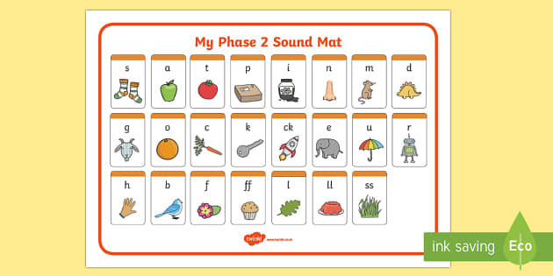
We learn letter sounds and names. We practise PURE sounds (See guidance for pure sounds)
We learn letter sounds and letter names.
We focusing on PURE sounds. See the guide for parents for help with pronunciation.

Slide 5
How does a Twinkl session work
We begin by using flashcards to recall the sounds that we have learnt. We use pictures and actions as prompts initially.
We practise writing the sound in the air and using pens/ pencils.
We introduce our new sound for the day and read a story that includes activities and games to help us practise it.
We complete activities in the classroom to use and practise the sounds that we know.
We begin to blend sounds to make and read words.
We introduce tricky words later in the scheme and progress to use phonics workbooks to practise our skills.

Slide 6
How can I help at home?
All children will initially bring home a yellow phonics book. This will contain the sound that we have learnt today and some activity suggestions
Practise phonics regularly and begin to look for them in stories.
‘Sound talk’ words, “I am going to feed the c-a-t now.”
After a few weeks, children will bring home word boxes. Practise sounding/ blending these words. Write them down, copy them on to sticky notes….practise, practise, practise!

Slide 7
How can I help at home?
When we feel that children are ready they will bring home books from our Rhino reading scheme.
Please read every night. The more practise that children have the more confident and fluent they will become.
Talk about the books that you read.
What is Kit feeling here? What do you think will happen next?

