Slide 1
Maths
Welcome to Early Years Foundation Stage and Key Stage 1

Slide 2
Maths
Mastery Approach
Maths in Reception
Maths in Key Stage 1
Lesson structure and content
Manipulatives and representations
How you can help

Slide 3
Mastery Approach
Mastering maths means:
pupils of all ages acquiring deep, secure and adaptable understanding the subject.
acquiring solid enough understanding of the maths taught to enable pupils to move on to more advanced material.
Class working together
Strong emphasis on every child making progress in every lesson
Keeping class together until skills/concepts are mastered
Does not mean children left behind/not challenged
‘Success for all’ achieved through intervention and deeper understanding

Slide 4
Mastery Approach – Key Features
Intervention to prevent gaps
For children not meeting expected outcomes or with gaps in understanding
Helped by receiving extra time on maths, one to one
Positive opportunity-consolidate understanding and be ready to progress alongside peers
Challenge provided
Achieved through ‘going deeper’, not accelerating.
Children mastering skills/concepts/procedures presented with higher order thinking activities (not accelerated through the curriculum)
Examples involving:
Use of the skills/concept/procedure to solve more challenging problems.
Explaining their thinking/methods (explain how they solved problems, what they notice, etc

Slide 5
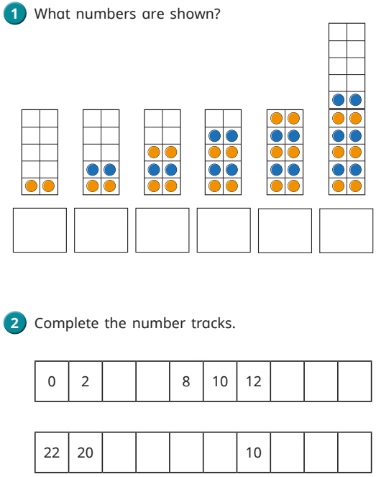
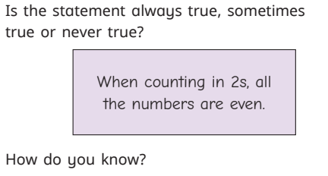
Mastery Approach – Key Features
Example of providing challenge to deepen understanding
Counting in 2s, 5s and 10s
Challenge

Slide 6
Mastery Approach – Key Features
Focused, thorough teaching
Focus on one small step at a time.
Each small step builds on the previous – ensures deep understanding of concepts.
Emphasis on more time taken to use models/images to represent mathematical concepts.
More time on each topic
Ensures appropriate time to practise and depth of knowledge
Many areas (number/calculation) taught over longer periods of time
Due to smaller steps, more time spent with models/images – ensures effective learning

Slide 7
Maths in Reception

Slide 8
Early learning goals in Maths

Slide 9
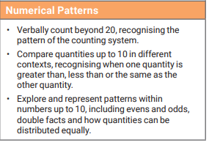
Early learning goals in Maths

Slide 10
There are 5 counting principles

Slide 15
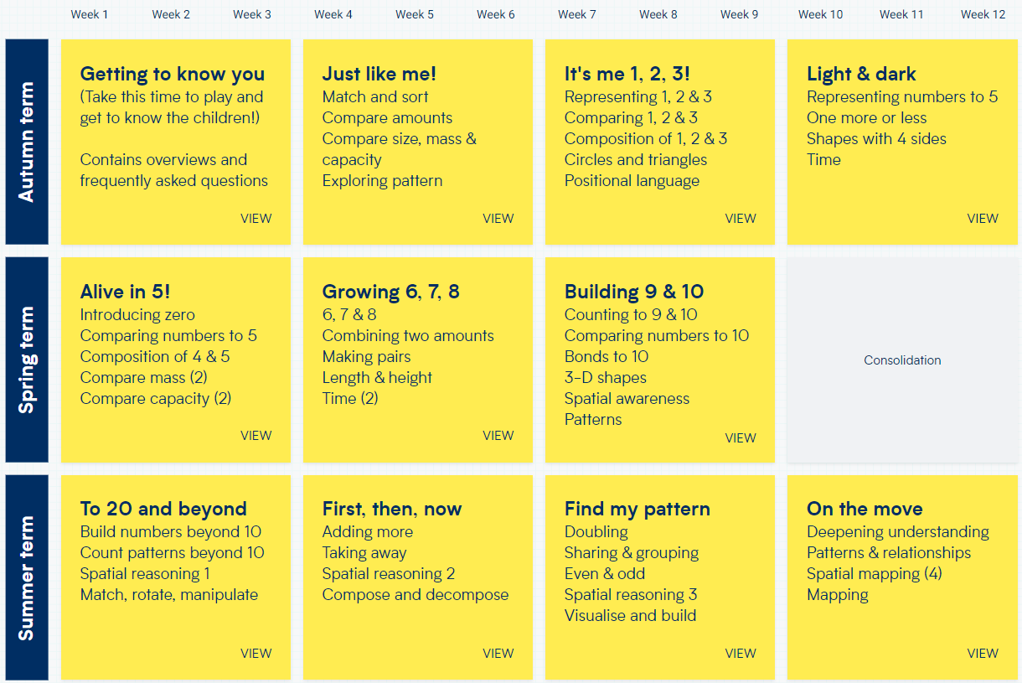
Reception Overview
Reception

Slide 16
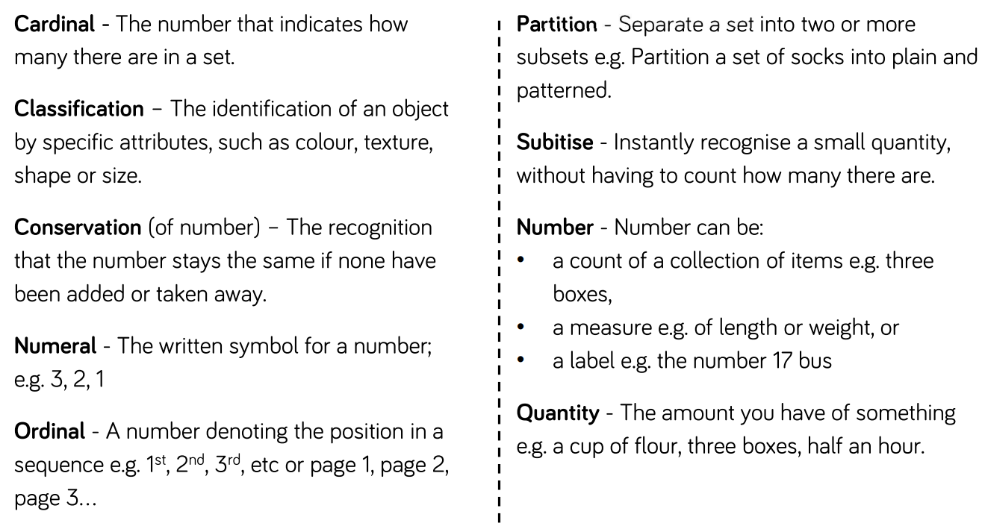

Slide 17
Maths in Key Stage 1
White Rose Maths
Whole school scheme
Designed to cover the whole maths curriculum for each year group.
Used across the whole school, supplemented by other resources, schemes.

Slide 18
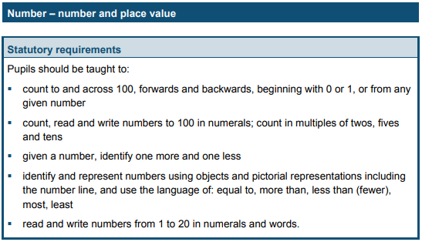
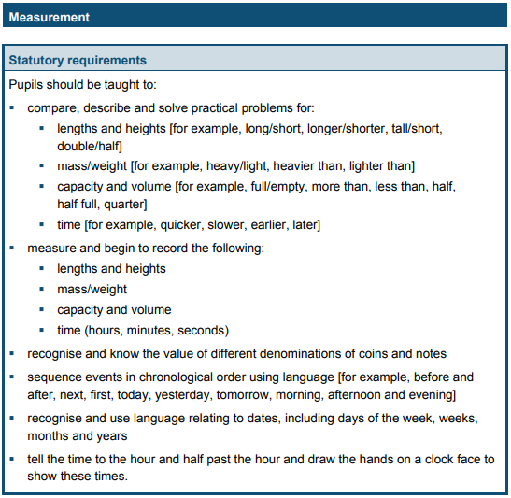
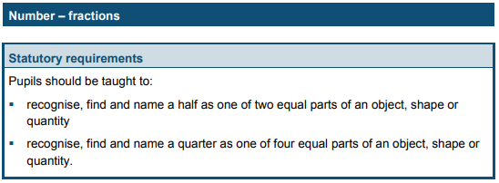
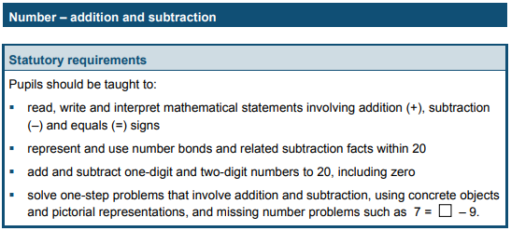
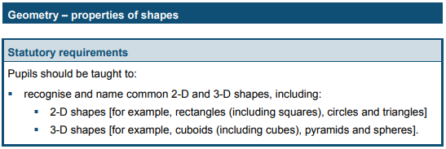
Maths in Key Stage 1
Year 1 Curriculum

Slide 19
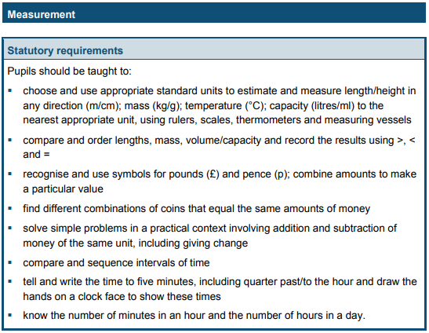
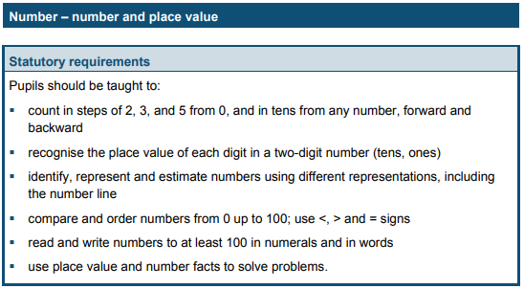
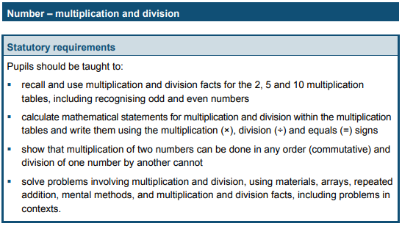
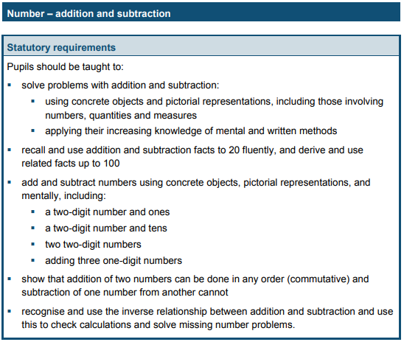
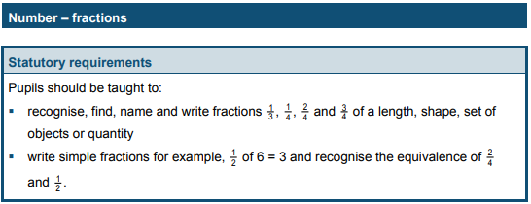
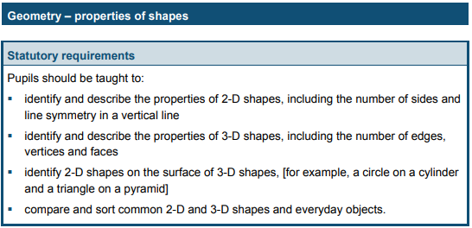
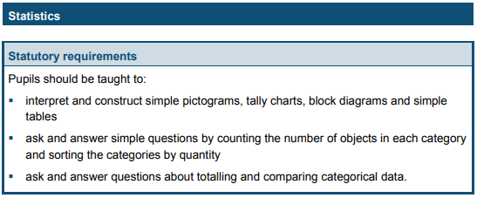
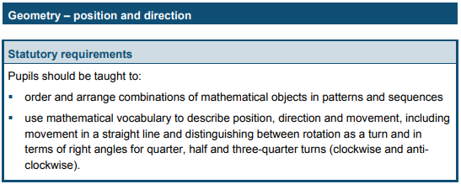
Maths in Key Stage 1
Year 2 Curriculum

Slide 20
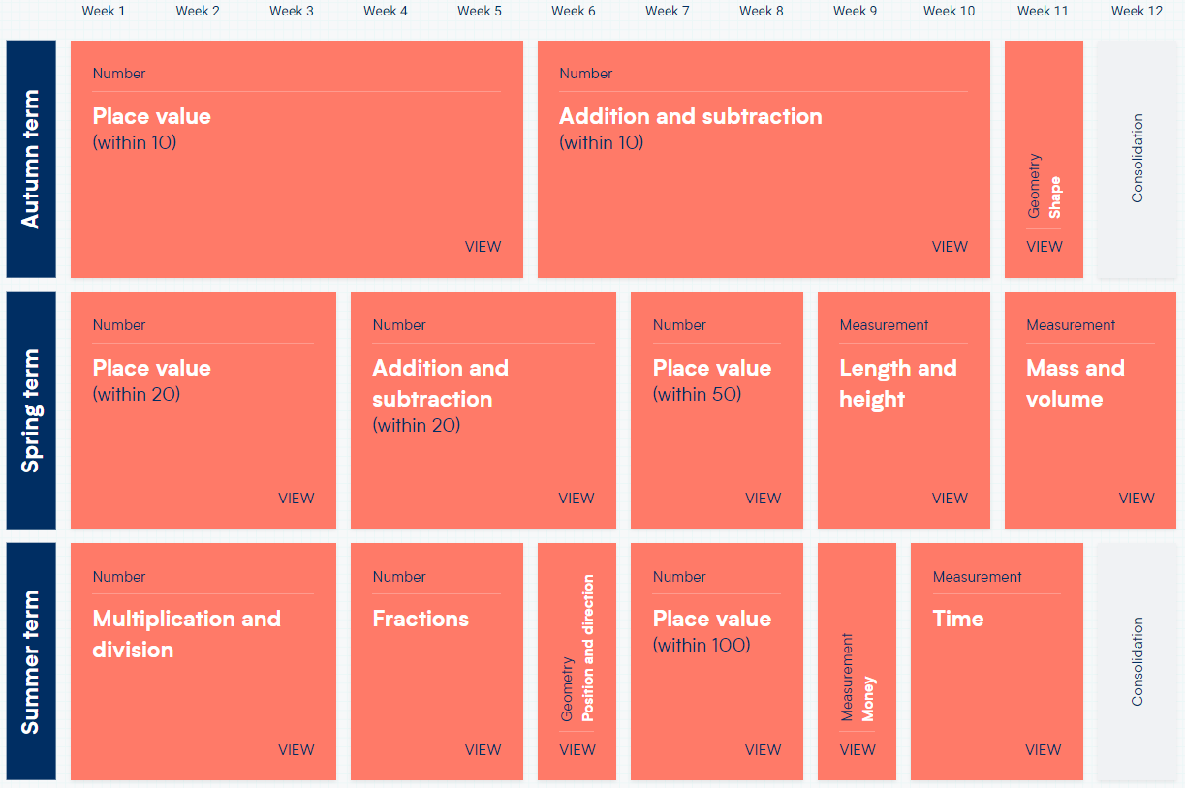
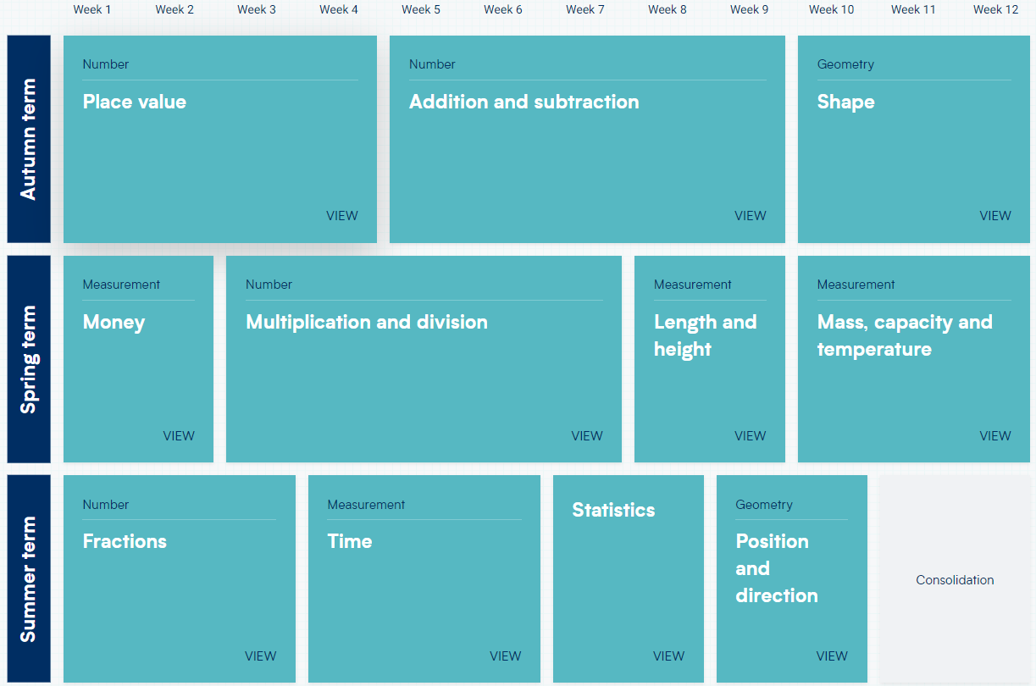
White Rose Maths - Overview
Year 1
Year 2

Slide 21
Lesson Structure and Content – KS1
Rapid recall/Fluency practise
Number bond/multiplication fact recall
Flashback
Practise/recap of prior learning
Vocabulary
Discussion around previously learnt/new vocabulary and meanings
Learning of new concepts
Introduction to, and practise of, new learning
Use of concrete/pictorial representations
Independent practise
Opportunities to apply their learning through a range of activities

Slide 22
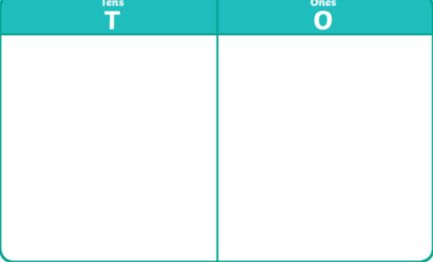
Manipulatives and representations
Part whole model
Place value grid
Ten frame
Number line
Base 10

Slide 23
How you can help
Year 2
Number bonds (rapid recall)
Doubling and halving numbers to 20
Counting on and back within 100
Counting on and back in 10s, 2s and 5s from any number
Learning, by heart, the 2, 5, 10 and 3 times tables
TT Rockstars
Year 1
Working within 20
Counting on and back,
Number bonds (e.g. number bonds for 6 are 6 and 0, 5 and 1, 4 and 2, 3 and 3)
Compare/order numbers
Doubling and halving.
Access White Rose Website for free, easily accessible guidance, support and resource - https://whiterosemaths.com

Slide 24
How you can help
White Rose website
Free, easily accessible guidance, support and resource
https://whiterosemaths.com/
Hover over ‘Parents and pupils’ tab

