Slide 1
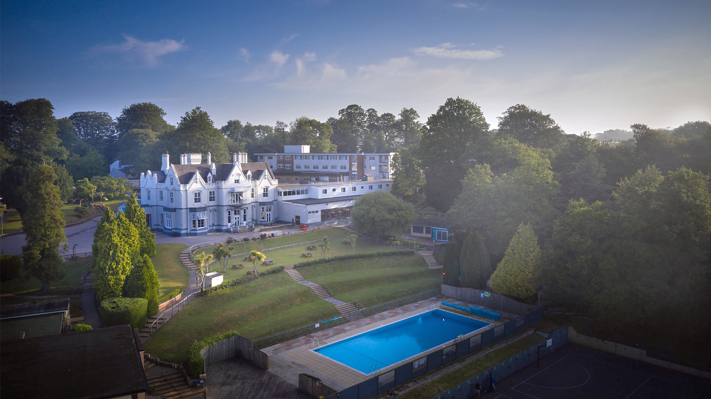
Year 5 & 6 Residential PGL BARTON HALL
26th – 28TH June 2024

Slide 3
THE FUN STUFF!
2 nights at PGL Barton Hall near Torquay
1 afternoon, 1 full day and 1 morning of fun and adrenaline
Non-stop activities and games including, during the day…..
Kayaking
Jacob’s Ladder
Laser Tag
Sensory trail (blindfolded obstacle course!)
Giant swing – Mr Martin’s favourite!
Disc Golf (like ultimate frisbee!)
Water games in the outdoor HEATED swimming pool!

Slide 4
And in the evenings….
Passport to the World – Mr Collinge’s favourite!
Nighttime archery tag
A VERY good night’s sleep ready for more action the next day!

Slide 5
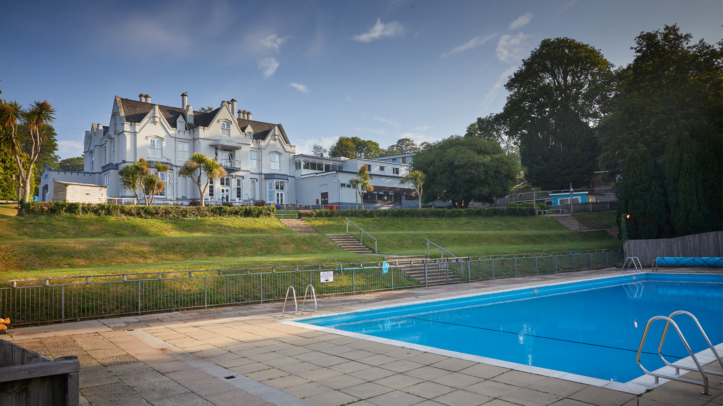

Slide 6
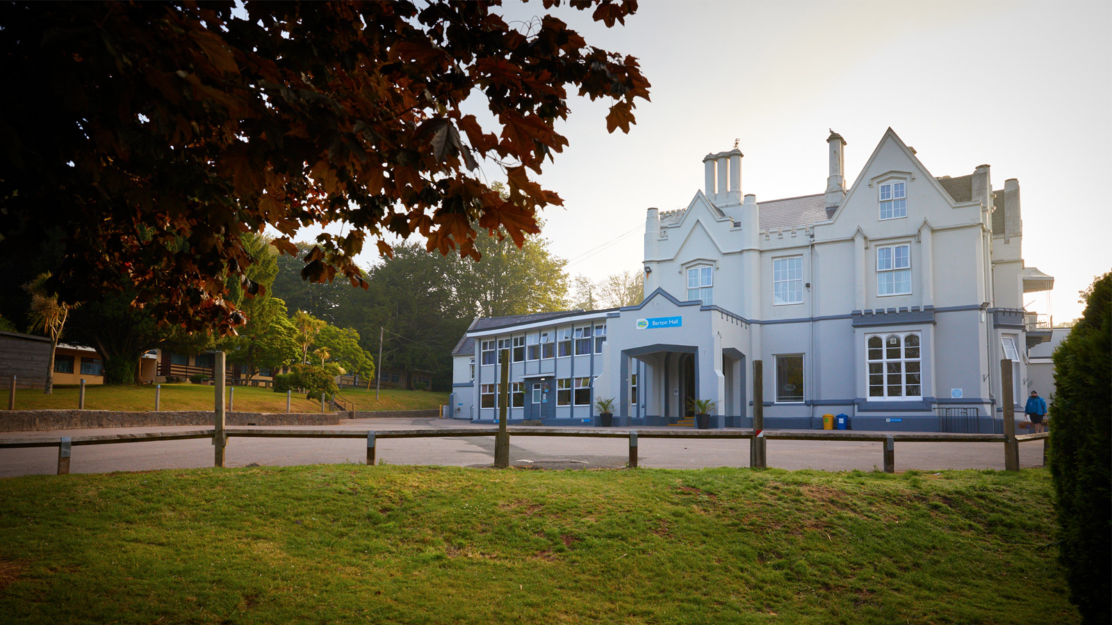

Slide 7
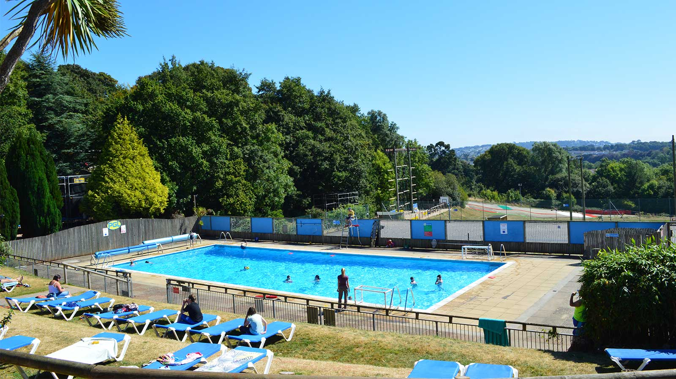

Slide 8
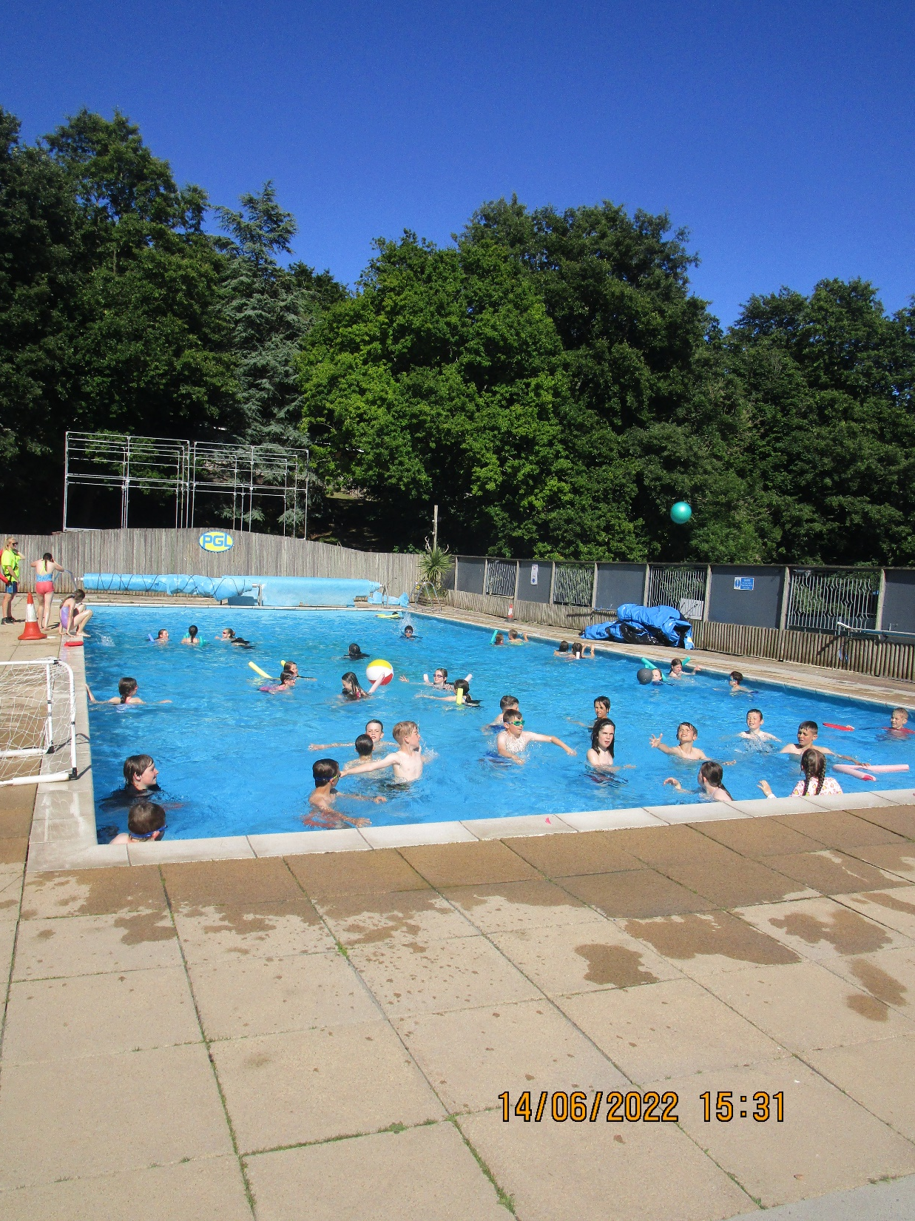

Slide 9
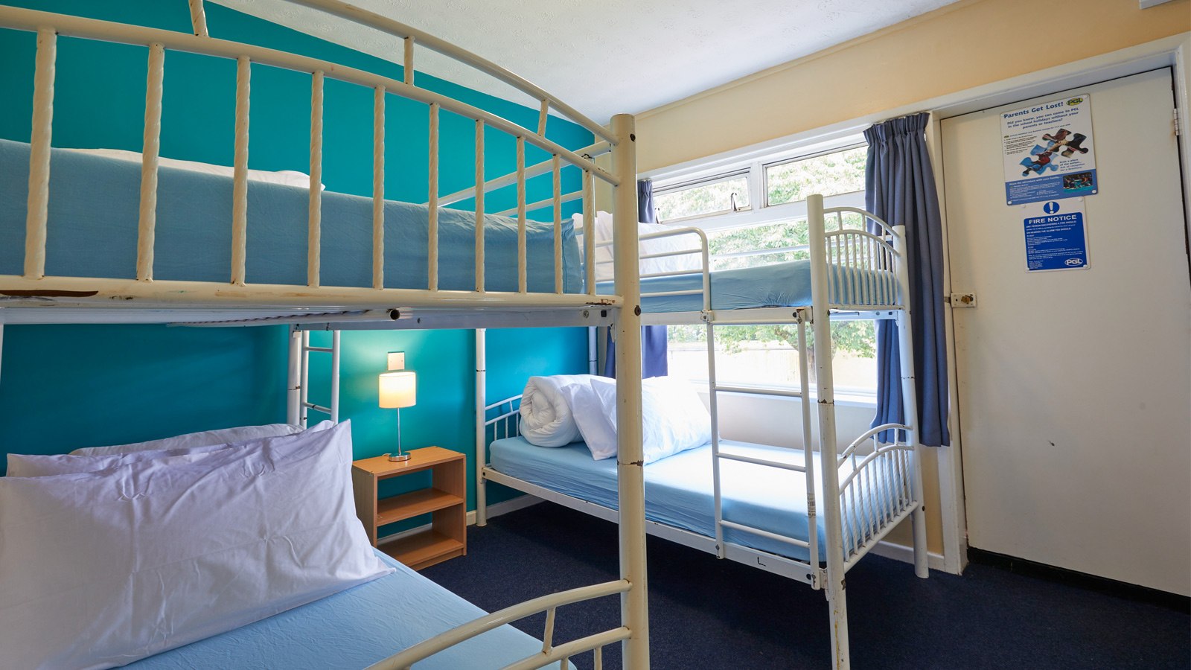

Slide 10
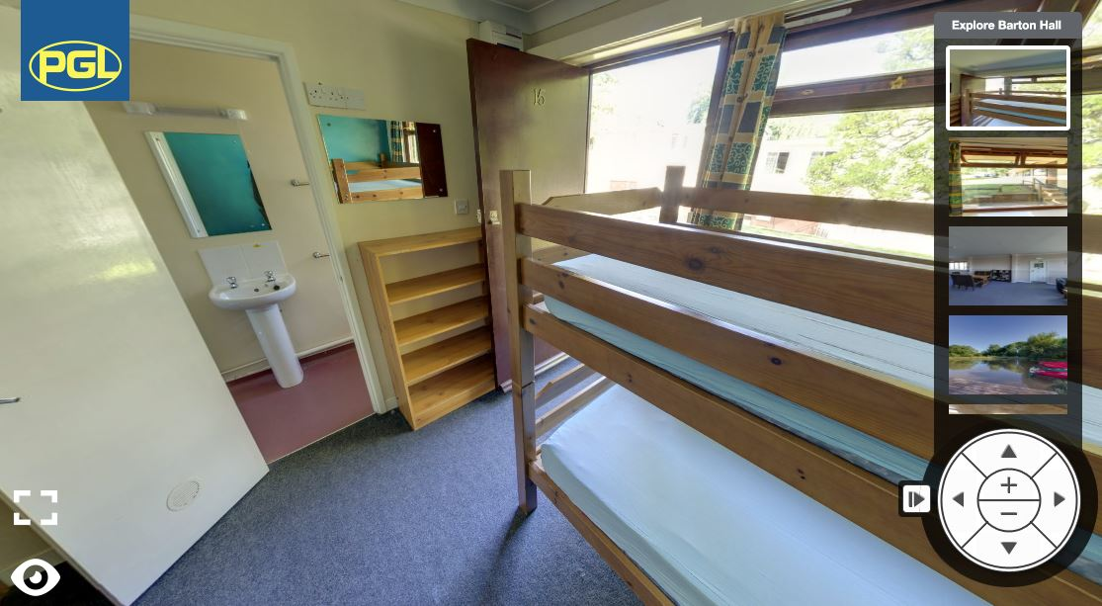

Slide 11
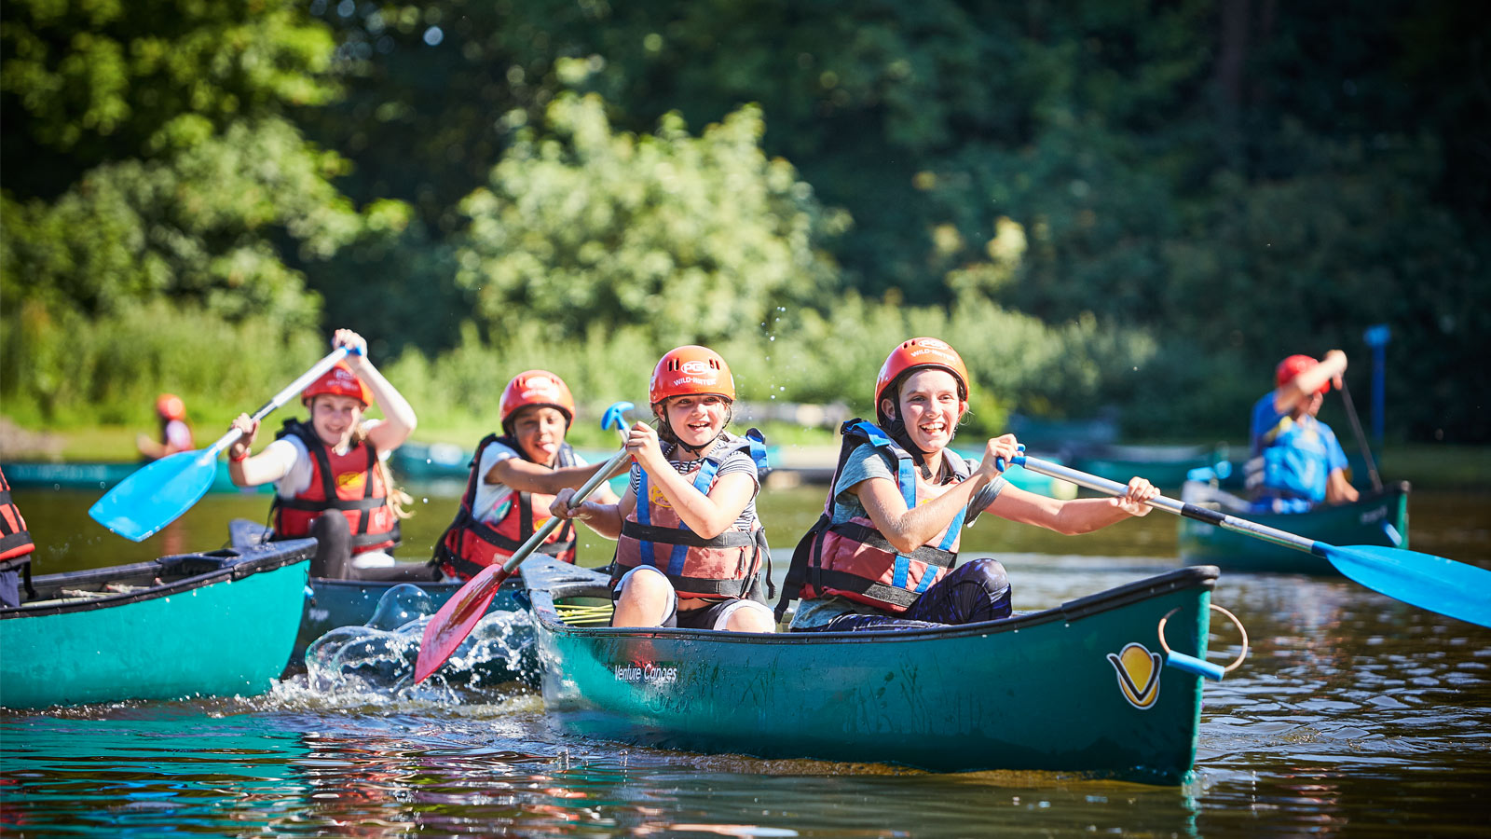

Slide 12
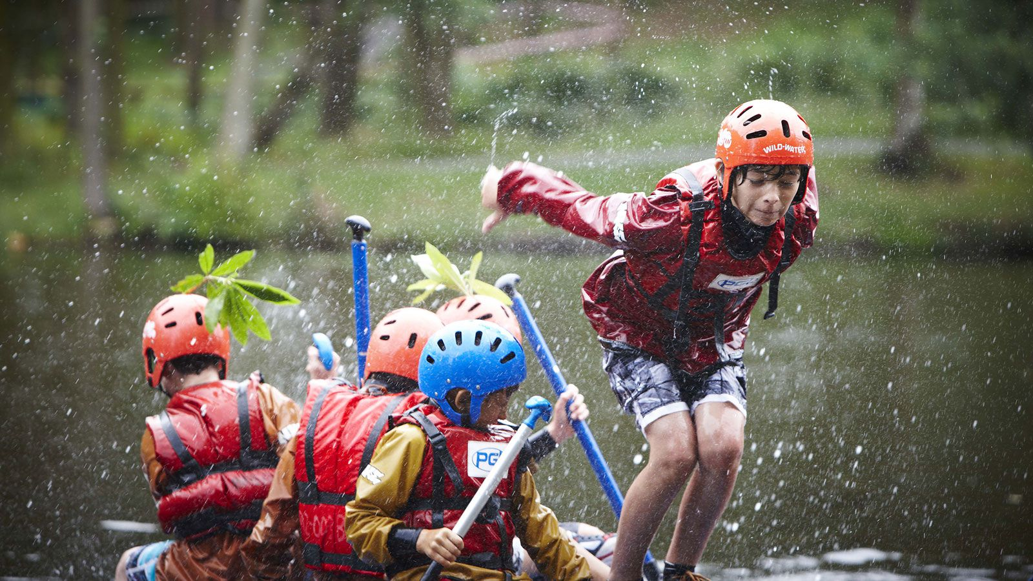

Slide 13
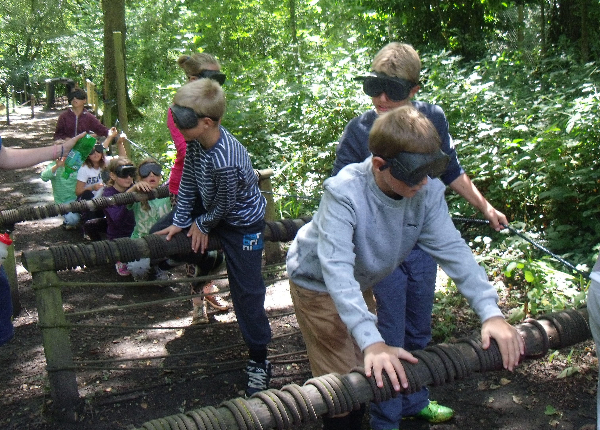

Slide 15
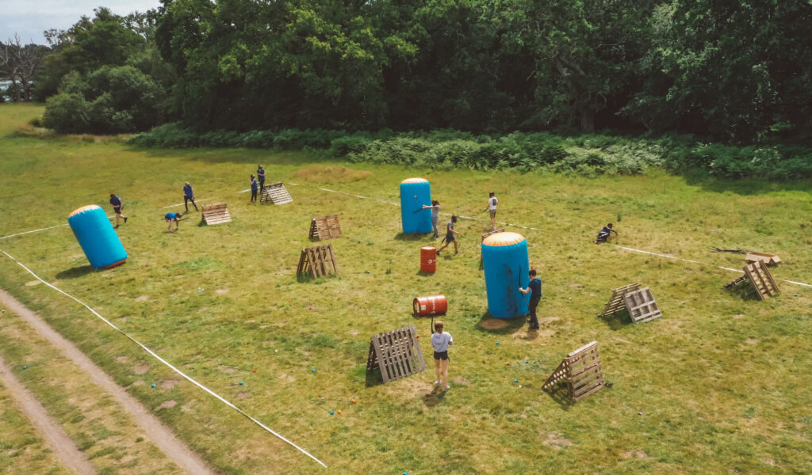

Slide 16
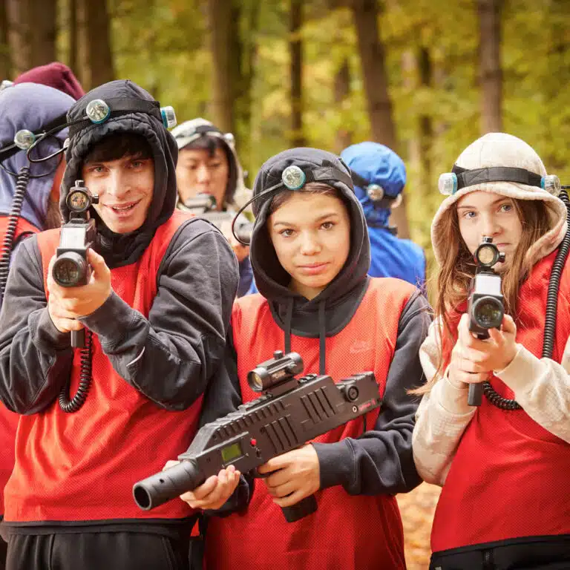

Slide 17
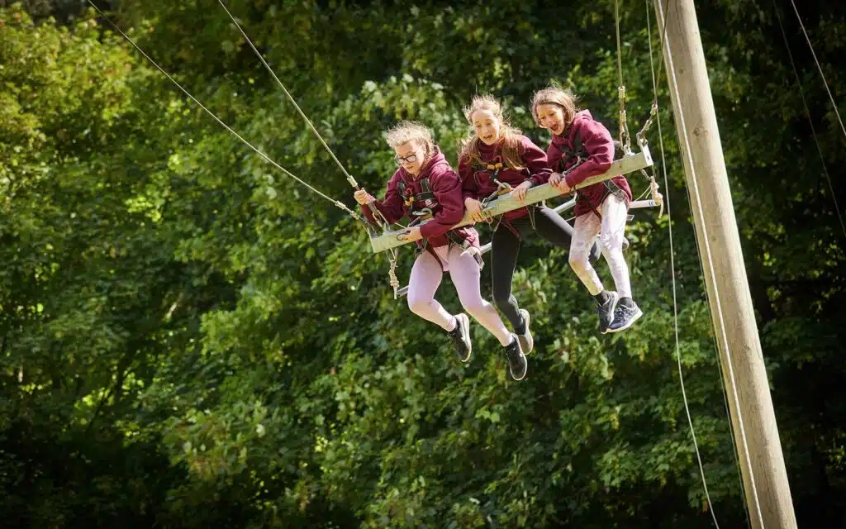

Slide 18
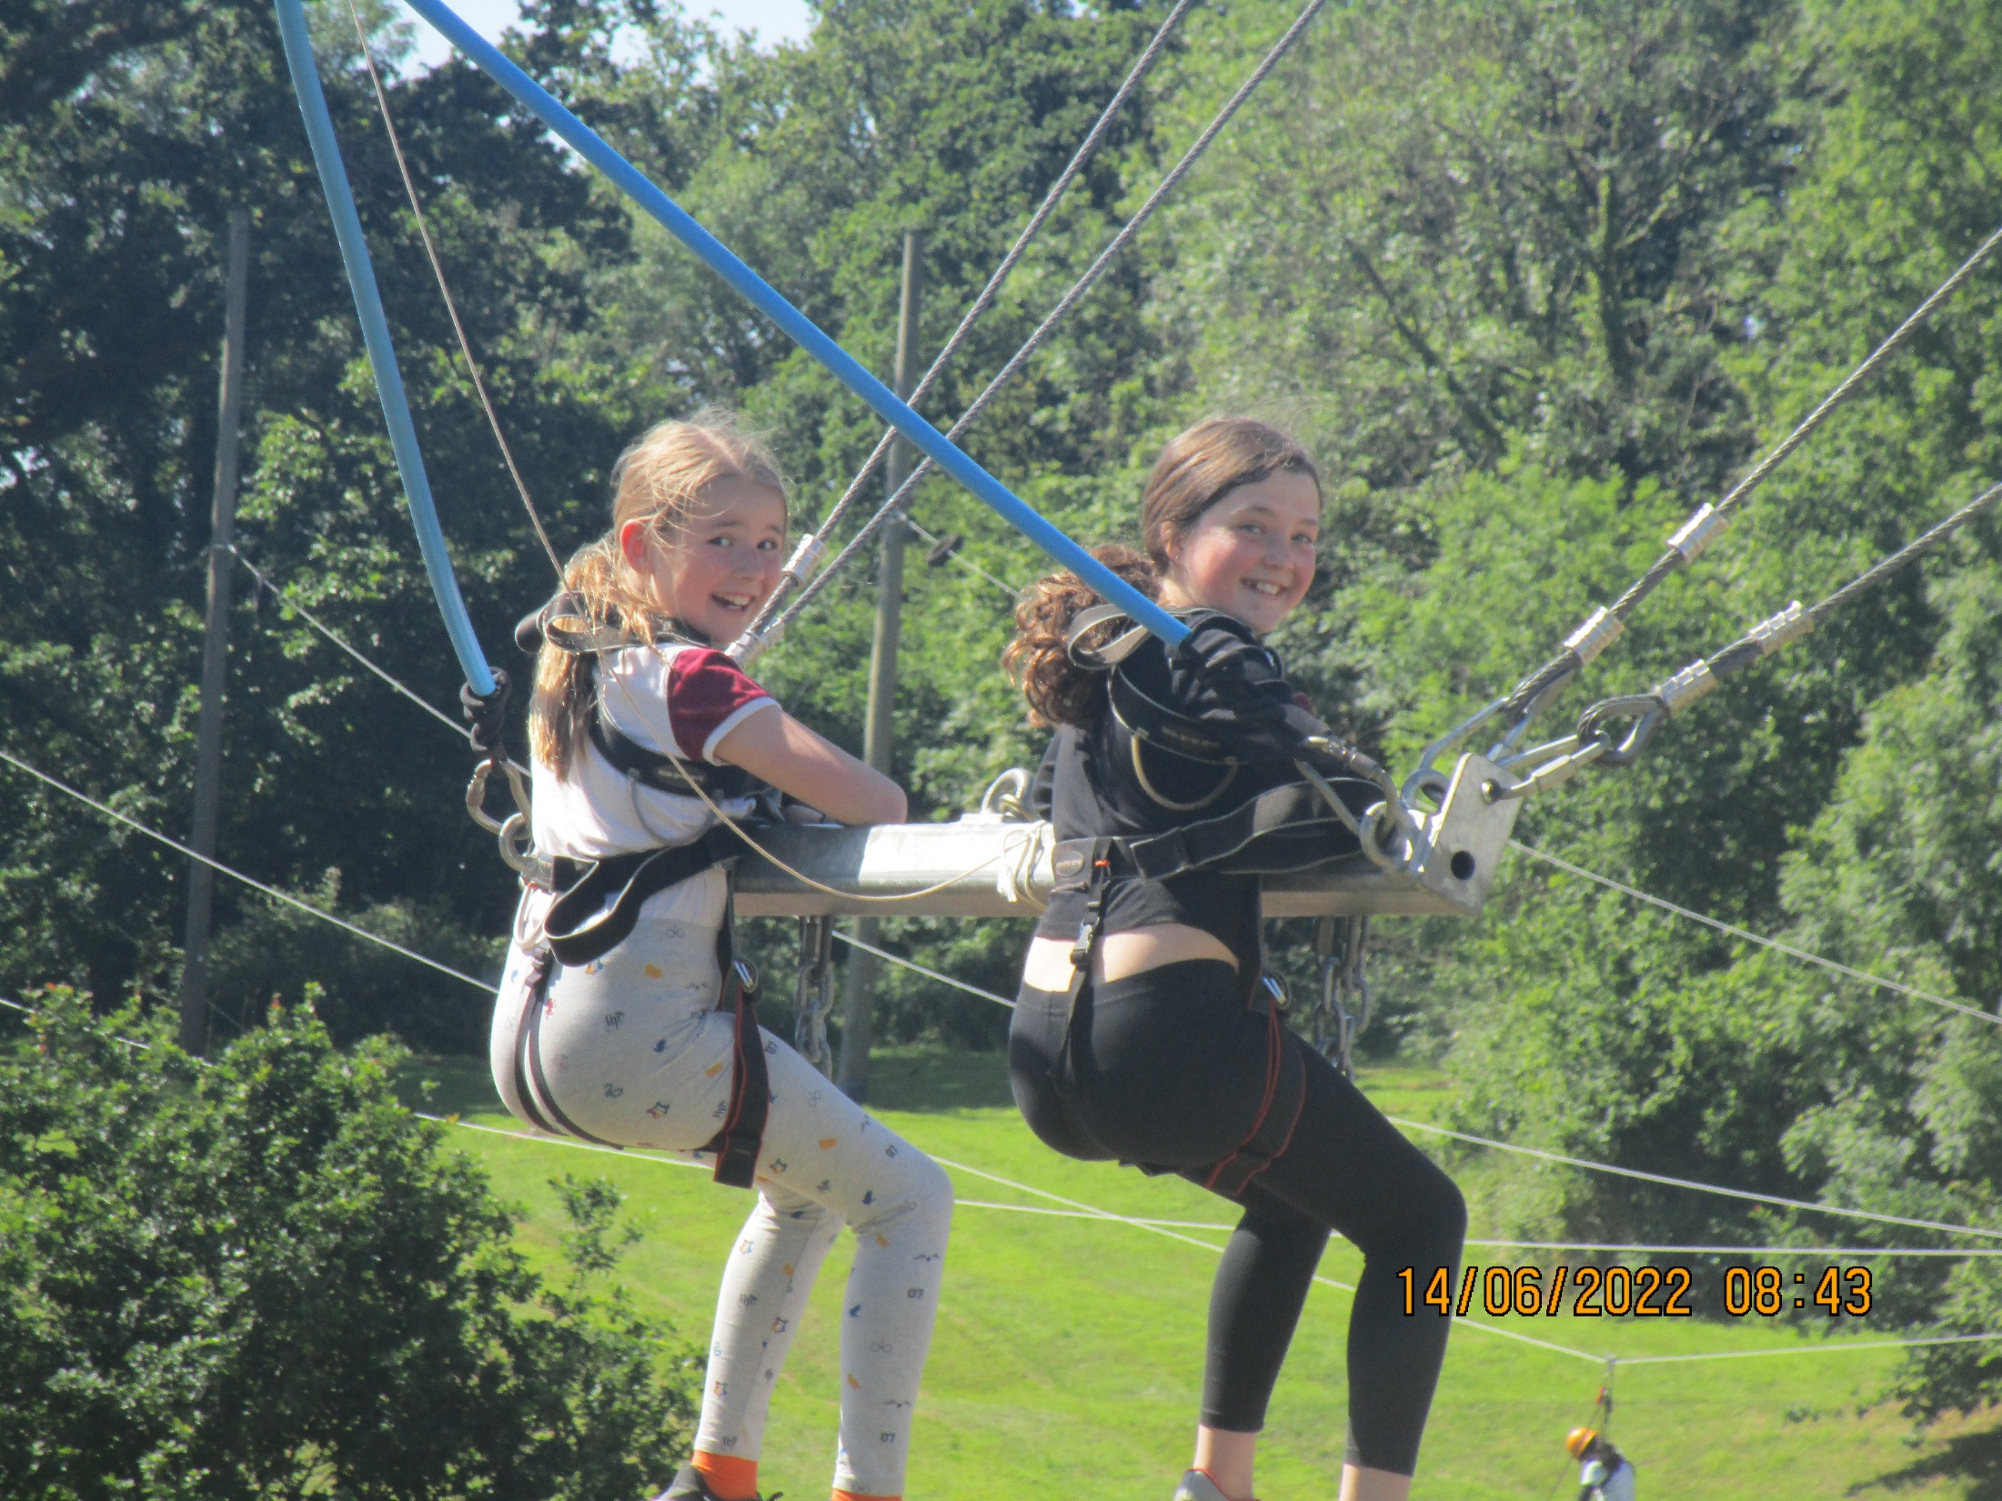

Slide 19
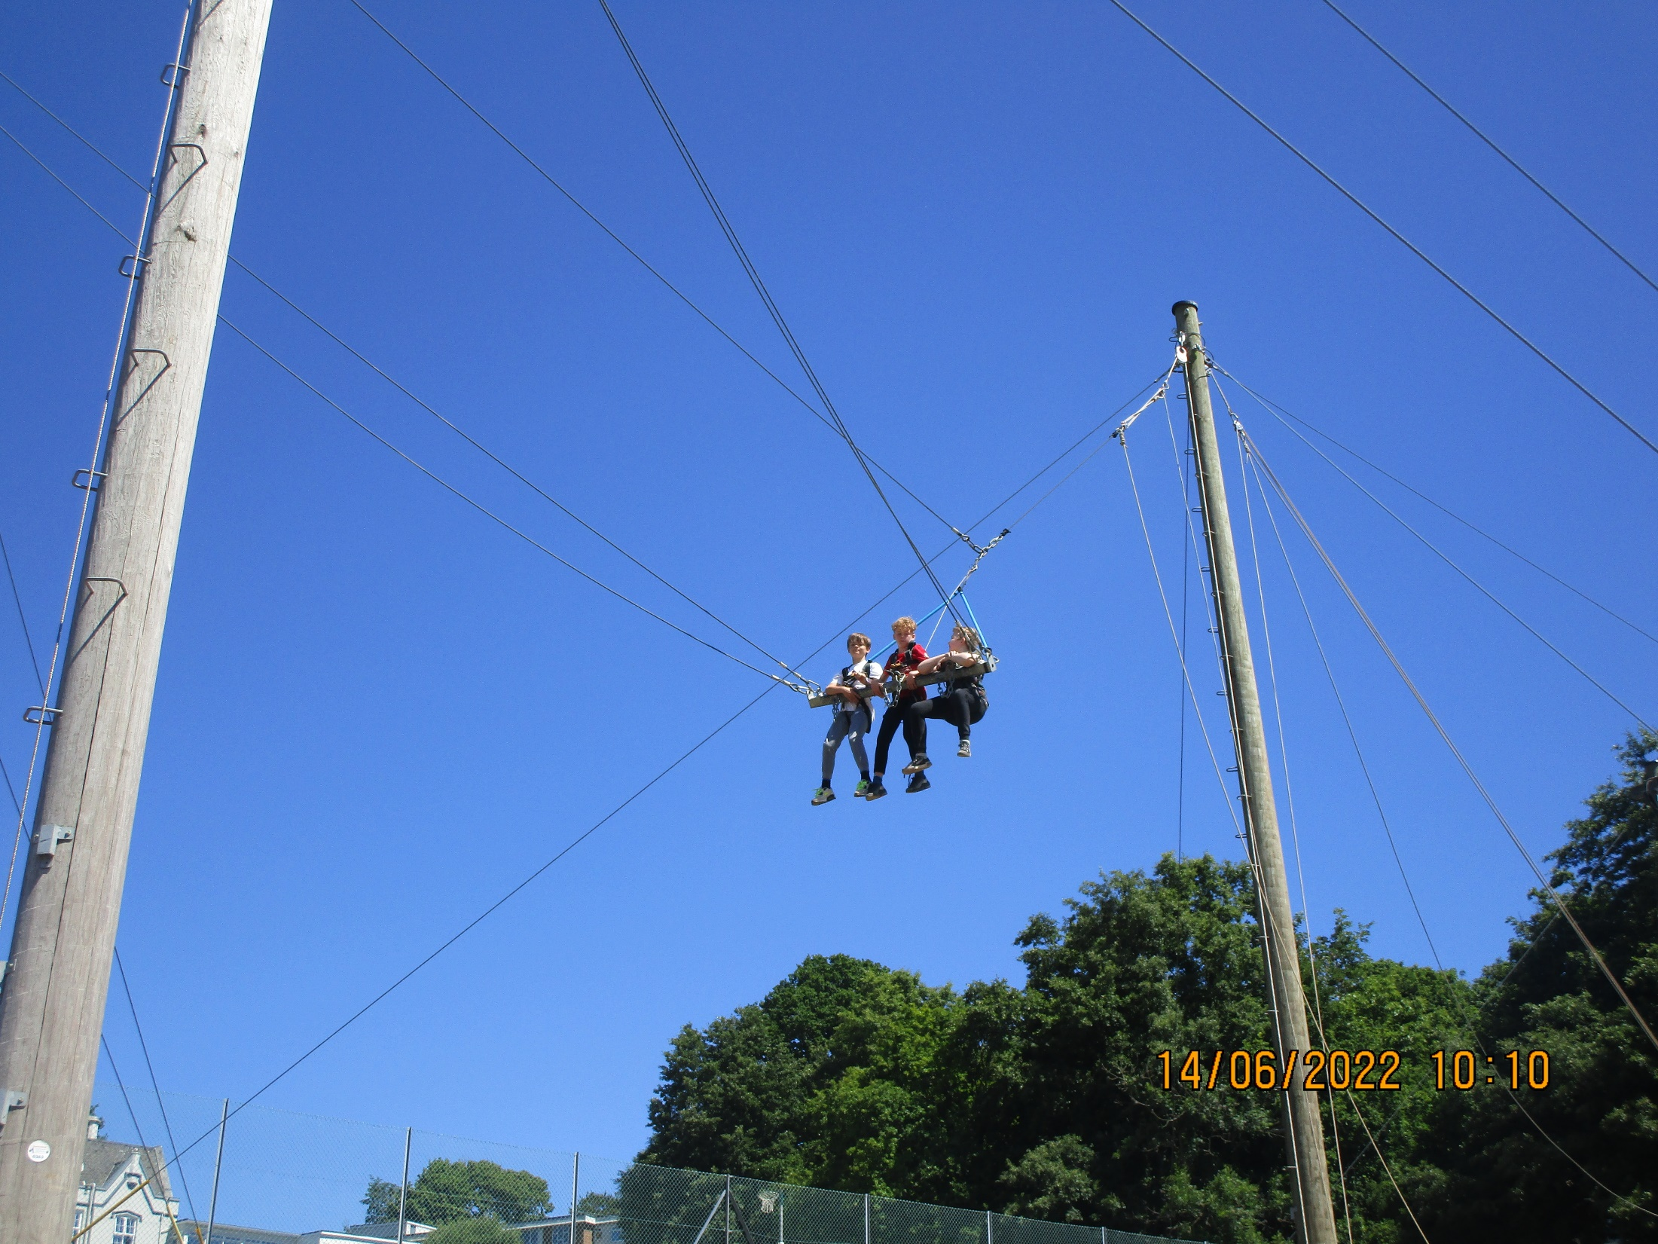

Slide 20
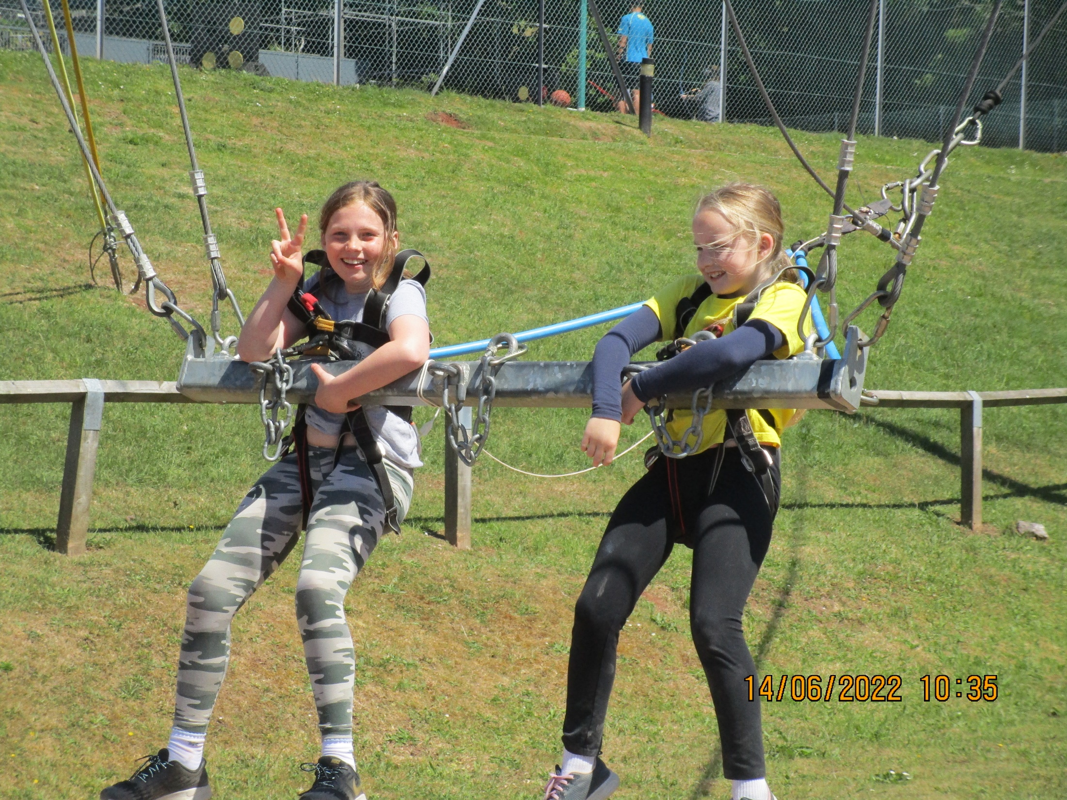

Slide 21
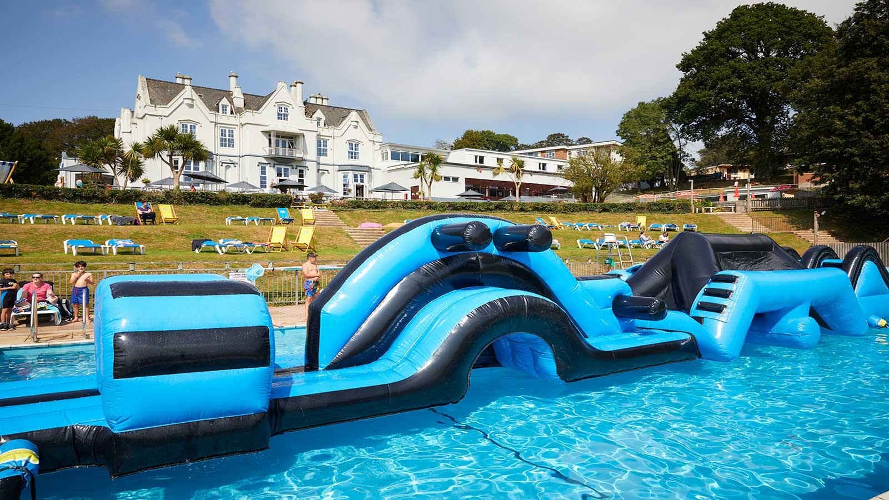

Slide 23
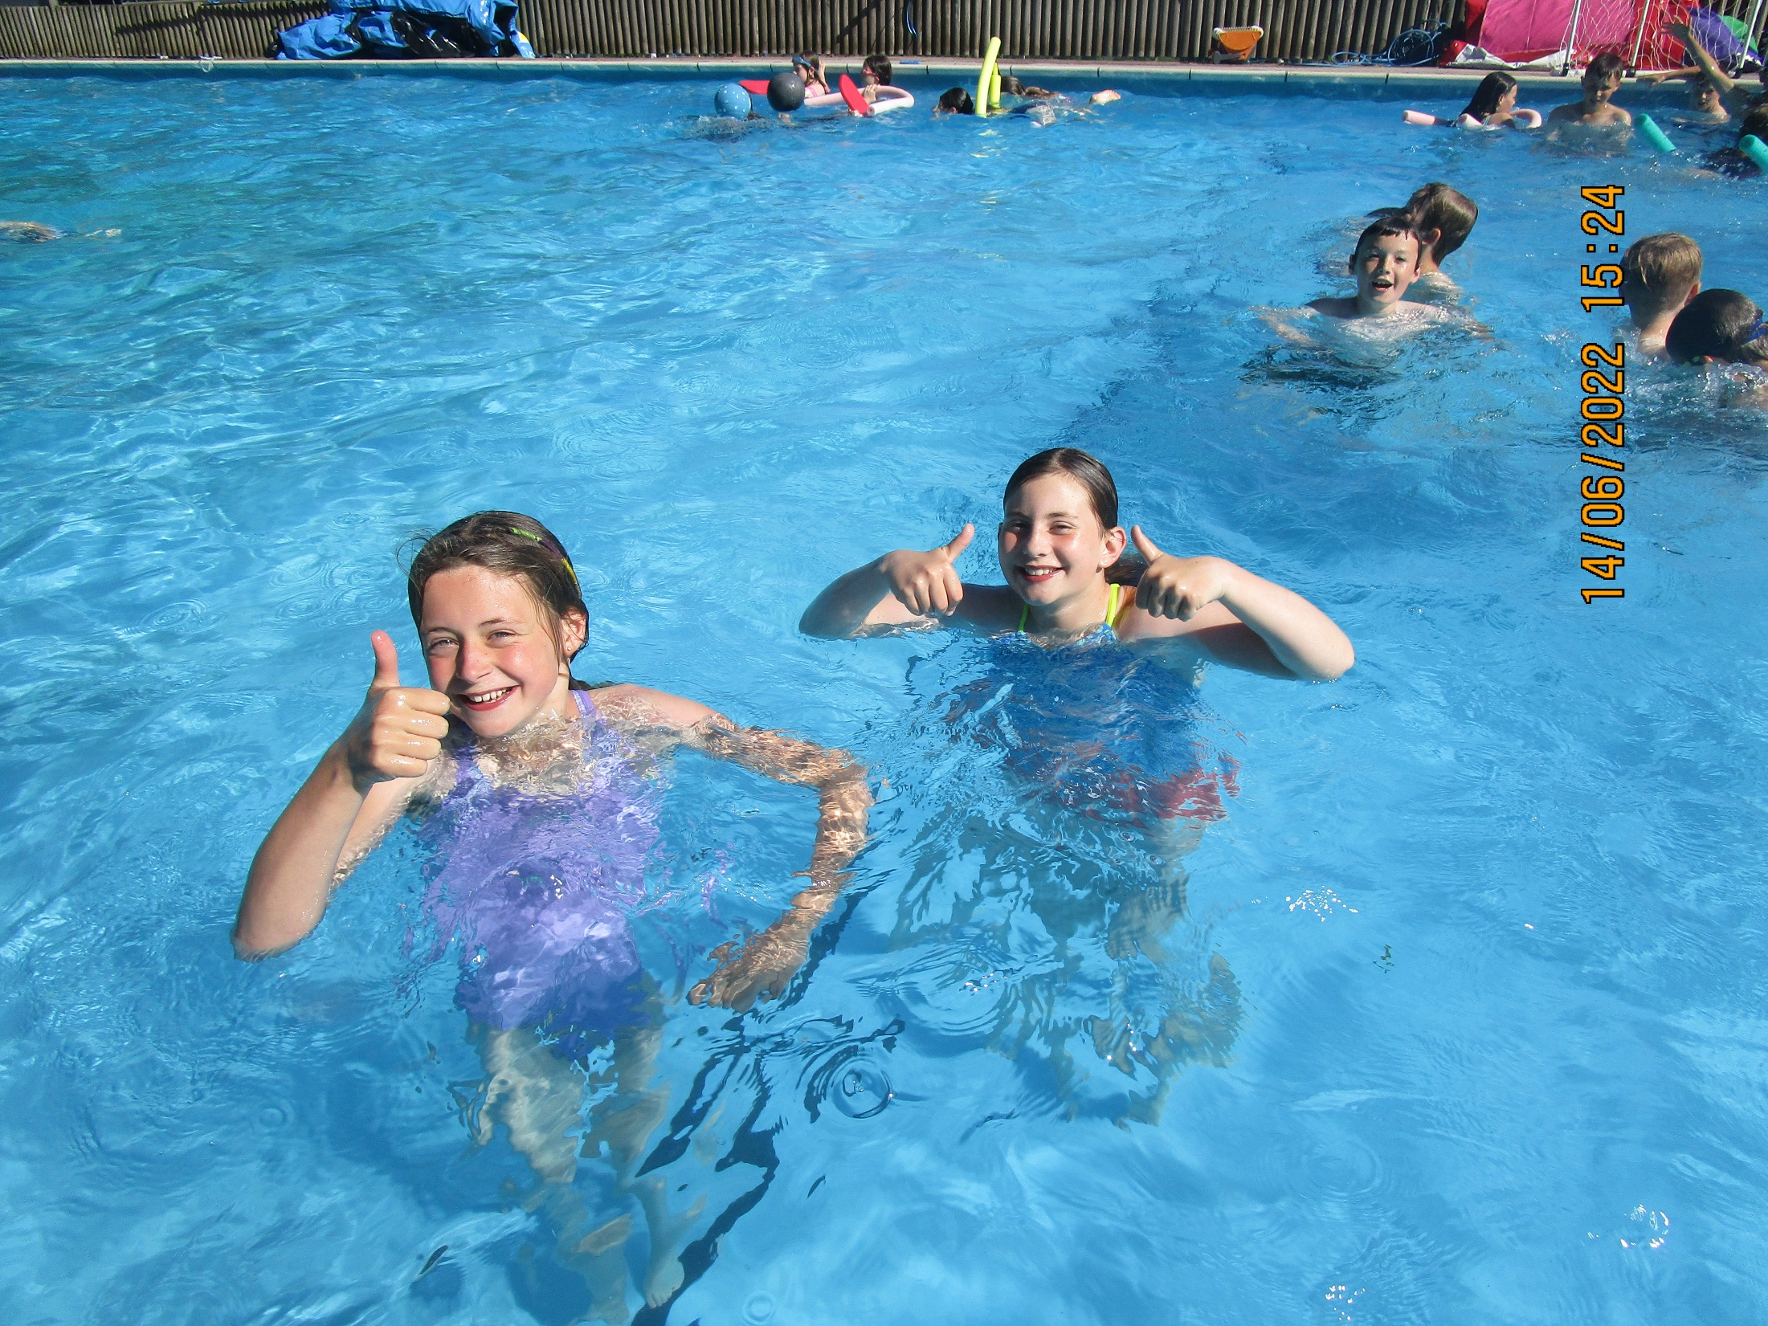

Slide 24
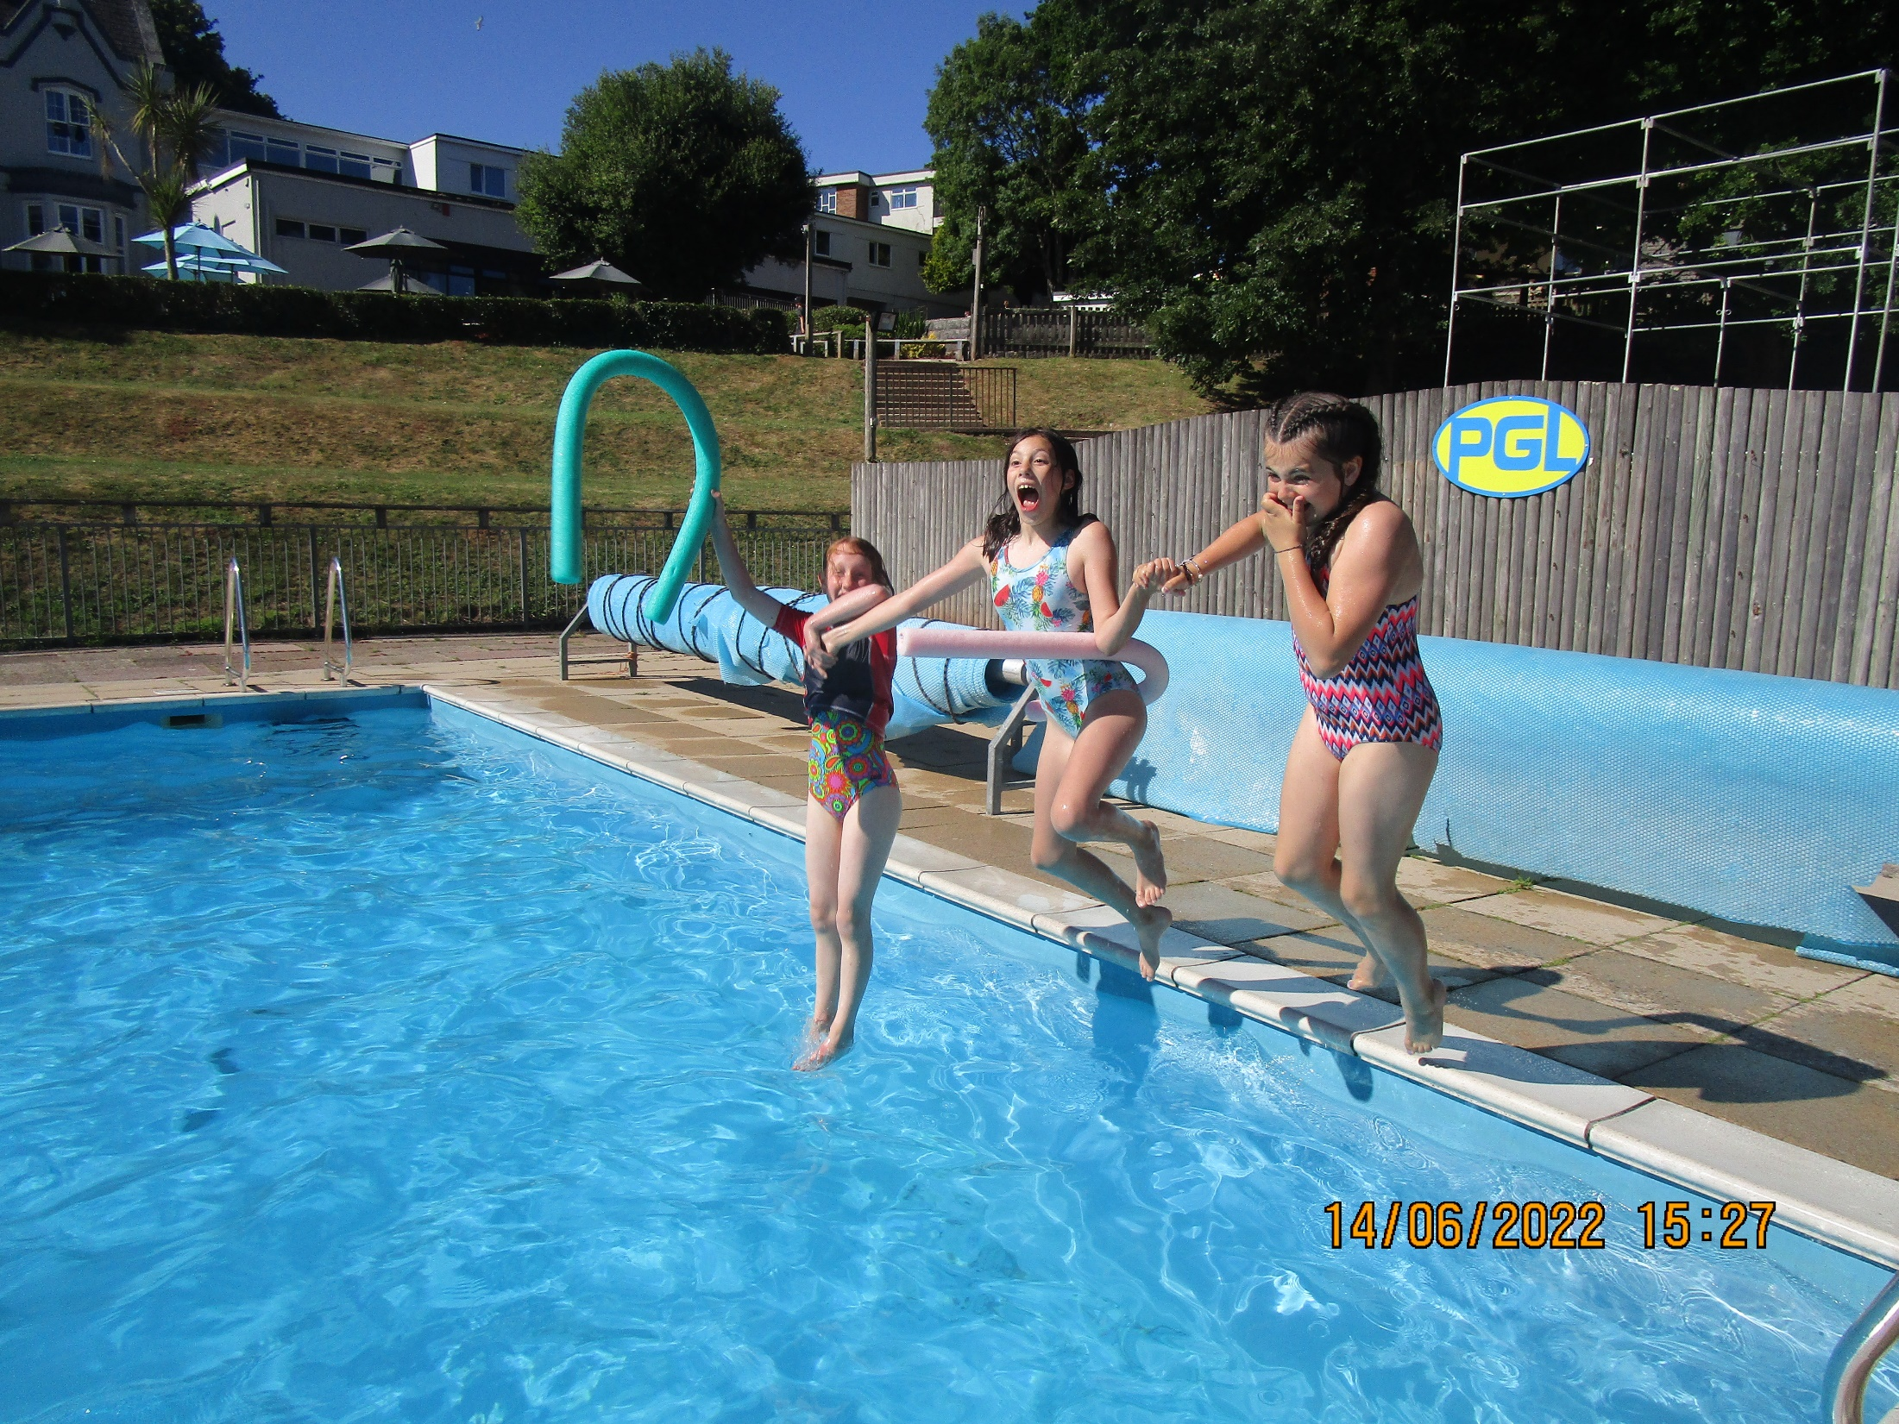

Slide 25
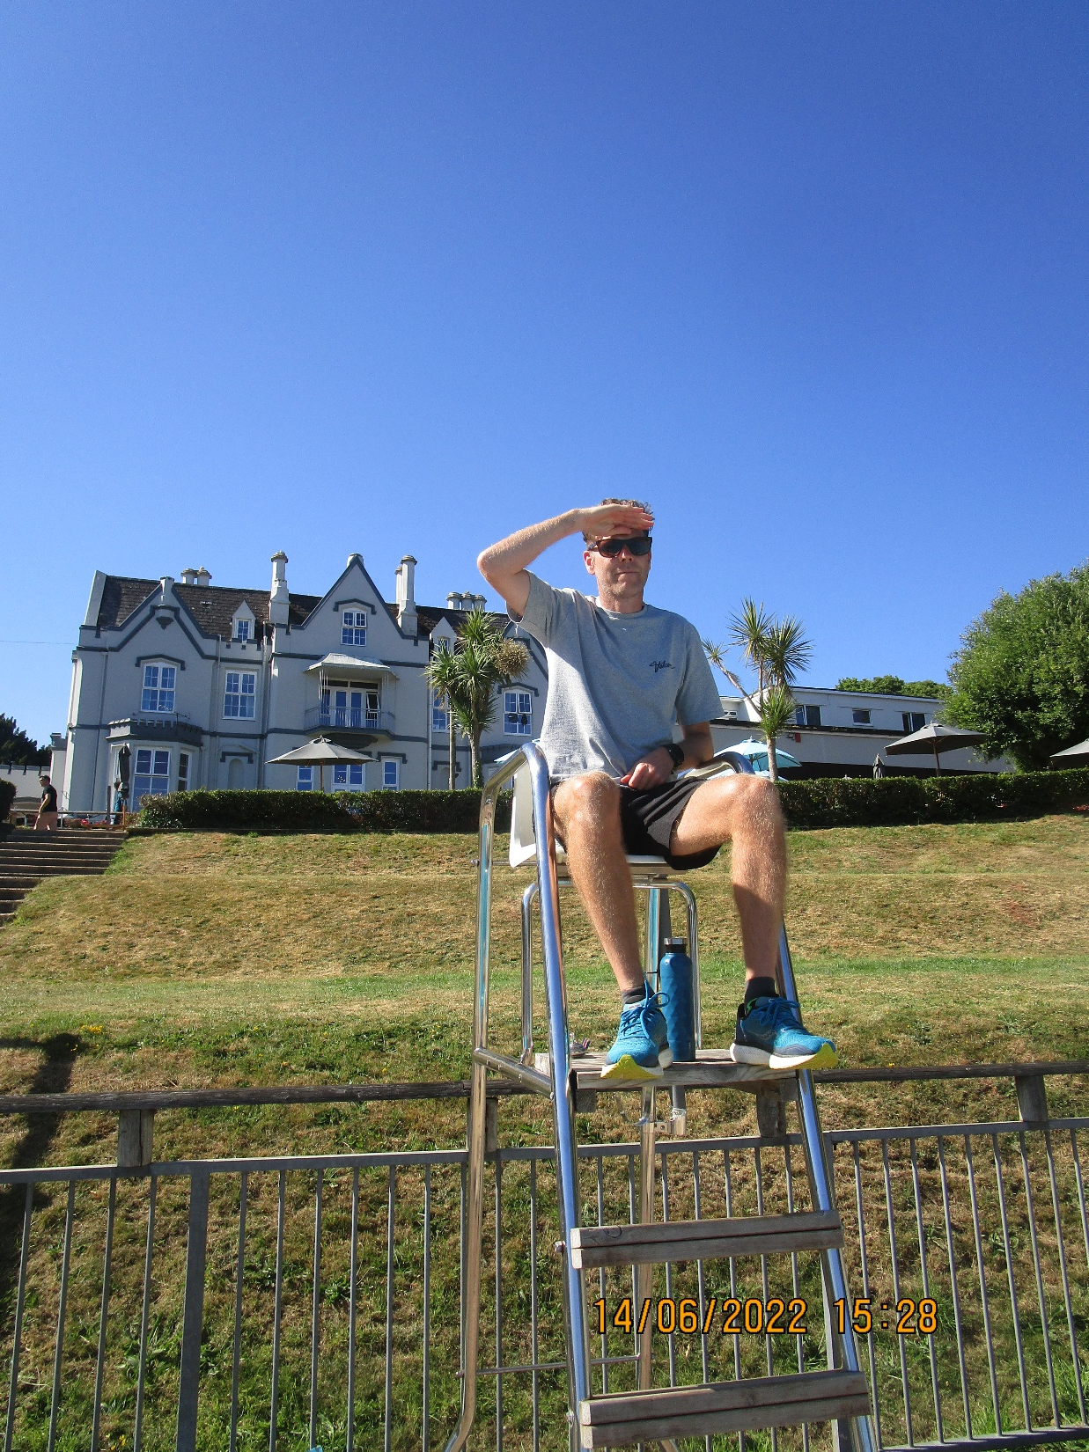

Slide 27
ITINERARY
Wednesday 26th June: arrive MBS 08:45
OTS Coaches depart 09:30
Arrive Barton Hall 12:00
Picnic lunch (packed lunch from home)
Emergencies briefing on arrival
Unpack in rooms
Full afternoon of activities and non-stop fun!

Slide 28
Return journey
Friday 28th June
Lunch at PGL
Goodbye to the amazing PGL staff
Hopleys coaches leave Barton Hall 13:00
Arrive MBS at approx. 16:00
SLEEP!

Slide 29
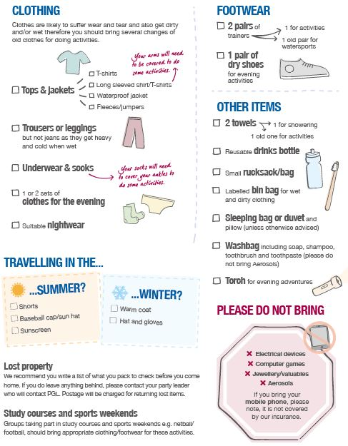

Slide 30
PLEASE DO NOT BRING…
Mobile phones (more on this later!)
Expensive jewellery/clothes
Electronic devices
Aerosols
Emotionally valuable items that might get lost/broken
Too many sweets!!

Slide 31
Kit List
Kit list from PGL in hand out.
Packed lunch for coach on Monday.
Sleeping bag and pillow – sheets provided.
Water bottle – named!
A few sweets/snacks – no nuts.
Medications – named, form completed, handed to staff.
Spending money (price list of items in pack) in a named envelope, handed to staff.
Card games, footballs, frisbees, reading books.

Slide 32
Frequently Asked Questions
Can my child access Wi-Fi?
How do I contact my child?
What if my child can’t swim?
Is there a gift shop?
My child might get a little homesick, how can I help?
What if my child is a bit of a fussy eater?

Slide 33
Boring but important stuff
PGL is fully insured and ABTA holders
All PGL staff are DBS checked
Fully qualified staff meet Activities Adventures Licensing Authority (AALA), British Activities Providers Association and Council for Learning Outside the Classroom (LOtC) standards
Hopleys Coach company fully insured

Slide 34
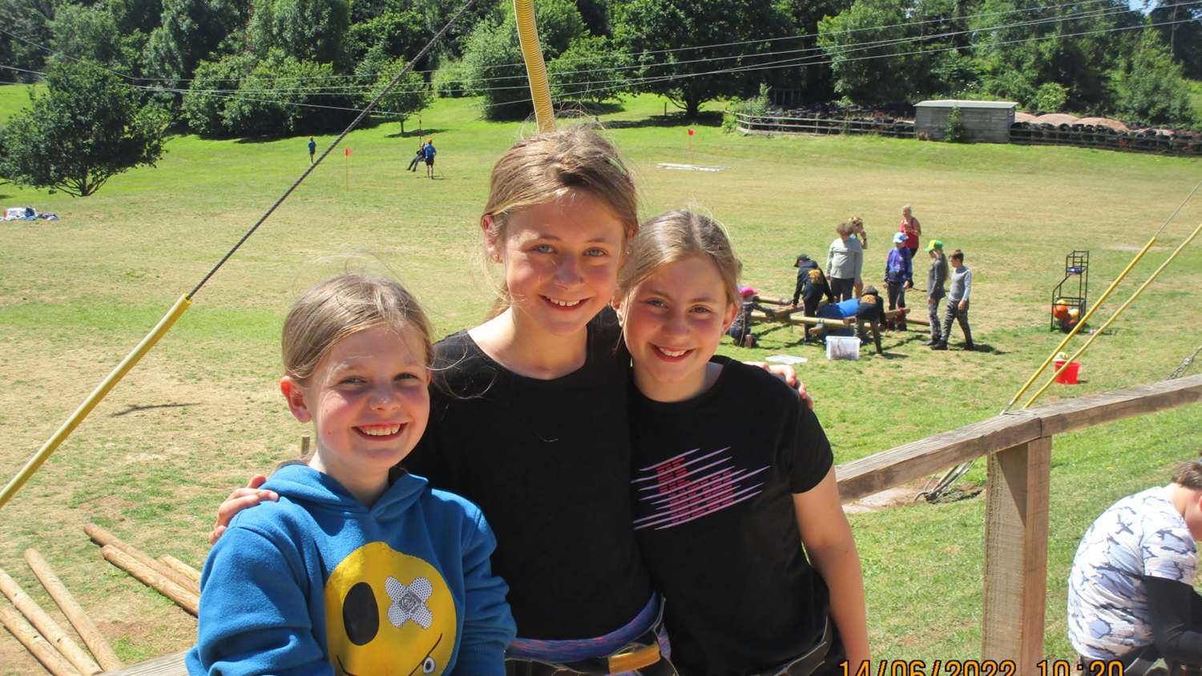
And finally…
THANK YOU

