Slide 1
Class 4 maths curriculum
NCETM booklets
What a lesson looks like.
Sentence stems and working wall
4 operations – how they are taught and the end point of each year group
How can I help at home? And useful links
Maths in Class 4

Slide 2
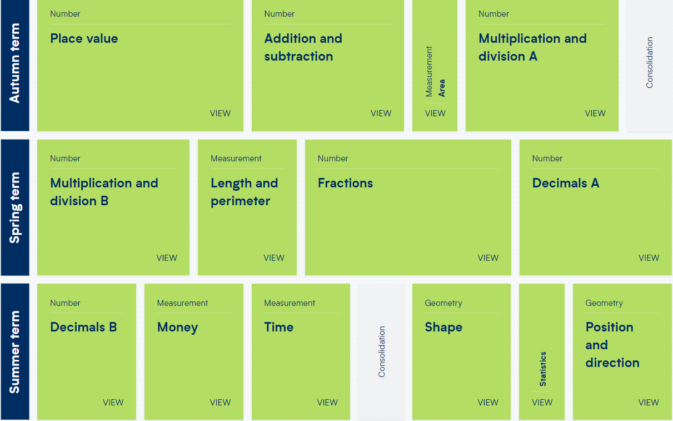
Year 4 yearly overview (WRM)

Slide 3
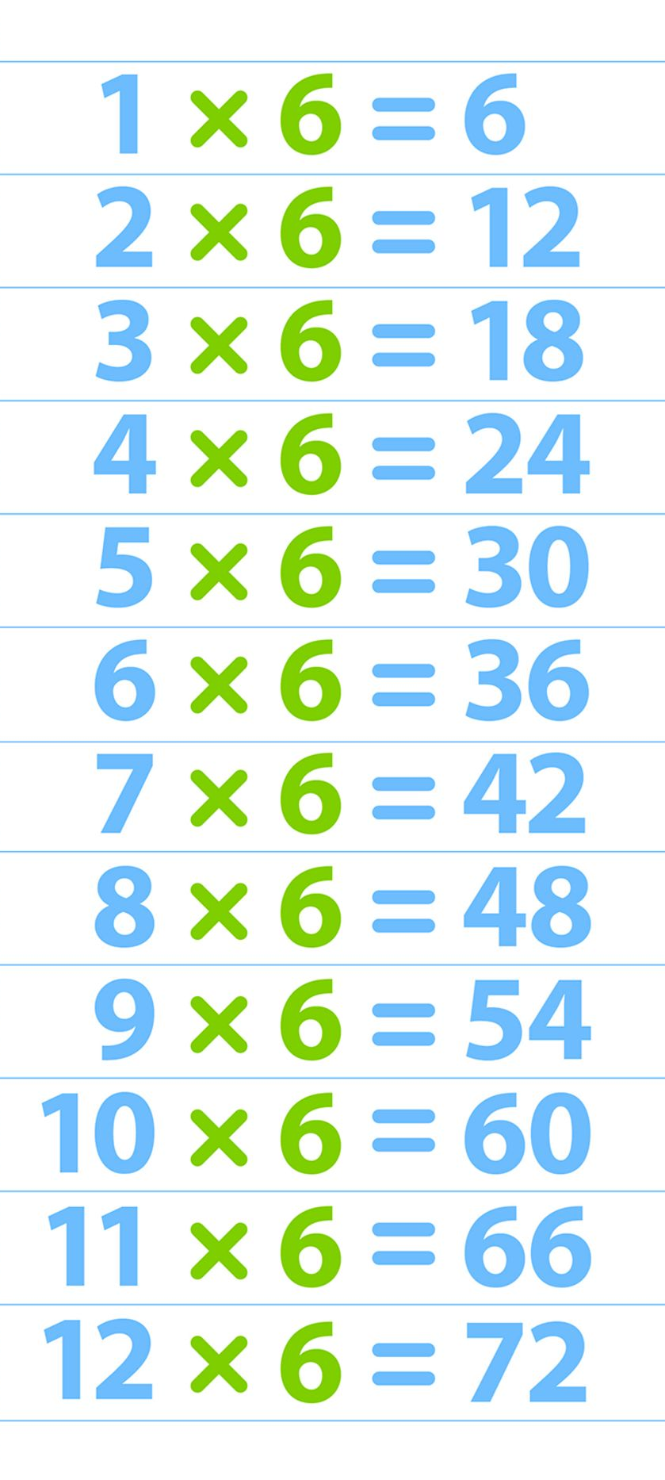
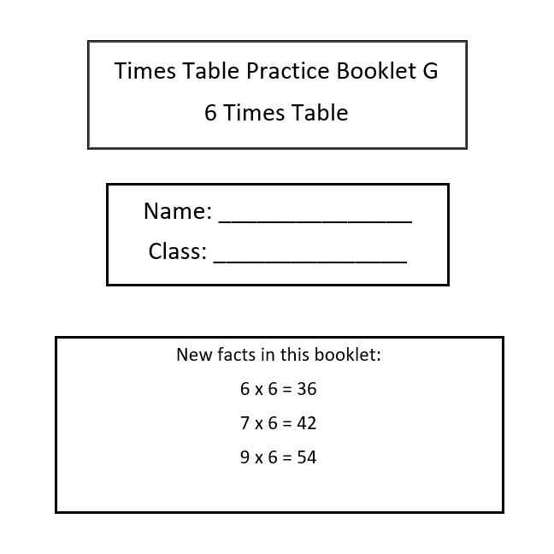
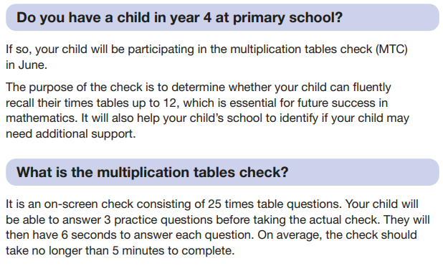
Who knows their 6 times table?
3 minutes!

Slide 4
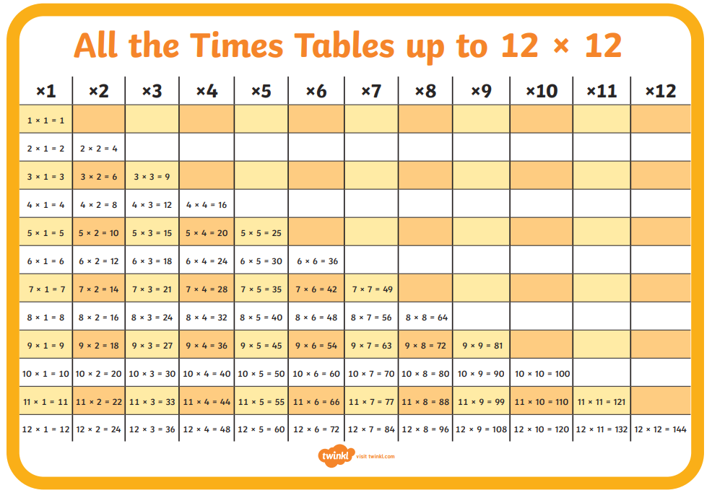

Slide 5
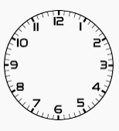
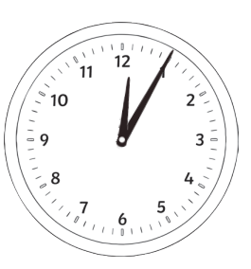
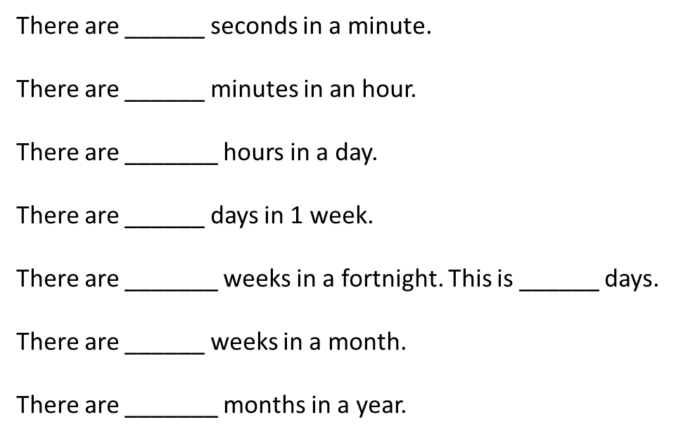
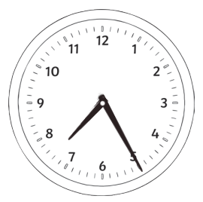
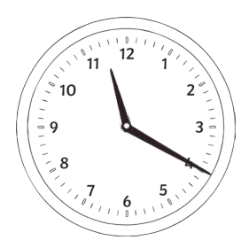
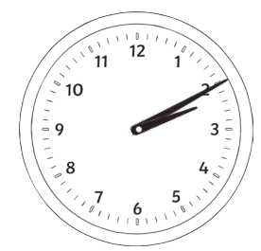
You need a clock each!
Declarative Knowledge
Q2
Q1
am is from 12 midnight in the morning until 11.59 in the morning.
pm is from 12 midday until 11.59 (afternoon & evening).

Slide 6
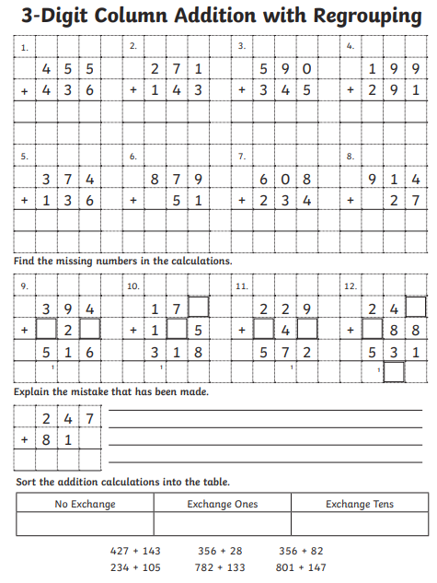
Procedural Knowledge- Addition with regrouping
Please write the calculations into your books.
Set out neatly, 1 square per digit and use a ruler.

Slide 7
WALT (What are we learning today?)
22.11.23
WALT know 7 times tables and division facts

Slide 8
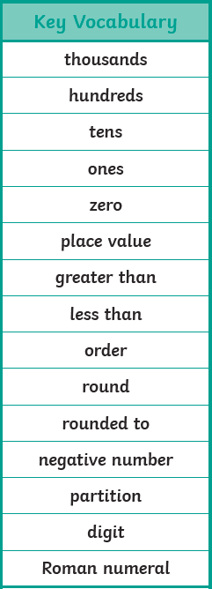
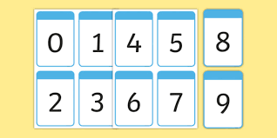
Can you remember any of our important words? Where can you look in the classroom?
one
two
three
four
five
six
seven
sight
nine
twenty
thirty
forty
fifty
sixty
seventy
eighty
ninety
equation
estimate
interval
mid-point
multiples

Slide 9
I Say,
You Say
equation - An equation is a number sentence where one side equals the other
interval - an interval in mathematics is a range of numbers between two points
mid-point - the point that is located directly midway between the two points
multiple – a multiple is repeated addition of the same number from zero 2+2+2+2+2+2+2 (numbers in times tables)

Slide 10
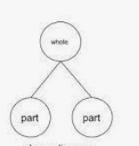
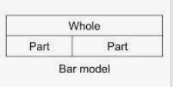
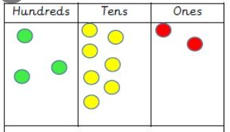
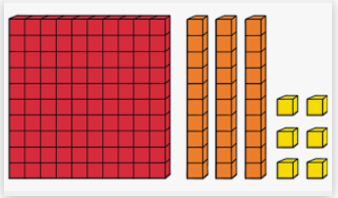
Teaching of the maths concepts using the school agreed representations and models.
Part whole model
Bar model
Place value counters
Base 10

Slide 11
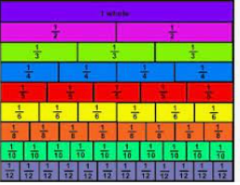
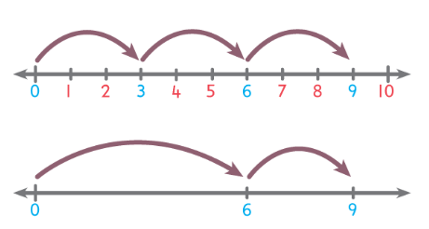
Fraction wall
Number lines

Slide 12
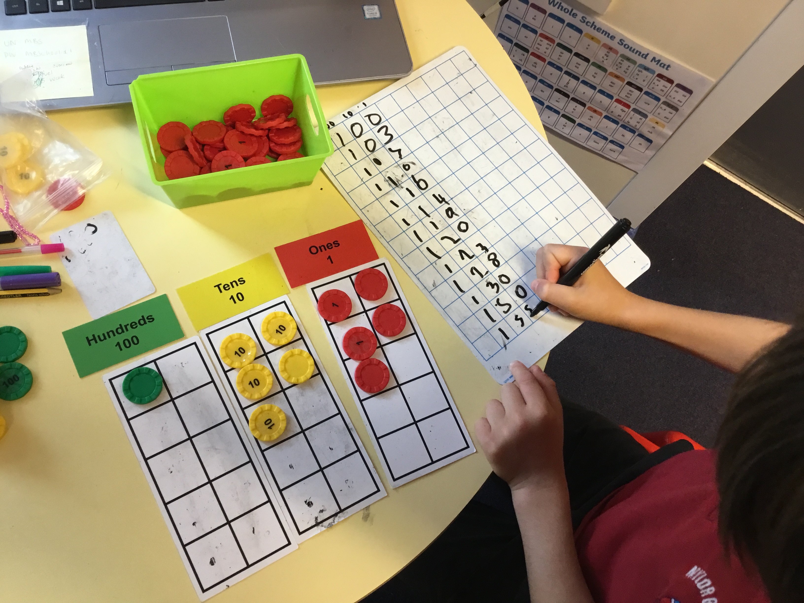
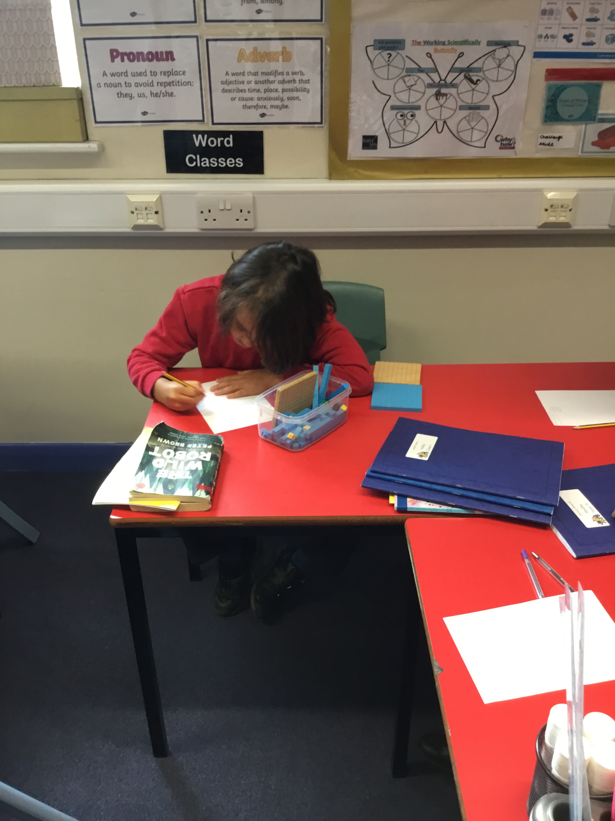
Opportunities for independent practise.
Here, the children have opportunities to practice fluency, reasoning and problem solving.

Slide 13
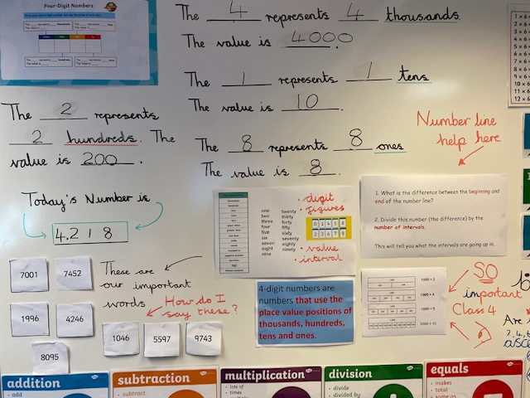
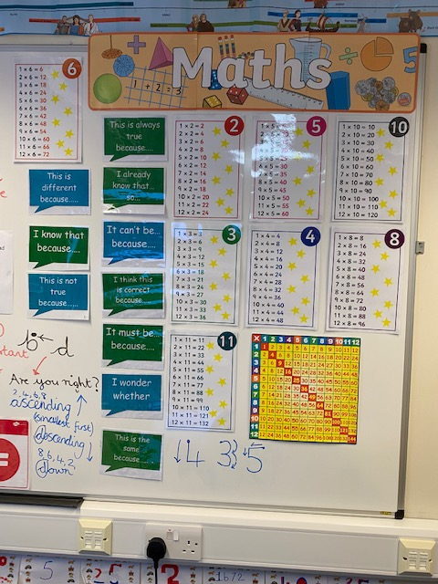
Sentence stems and working walls.

Slide 14
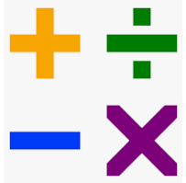
4 operations: addition, subtraction, multiplication and division.

Slide 15

We encourage children to add mentally, using their knowledge of number bonds

Slide 16


Slide 17


Slide 18


Slide 19
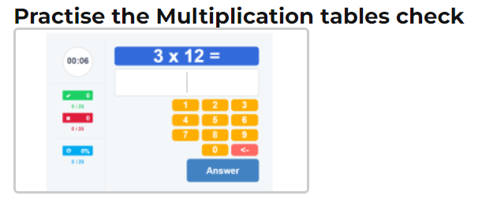
How can I help at home?
Regular practise of times tables (this is so important)
“Can you tell me a Maths word I don’t know?”
“What did you learn about today in Maths?”
Positive attitudes towards Maths - “I used to love these at school” as opposed to “I didn’t like Maths!, I was rubbish at maths”
Times Tables Rockstars, songs on YouTube (times tables), EdShed (MathsShed) for further games & timestables.co.uk (see below)
https://ttrockstars.com/
https://www.topmarks.co.uk/
https://mathsframe.co.uk/

