Slide 1
BF Adventure Year 3 and 4 Residential 12-14th June 2024

Slide 2
Day 1
Arrive at school at the usual time. Bring with you your kit (see kit list) and a packed lunch and water bottle.
11.30 am – Children travel to BF Adventure via school minibus and staff cars.
12.00 pm – Arrive at BF Adventure, orientation inc move into tents.
12.30 pm – Lunch
1.00 pm - afternoon activities: Zip Wire and Low Ropes Course.
4.00 pm – Free time
5.30 pm – Dinner (Pasta and a choice of salad)
6.30 pm – Self-led activities (rounders/ team games)
8.30 pm - Preparation for bed
9.00 pm – into tents
10.00 pm – Lights out.
Notes:
How presentation will benefit audience: Adult learners are more interested in a subject if they know how or why it is important to them.
Presenter’s level of expertise in the subject: Briefly state your credentials in this area, or explain why participants should listen to you.

Slide 3
Day 2
7.30 am – Wake up, dress, teeth and preparations of the day.
8.30 am – Breakfast (Breakfast baps, fruit juice, toast etc)
9.30 am – Preparation for the day, sun cream, hats / raincoats, waterproofs, toilet etc.
10.00 am – Activity one: Kayaking
12.00 pm – Lunch (packed lunch provided by BF Adventure)
1.00 pm – Activity two: Temple Run
4.00 pm – Free time
5.30 pm – Dinner (BBQ and a choice of salad)
6.30 pm – Self-led activities (Talent Show – small props or items can be brought from home)
8.30 pm - Preparation for bed
9.00 pm – into tents
10.00 pm – Lights out.
Notes:
Lesson descriptions should be brief.

Slide 4
Day 3
7.30 am – Wake up, dress, teeth and preparations of the day.
8.30 am – Breakfast (Breakfast baps, fruit juice, toast etc)
9.30 am – Preparation for the day, sun cream, hats / raincoats, waterproofs, toilet etc.
10.00 am – Activity one: Giant Catapult Building
12.00 pm – Lunch (packed lunch provided by BF Adventure)
12.30 pm – Tidy up and pack.
1.00 pm – Leave
1.30 pm – Arrive at school
3.15 pm – Usual pick-up arrangements.
Notes:
Example objectives
At the end of this lesson, you will be able to:
Save files to the team Web server.
Move files to different locations on the team Web server.
Share files on the team Web server.

Slide 5
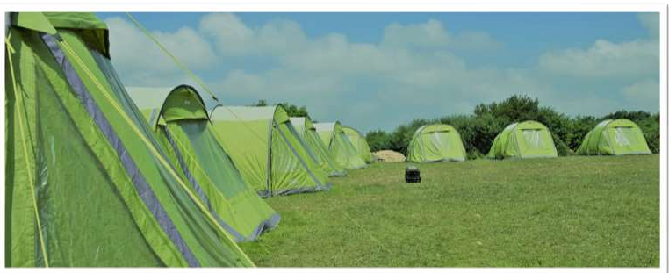
Sleeping arrangements
Tent groups
There are up to 5 children per tent, these groups will be decided on the morning of the trip and will be in conjunction with your child’s choice. They will have at least 1 friend with them in their tent.
We strongly encourage all children to stay for the night as it is part of the whole experience and is bonding for the cohort – often being the aspect of the trip which the children enjoy the most. Any alternative arrangements need to be agreed before we take part in this residential.

Slide 6
Toilets and Showers
There are numbers of clean, new toilets and showers within the camping area. If your child needs to go to the toilet in the nighttime, they are to take their torch, AND a friend – even if this means waking the friend up! – and take themselves to the toilet block. Please don’t worry about using the toilet at night – it is very safe and within easy reach of the tent block.
Children will be encouraged to take a shower at least once whilst we are away.

Slide 7
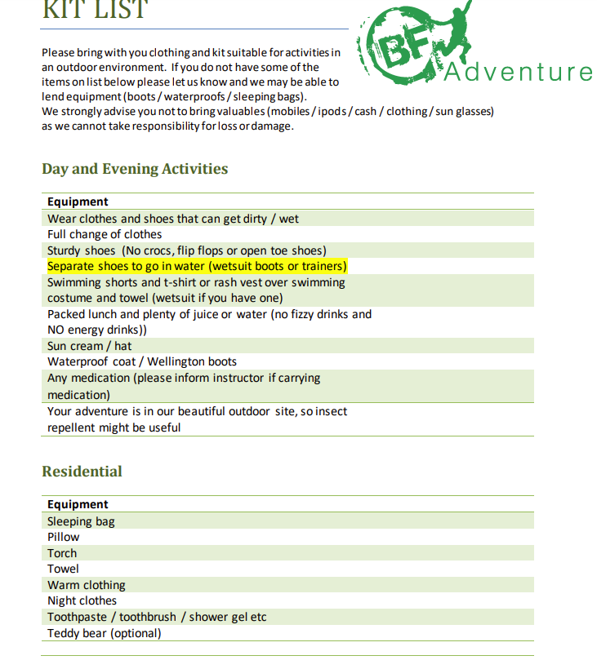
Kit List

Slide 8
Gadgets, cameras, phones
None of these items are necessary or permitted. If your child needs to speak with you, there is a school mobile which will be available to them.
Books, colouring, card games
You can bring 1 or two of these items – NO electrical items please
Updates
We will keep you updated at the end of each day through an email to the 1. contact on your child’s list.
We will also be uploading photos to the BF adventure section of the school website.
No news is good news – if you don’t hear from us in the daytime – your children are having a GREAT time!

Slide 9
Food
Day 1
Bring your own packed lunches and water bottles – no food is allowed in the tents as it encourages rodents.
Dinner – Pasta and salad
Day 2
Breakfast – breakfast baps, toast, Juice
Packed lunch – provided by BF adventure
Dinner – BBQ
Day 3
Breakfast (as above)
Packed lunch – provided by BF Adventure

Slide 10
Getting Lost!
If you think that you are lost.
Stand still and count to 500 - someone will return for you.
2. Do not wander off!
3. Do not enter parts of the park which are cordoned off.

Slide 11
Sun cream + Insect Repellent
Please make sure that these items are packed and labelled.
Packing and BLACK BAGS!
Please pack your clothes in 1 bag so that you can carry your clothes and your sleeping bag/pillow
Please bring at least 3 black bags for all of your dirty clothes and towels.

