Slide 1
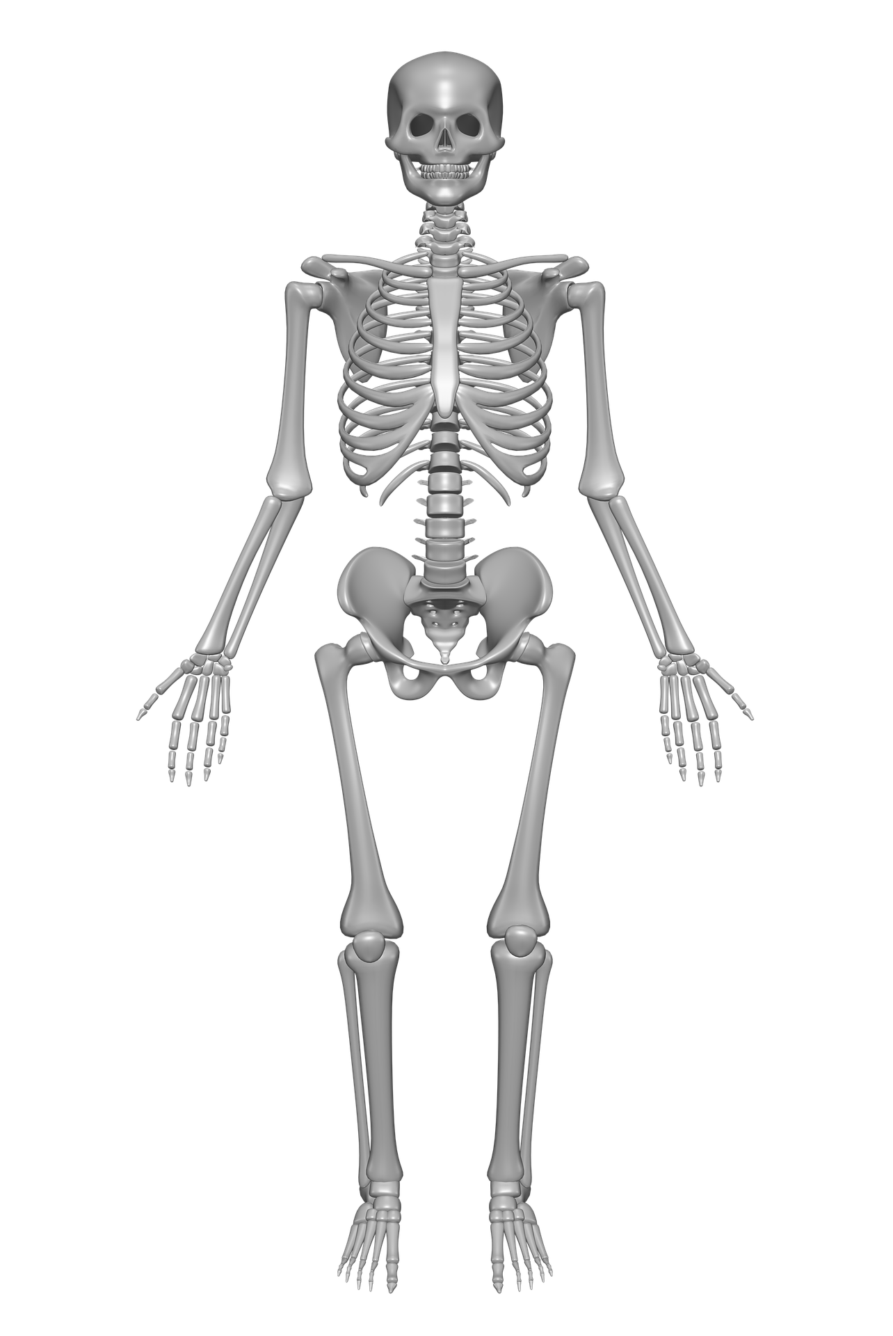
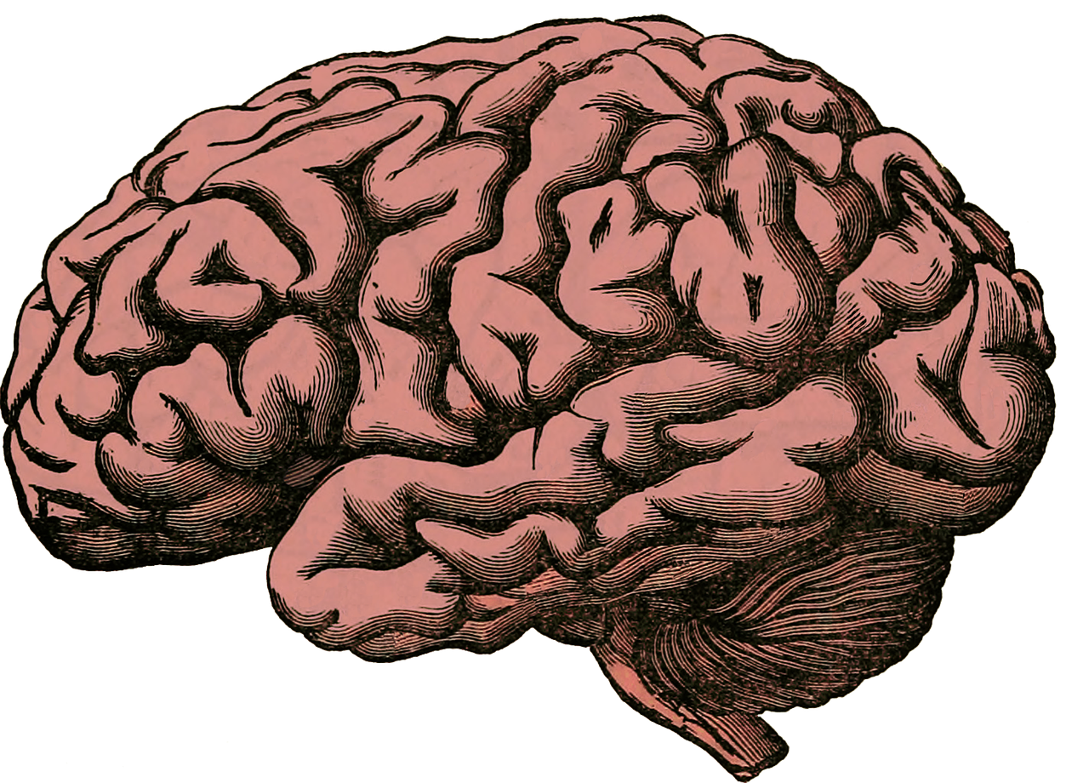
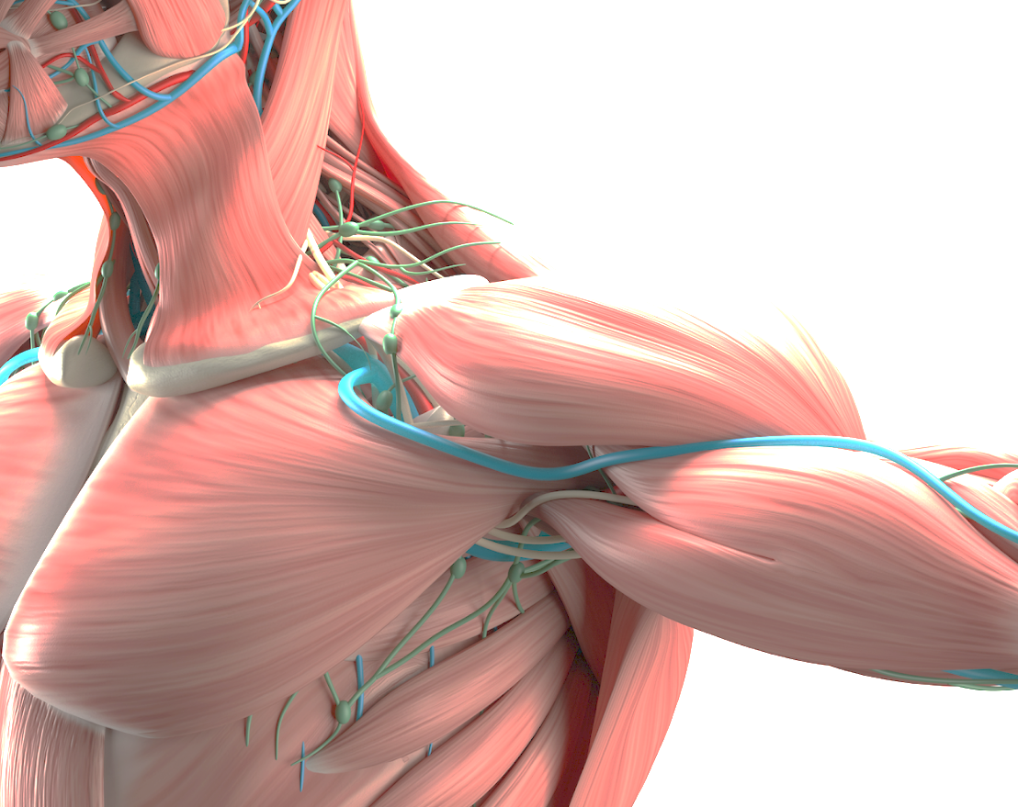
What are the different types of nutrients?
Protein help your body to grow and repair itself
examples include red meat, yogurt, beans
Carbohydrates give you energy examples include bread, potatoes, pasta
Fats give you energy examples include nuts, oils, avocados
Vitamins keep your body healthy examples of foods high in vitamins include oranges, carrots and nuts
Minerals keep your body healthy examples of foods high in vitamins include milk, sweetcorn, spinach
Fibre helps you to digest the food that you have eaten examples of foods high in fibre include wholegrain bread, cereals and lentils
Water helps to move nutrients in your body and get rid of waste that you don’t need examples of foods high in water include celery, cucumber, tomatoes
Knowledge Organiser
Animals Including Humans – What Makes Us
ROCKET WORDS Learn these words and their definitions.
Key Word | Definition
skeleton | The set of bones on a human or animal, joined together to make our structure.
tendon | A tough, elastic tissue which connects the muscles and bones
involuntary muscles | Muscles not controlled by an individual’s will.
voluntary muscles | Muscles whose actions are controlled by an individual’s will
Skull
Protects brain
Creates facial structure
Brain
The Brain is like a computer and controls our nervous system.
It controls our breathing, movement and our thoughts.
Ribcage
Protects heart and lungs
Supports shoulder and chest muscles
Spine
Protects spinal cord
Balance and structure
Enables flexible motion
Lesson sequence
What are the different food types?
Fruit and vegetables
Bread, rice, potatoes, pasta and other starchy foods.
Milk and dairy
Oils and spreads
Meat, fish, eggs, beans and other non-dairy sources of protein.
1
Know how to keep healthy through diet
2
Design a healthy dinner for Tim Peake in space
3
Learn about voluntary and involuntary muscles
4
5
6
Introduction to the skeleton
Know about the skeleton – tendons and ligaments
Explore how skeletons and muscles are used for support, protection and movement
Limbs
Movement
Handling and carrying
Muscles
Our muscles are attached to our bones by tendons. They contract and relax, and always work in pairs. There are over 650 muscles in our bodies!
Pelvis
Supports upper body weight
Attachment for lower limbs
Protects organs

