Slide 1
NCETM booklets
What a lesson looks like.
Sentence stems and working wall
4 operations – how they are taught and the end point of each year group
Maths in Year 3 and 4

Slide 2
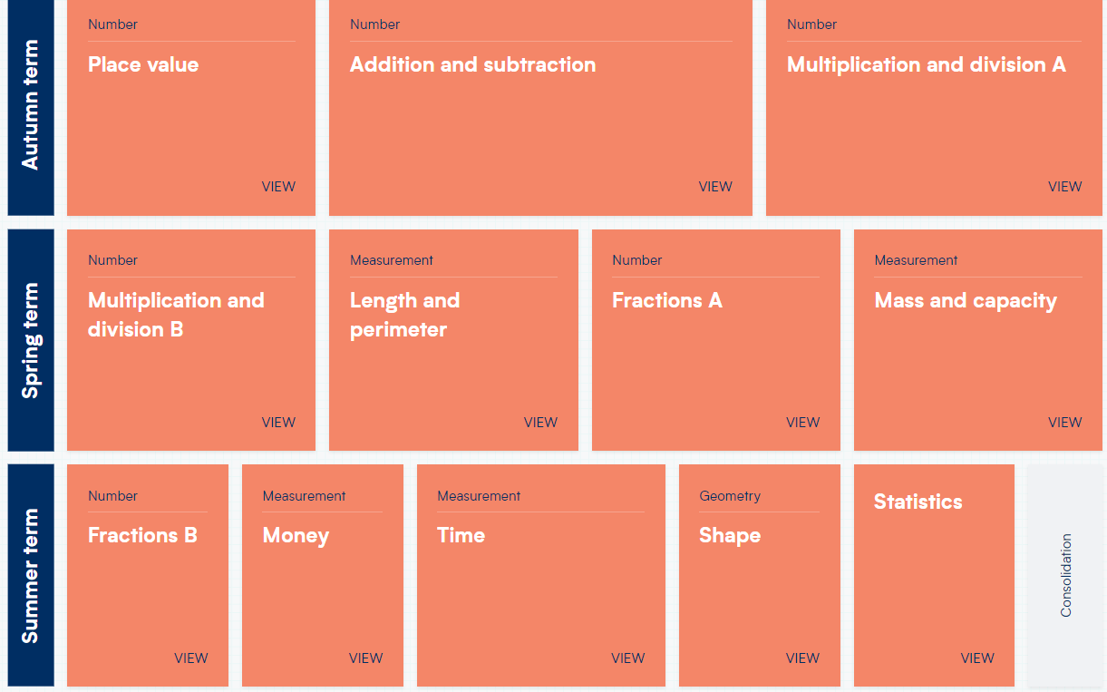
Year 3 yearly overview (WRM)

Slide 3
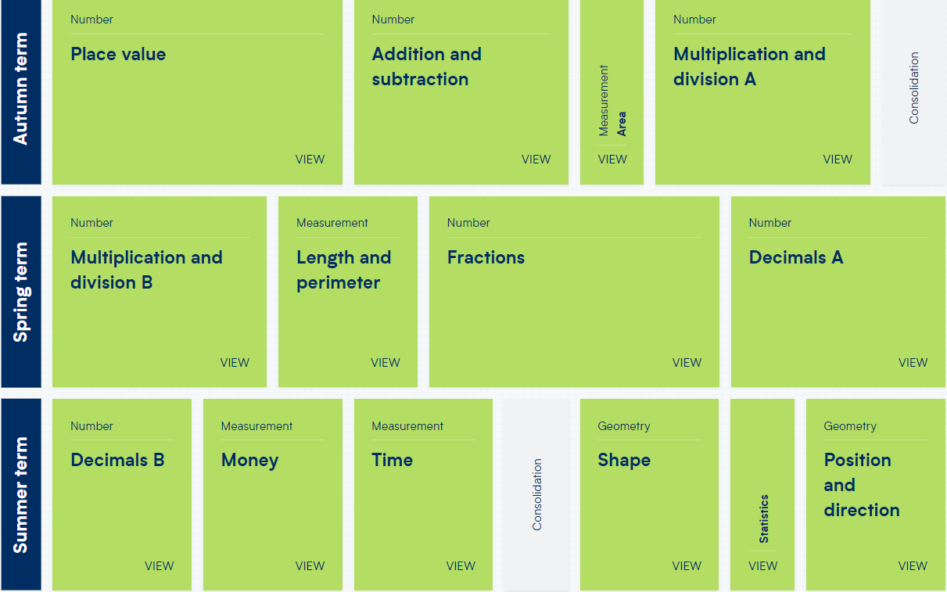
Year 4 yearly overview (WRM)

Slide 4
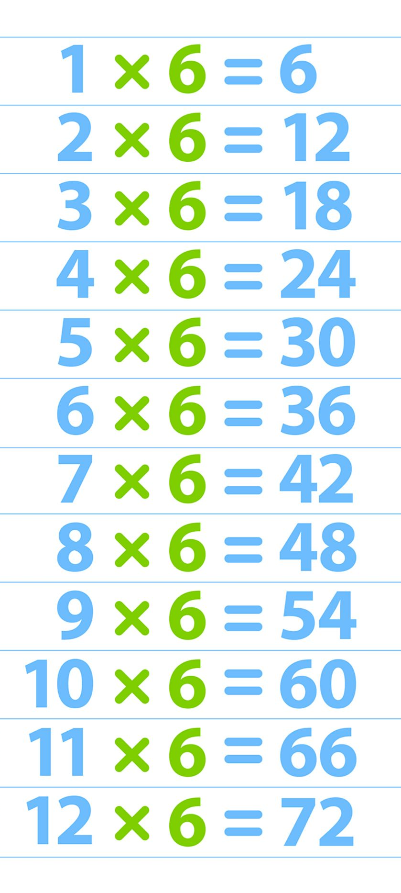
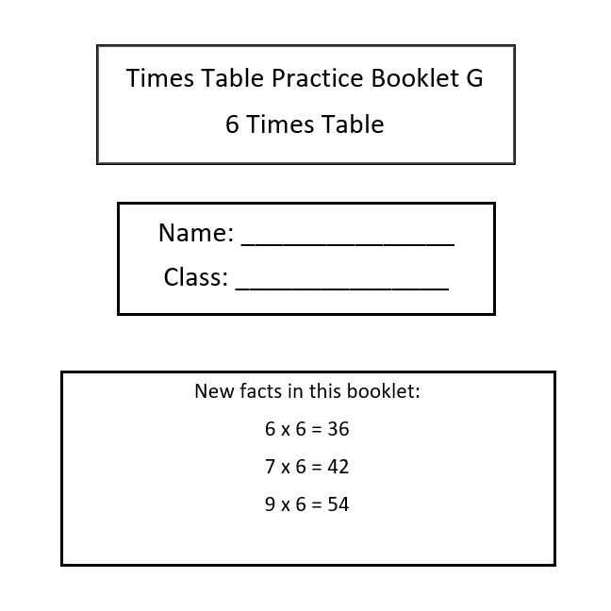
3 minutes!
Who knows their 6 times table?

Slide 5

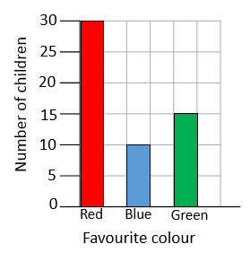
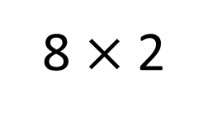
Year 4 | Week 3 | Day 2
8 $×$ 2
1) Find 100 more than the number shown.
2) Write 6,425 in words.
3) How many children’s favourite
colour is blue?
4) Subtract 386 from 900

Slide 6
Year 4 | Week 3 | Day 2
8 $×$ 2
1) Find 100 more than the number shown.
2) Write 6,425 in words.
3) How many children’s favourite
colour is blue?
4) Subtract 386 from 900
1,540
six thousand, four hundred and twenty-five
10 children
514

Slide 7

20.09.22 WALT understand four-digit numbers in the linear number system

Slide 8
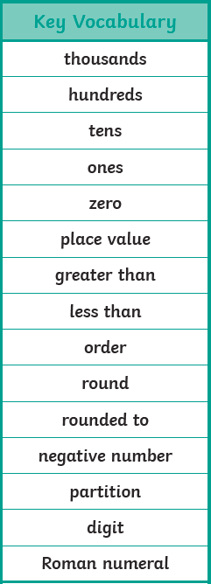
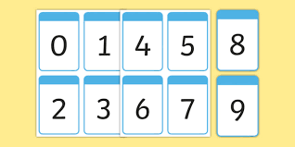
Can you remember any of our important words? Where can you look in the classroom?
one
two
three
four
five
six
seven
sight
nine
twenty
thirty
forty
fifty
sixty
seventy
eighty
ninety
equation
estimate
interval
mid-point
multiples

Slide 9
I Say,
You Say
equation - An equation is a number sentence where one side equals the other
interval - an interval in mathematics is a range of numbers between two points
mid-point - the point that is located directly midway between the two points
multiple – a multiple is repeated addition of the same number from zero 2+2+2+2+2+2+2 (numbers in times tables)

Slide 10
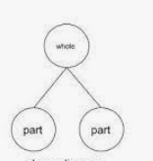
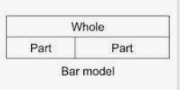
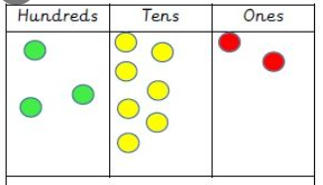
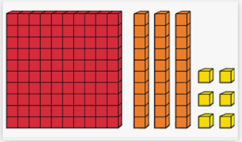
Teaching of the maths concepts using the school agreed representations and models.
Part whole model
Bar model
Place value counters
Base 10

Slide 11
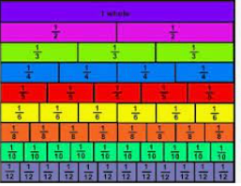
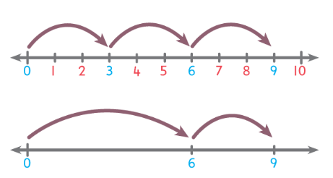
Fraction wall
Numberlines

Slide 12
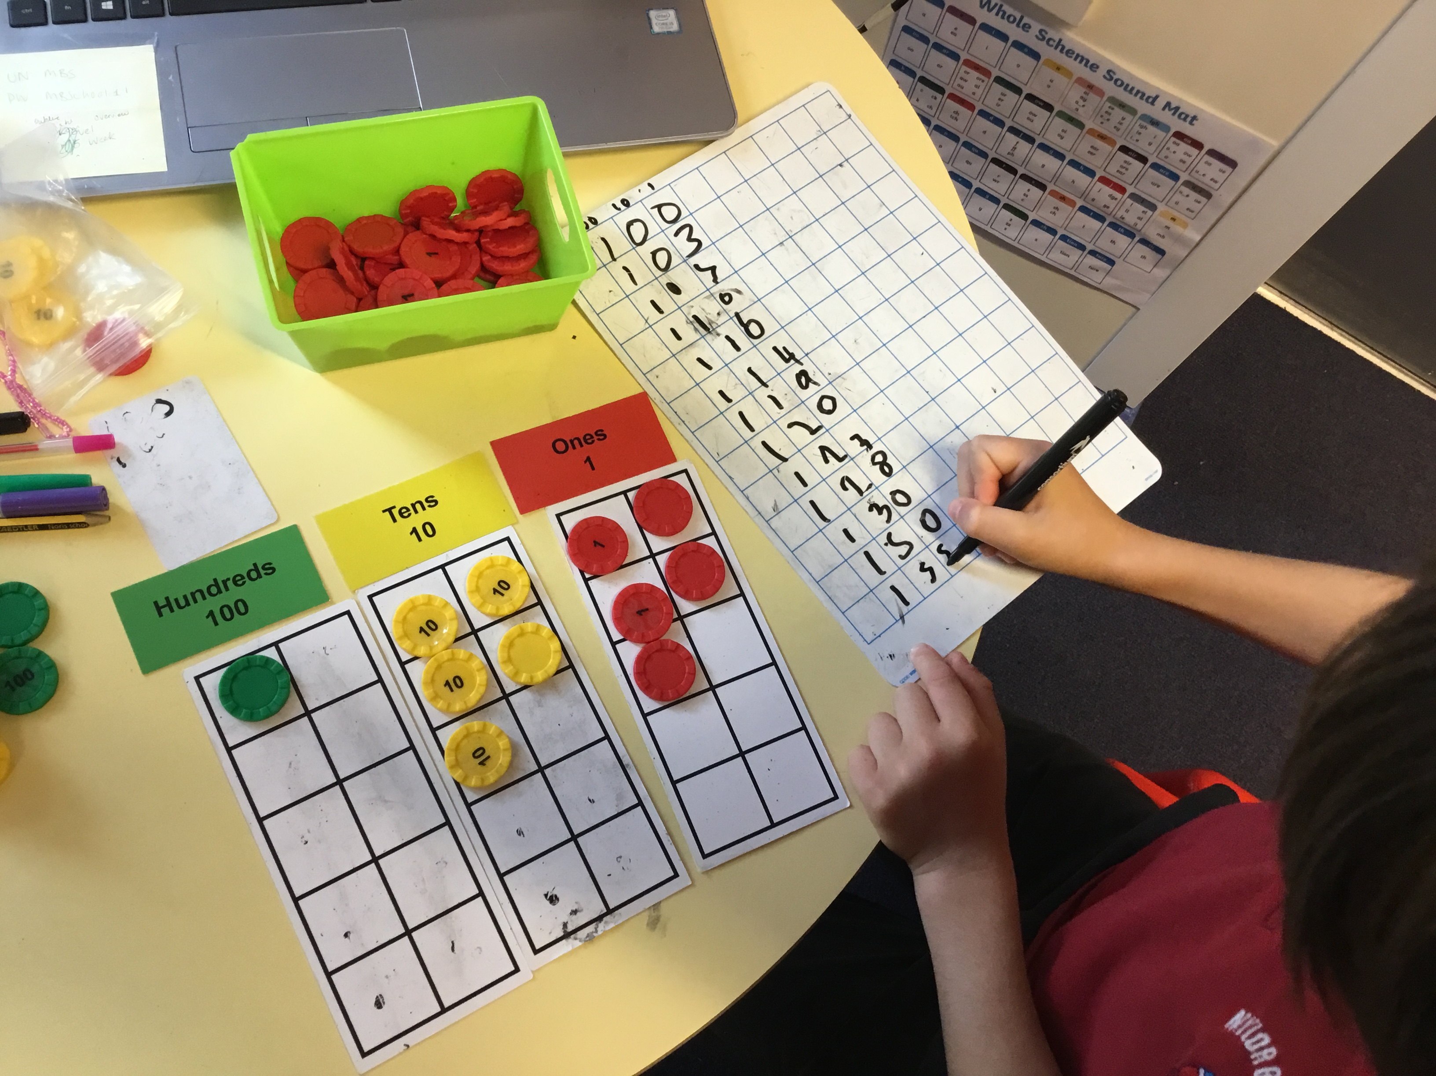
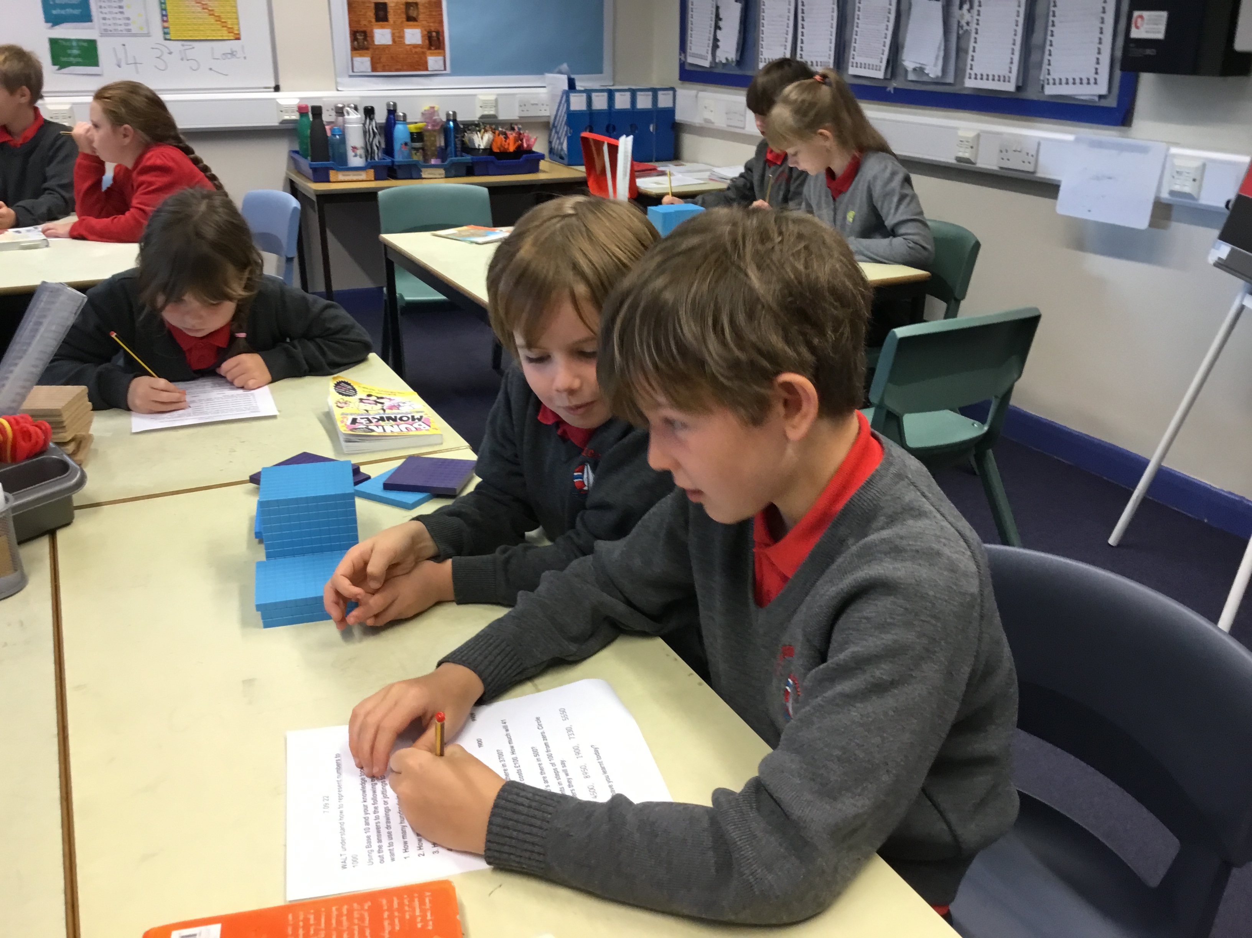
Opportunities for independent practise.
Here, the children have opportunities to practice fluency, reasoning and problem solving.

Slide 13
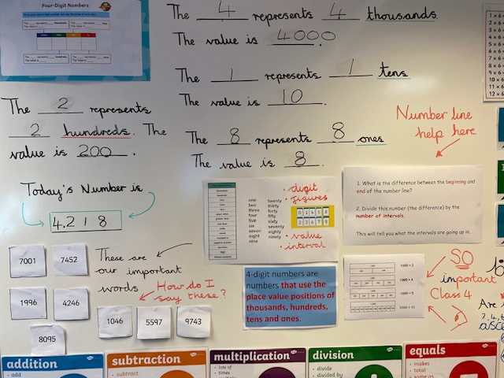
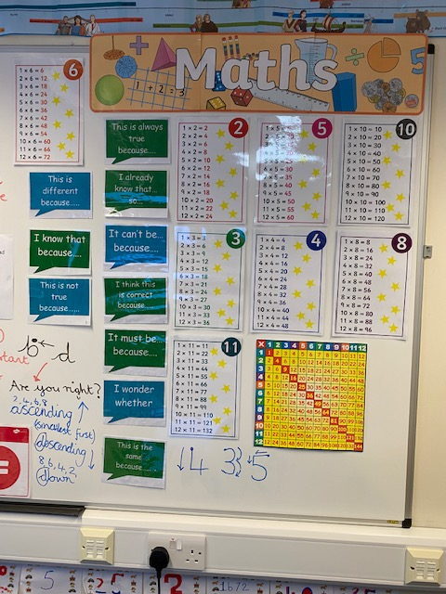
Sentence stems and working walls.

Slide 14
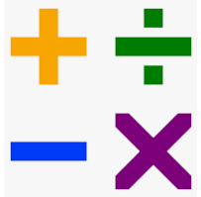
4 operations: addition, subtraction, multiplication and division.

Slide 15

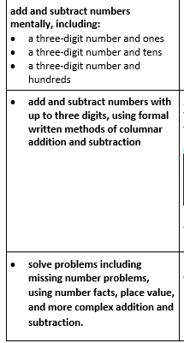
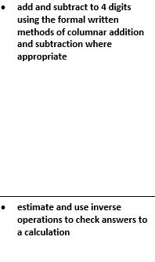
Year 4 addition
Year 3 addition
We encourage children to add mentally, using their knowledge of number bonds

Slide 16


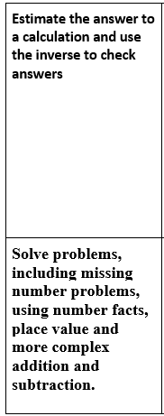
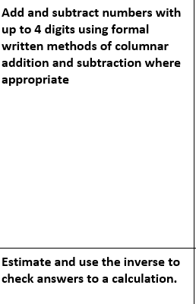
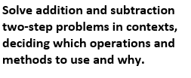
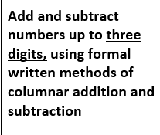
Year 3 subtraction
Year 4 subtraction

Slide 17

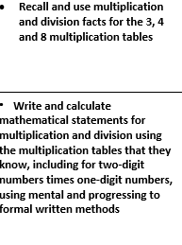
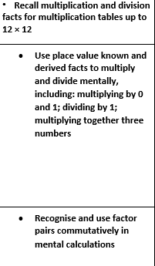
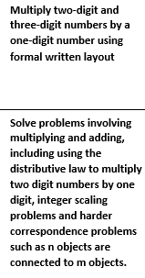
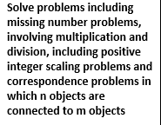
Year 3 multiplication
Year 4 multiplication

Slide 18

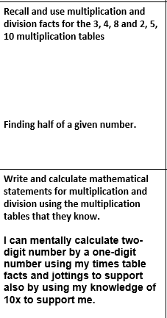
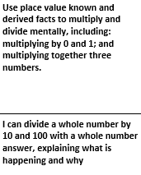
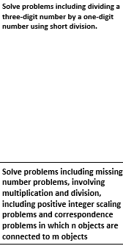
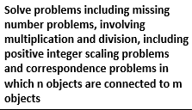
Year 3 division
Year 4 division

Slide 19
Useful links:
https://ttrockstars.com/
https://www.topmarks.co.uk/
https://mathsframe.co.uk/

