Slide 1
Assessment and book level grading inc. Accelerated Reader and how it works
The importance of reading - 5 times per week
Quizzing reading books
Focussed readers / independent reading
VIPERS
Whole Class Reading lessons (WCR)
Hug in a mug / reading rewards/ Reading Club
Reading Spines / Class reading books and protected characteristics / Choral reading
How you can support your child to read inc. VIPERS in reading diaries
Reading in Year 4

Slide 2
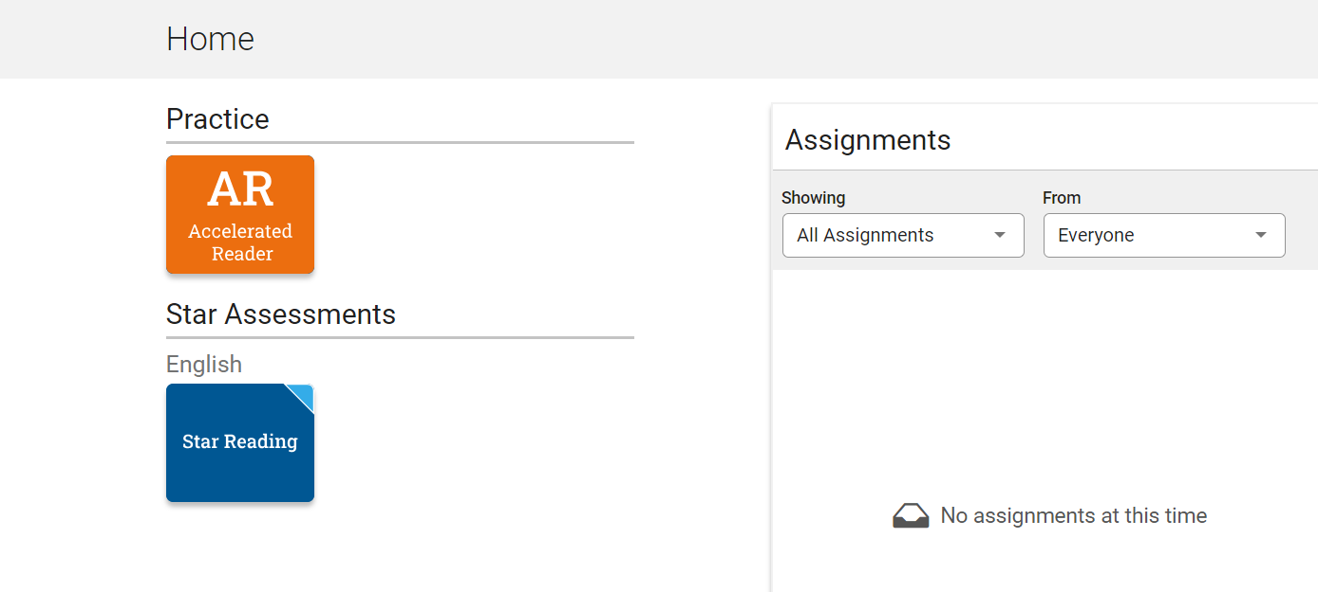

Slide 3
Once your child has completed a STAR test, we receive the following information on each child:
Book Levels
0.0 – 1.9
Children working here are using the phonically decodable books for KS 1
4.0 – 4.9
Reading Age
Book Level Range
5.0 – 5.9
2.0 – 2.9
6+
3.0 – 3.9

Slide 4
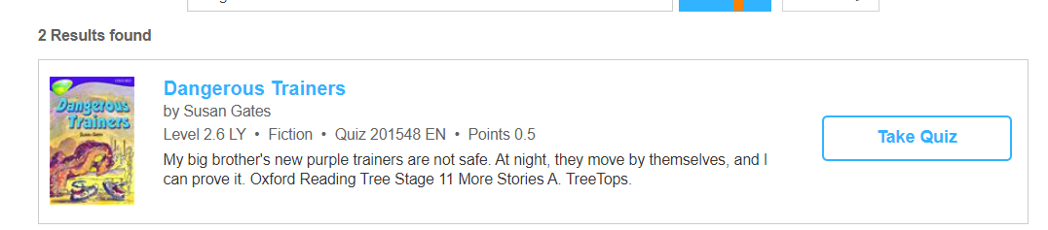
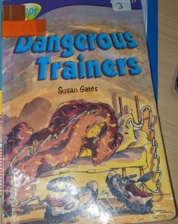
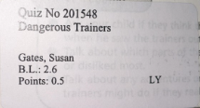
AR Quizzing

Slide 5
Reading in Class
Your children reads every day in class either independently, chorally, in groups or to and adult.
Each class holds a list of pupils and reads with children either individually or within a group every week – some children will be read with more often.
This allows us to keeping a running assessment of progress made, vocabulary comprehension and reading fluency.
Reading in class is not enough practise to learn to read fluently – children must also read 5x week at home and will need parental support to do so please.

Slide 6
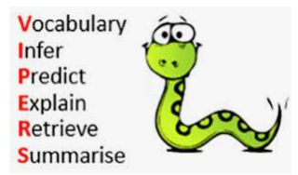
VIPERS
VIPERS is the taught reading strategy in school

Slide 7
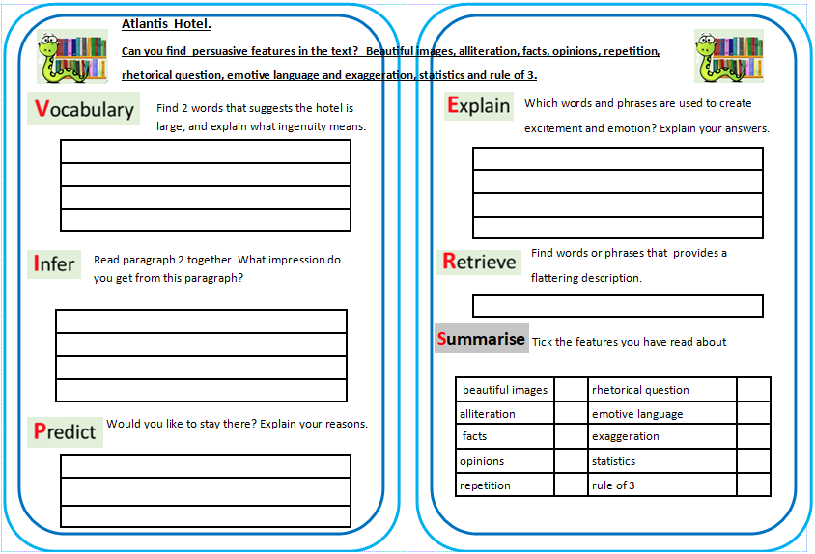

Slide 8
You will also notice in your child’s diary a selection of VIPERS questions. When your child has read with an adult in school – they will record which VIPERS they have discussed with your child. (If you would like to use these questions at home too, that would really help your child to get ‘under the skin’ of their book and increase their understanding.)

Slide 9
After much discussion at our recent INSET training day, we have just started to teach 4 reading lessons per week, as well as the other reading opportunities mentioned.
These are 30 minutes long, twice using the class text and twice with a curriculum text, usually linked to topic work.
The next few slides are examples this.

Slide 10
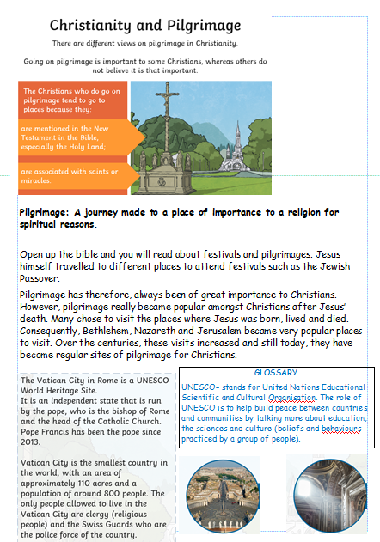

WCR – 2nd of 2 lessons
WALT: Know how to decode meanings from a text.

Slide 11
Paired reading
Take turns to read section 1.

Slide 12
Quick Quiz (answers in books)
1. What type of text is this?
(fiction or non-fiction)
2. What religion does the text focus upon?
3. Do all Christians take a pilgrimage in their life?

Slide 13

Vocabulary Check
mentioned
associated
spiritual

Slide 14
Choral reading- paragraphs 2 & 3

Slide 15

Table talk
Why do you think pilgrimage became more popular after Jesus’ death?

Slide 16

Vocabulary Search
Find a word in the glossary that means the same as:
(write them down)
due to or because of
hundreds of years

Slide 17
echo reading- paragraph 4 and Glossary

Slide 18

Individual Thinking
(write your answer down)
Who is the Pope and what are his roles in the church?

Slide 19

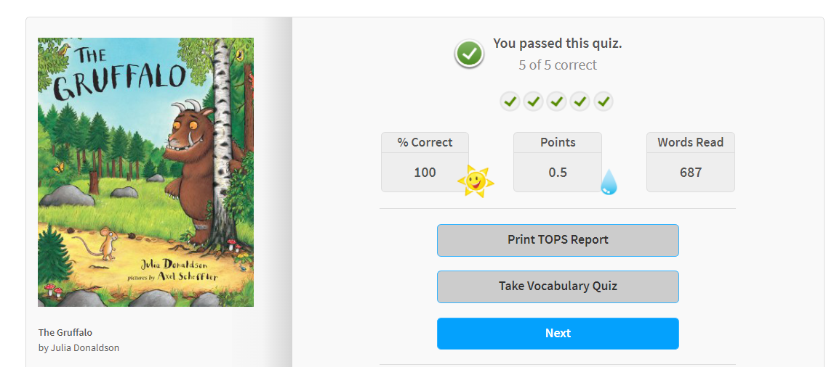
Look at a Book with a Hug in a Mug
Reading Rewards and certificates
Powerpoints/rewards for 5x reads per week.

Slide 20
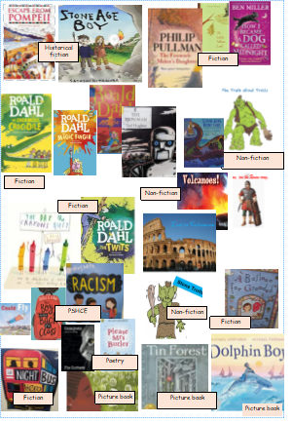
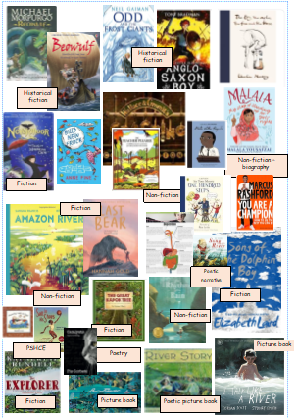
Year 3 Reading Road Map
Year 4 Reading Road Map

Slide 21
Read with your child at least 5x per week ( 5 to 10 minutes a day is enough, some children will finish a book in this time, others will only read a few pages)
Choose your time carefully – 5 minutes of quality time is better than 15 minutes of stressful struggle.
Use the VIPERS questions in the front of your child’s reading diary, in order to structure 1 or 2 questions about what your child has read. Please sign the diary after you have heard them read (Use the VIPERS code if you like)
Repeated reading - following recently published evidence, we are requesting that children who are reading at green and orange book band levels read their books at least twice – this is so that the first reading is to decode the text and begin to understand the story. The second reading allows for full comprehension and the development of fluent reading without the need to sound out unknown vocabulary
Becoming independent
As your child becomes a more confident and proficient reader (usually Class 4 +) the need to read with your child becomes less necessary, however your child STILL needs to read 5x a week – moving towards the Class 5 goal of 60 pages per week. To remain engaged with your child’s reading, please use the VIPERS questions (just 1 or 2, to gauge how much your child has understood their test. Please continue to sign their diaries
Making books exciting
Your child’s school reading book is not the only book which they can read at home (however, it is the book which they will need to read in school, as these books are carefully selected to build vocabulary, link with known phonics and build confidence) Self-chosen books are BRILLIANT for keeping children interested in reading, these are perfect for sharing at bedtimes etc.
AR book finder: If your child buys a new book and you want to know the book level or the quiz number you can use this website to find those details

Slide 22
How do we teach spelling ?
Spelling are benchmarked at the beginning of the year.
We follow the Spelling Shed scheme and learn the Year 4 set of words.
Spellings are then set on a Friday and tested the following Friday.
Daily spelling practise takes place in school for 10 minutes per day.
During spelling lessons, the children are taught the pattern of the spelling for that week .
Edshed is used to help children to practise spellings – please can your child use Edshed to help to learn their spellings

Slide 23
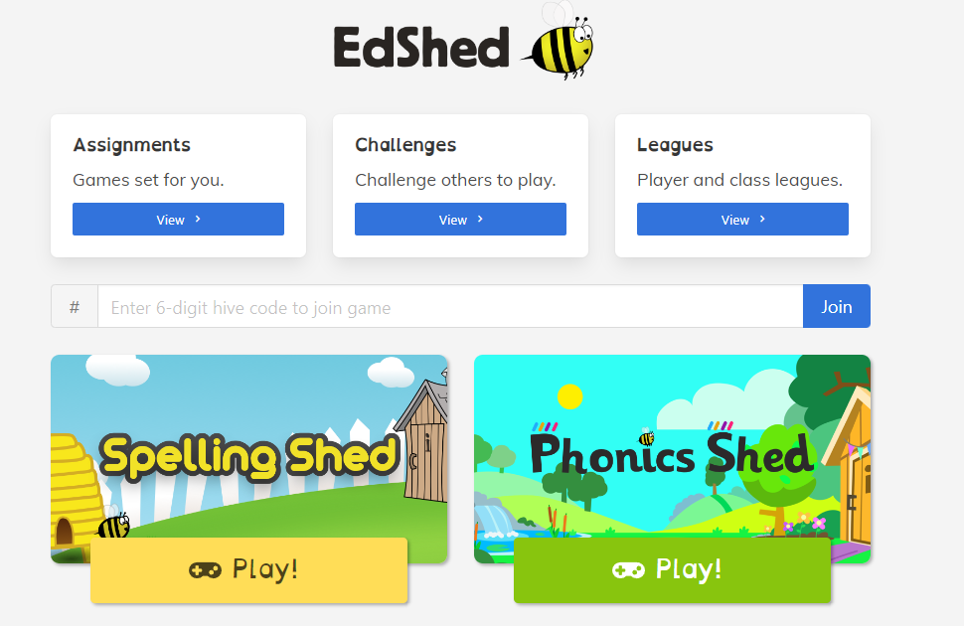
EdShed

Slide 24
