Slide 1
Year 5 and 6 Reading at Mylor Bridge School

Slide 2
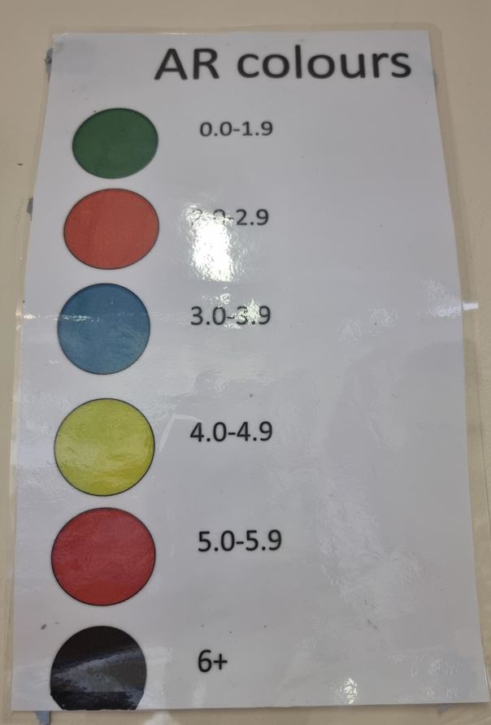
STAR Tests
Each child completes a STAR test every half term
This enables staff to signpost children to books at the appropriate level through a colour system
It produces a reading age that can be used to track progress throughout the year

Slide 3
Book Choices
Children can read books from library and from home
If children wanted to read a book above their AR colour, we would recommend them speaking to an adult to see if it was at an appropriate level
We want to encourage children to have a lifelong love of reading

Slide 4
AR Reading Quizzes
Most books in our library are ‘quizzable’. However, if your child’s book isn’t, they won’t be discouraged from reading it
After children finish their reading books, they are encouraged to take a quiz based on what they have read
The children can use the books to help them should they wish
This enables us to gauge their understanding of the text and influence future choices
Children can work to attain certificates and awards through passing these quizzes

Slide 5
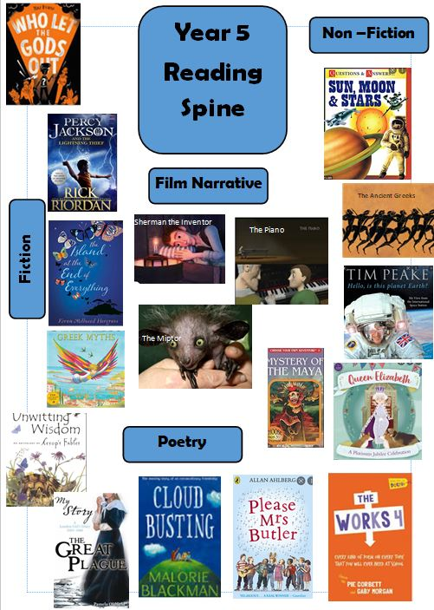
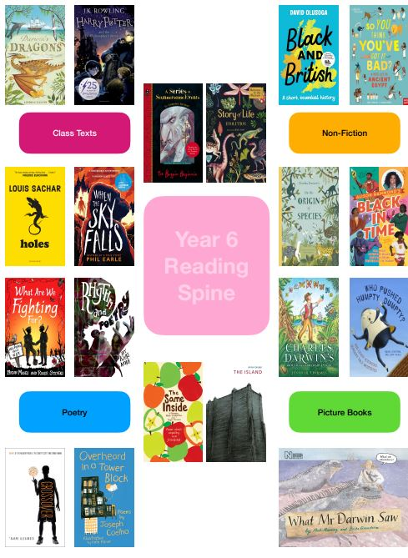
Class Texts
Through the year, the children will read together as part of our focus texts. This is timetabled in for 15 minutes after morning break. Some of our texts feed into our English units and our VIPERS questions.
This involves teacher reading, shared reading and individual reading aloud
Children are encouraged to use decoding strategies when faced with new vocabulary and the class discusses the meanings and uses of new words

Slide 6
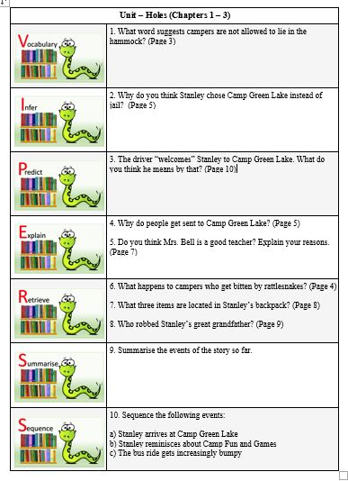
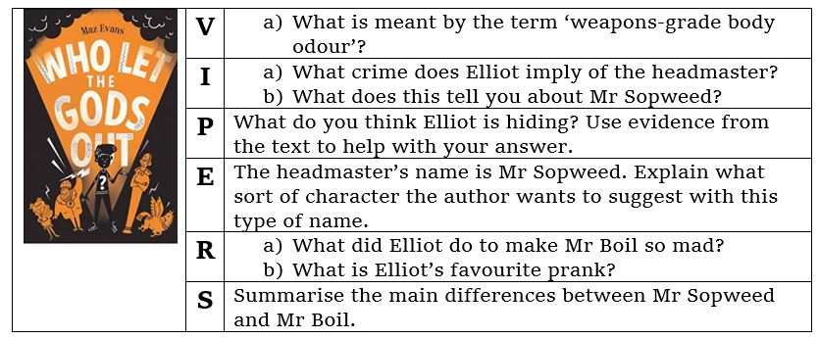
VIPERS
In Year 5 and 6, the children complete a weekly VIPERS lesson where they are using their comprehension skills to answer questions.

Slide 7
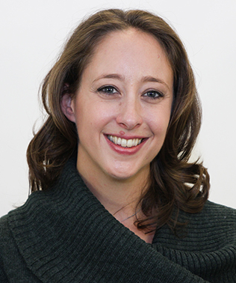
Author Visits
In November, Year 5 and 6 are having a virtual author visit from Maz Evans (author of Who Let the Gods Out?)
This is something we are keen to more of as the year progresses. However, we are aware of costings and the difficulty of getting authors all the way down in Cornwall!

Slide 8
SATS and Assessment
In Year 5, children will take a formal reading comprehension test at the end of every term. At the end of the summer term, they will sit a Year 6 SAT which will prepare them for the types of questions they will expect in Year 6
In Year 6, the children will take regular previous SAT papers in preparation for the test in May.
The questions are of a similar style to our weekly VIPERS lessons to best prepare the children for these tests
They have an hour to read 3 separate texts and answer the questions
More information will be delivered later in the year

Slide 9
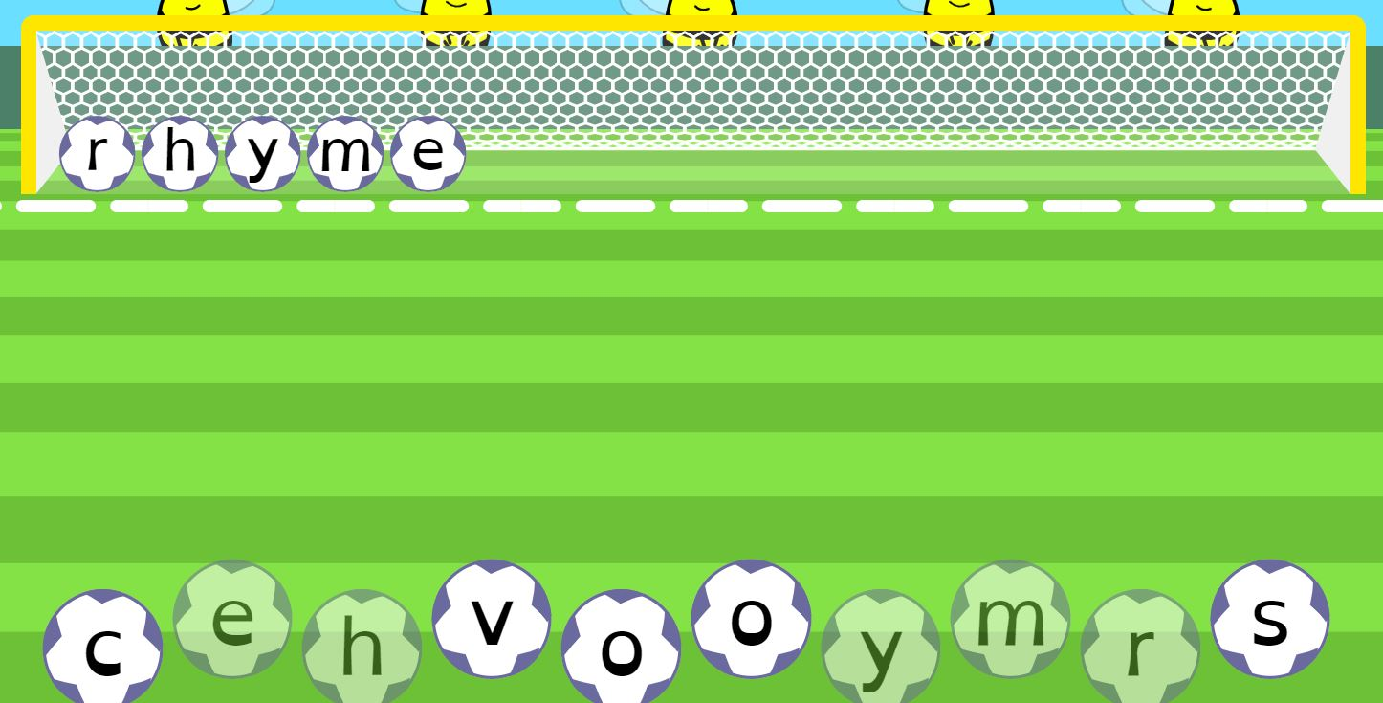
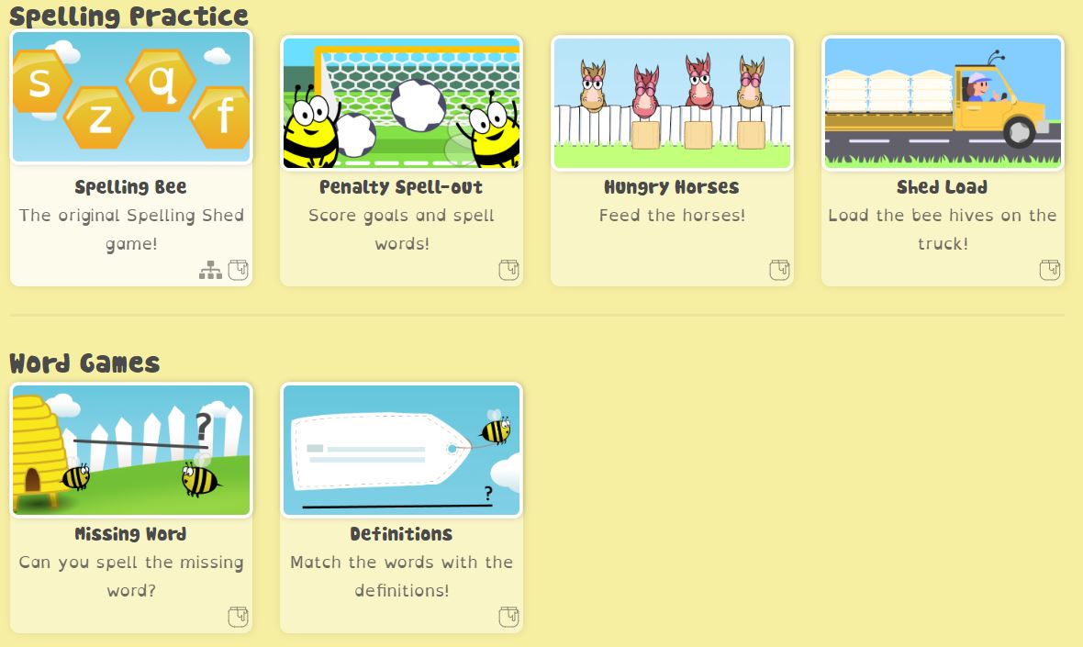
EdShed and Spellings
We use a number of online resources to support the children’s weekly spellings
EdShed (LINK) is used daily between 8:45 – 9 so the children can practise their spellings in preparation for the weekly spelling and proof-reading dictation on Fridays

Slide 10
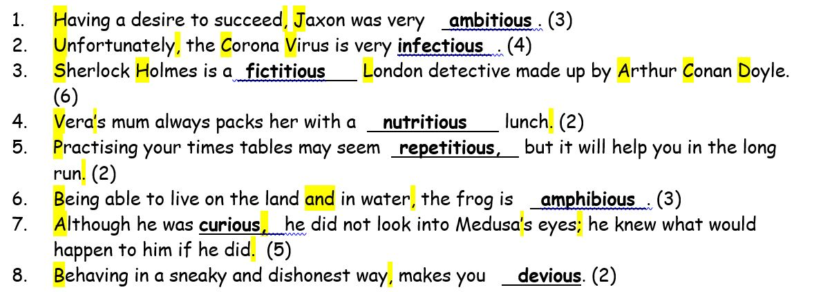
Friday Proof-Reading

Slide 11
Google Classroom
Every child has an individual log-in for Google
They can log in from any device by using their email address:
Firstname.Surname@mylor-bridge.cornwall.sch.uk
Their password is a colour, an animal and a two-digit number – these are available at school and on their password cards
Once logged in, all passwords for EdShed and TT Rockstars etc. are remembered to prevent having to log in each time

Slide 12
Reading at Home

